Slide 1
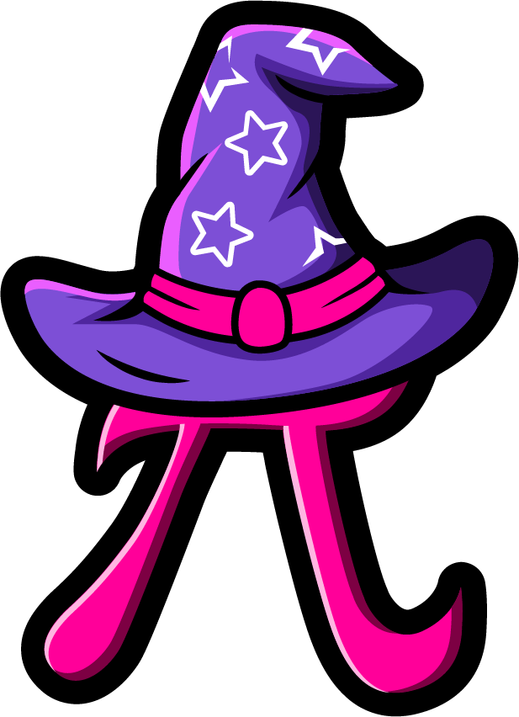
Lesson 1:
Add or subtract 1 or 2
www.arithmagicians.com

Slide 2

+1
+1
+1
+1
+1
+1
+1
+1
+1
+1
80
81
82
83
84
85
86
87
88
89
90
Get ready to count up in 1s

Slide 3


Recap:
49
48 + 1 = ?
50
2) 48 + 2 = ?
50
3) 49 + 1 = ?
4) 49 + 2 = ?
51

Slide 4


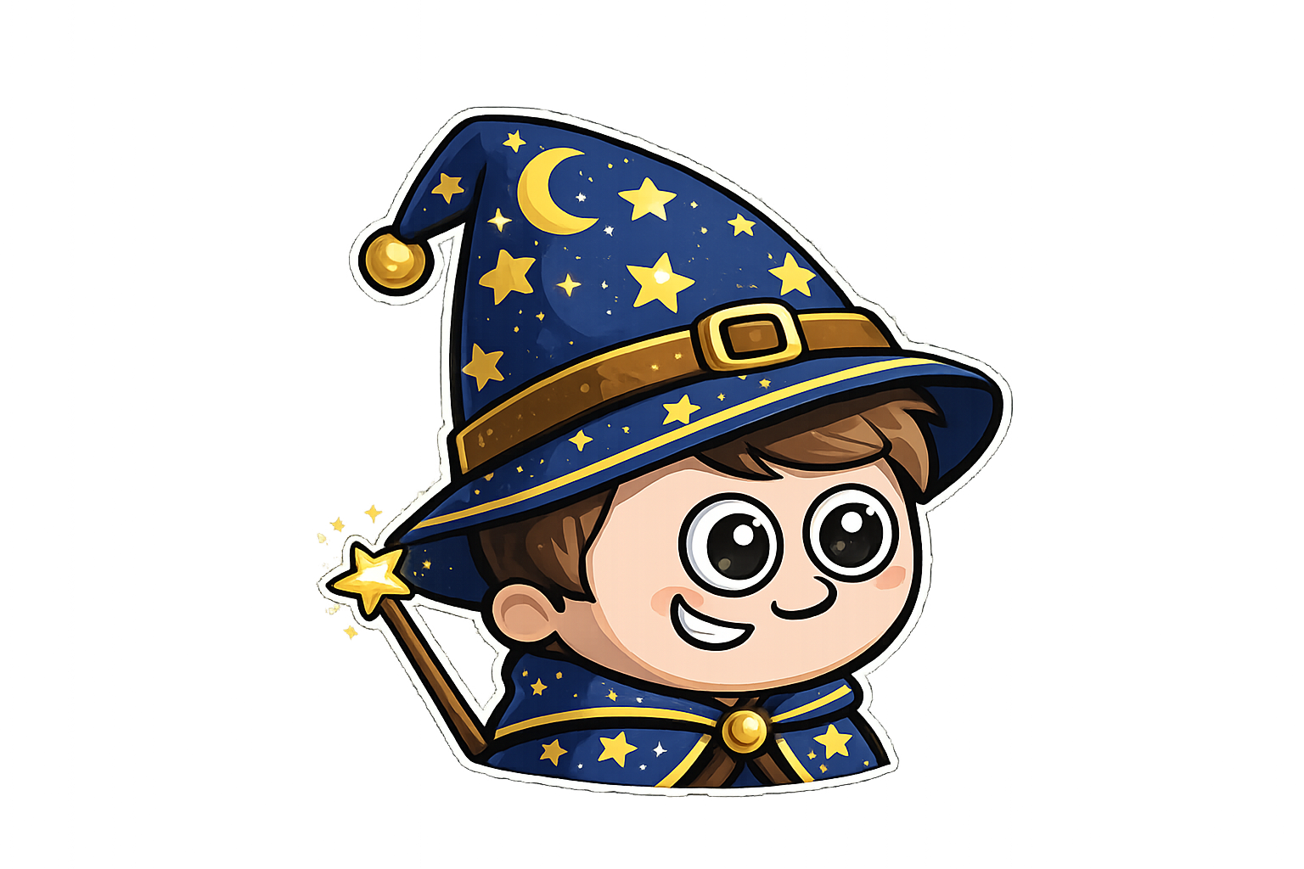
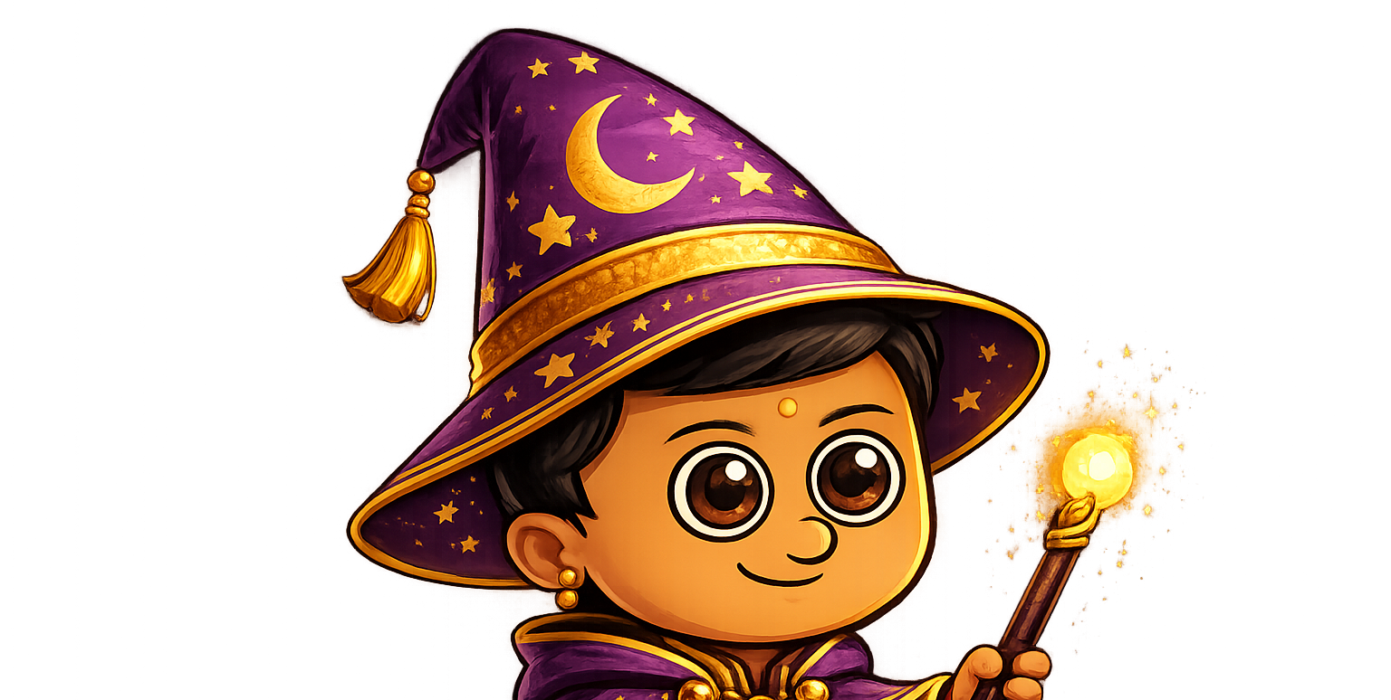
Sam has 4 apples.
Amy has 1 more apple than Sam.
Ali has 1 less apple than Sam.

Slide 5

Sam has 6 sweets.
Amy has 2 more sweets than Sam.
Ali has 2 fewer sweets than Sam.

Slide 6
Your Turn
Sam has 3 circles.
Amy has 2 more circles than Sam.
Ali has 1 fewer circle than Sam.
Amy
Draw the circles
for each wizard.
Sam
Ali

Slide 7

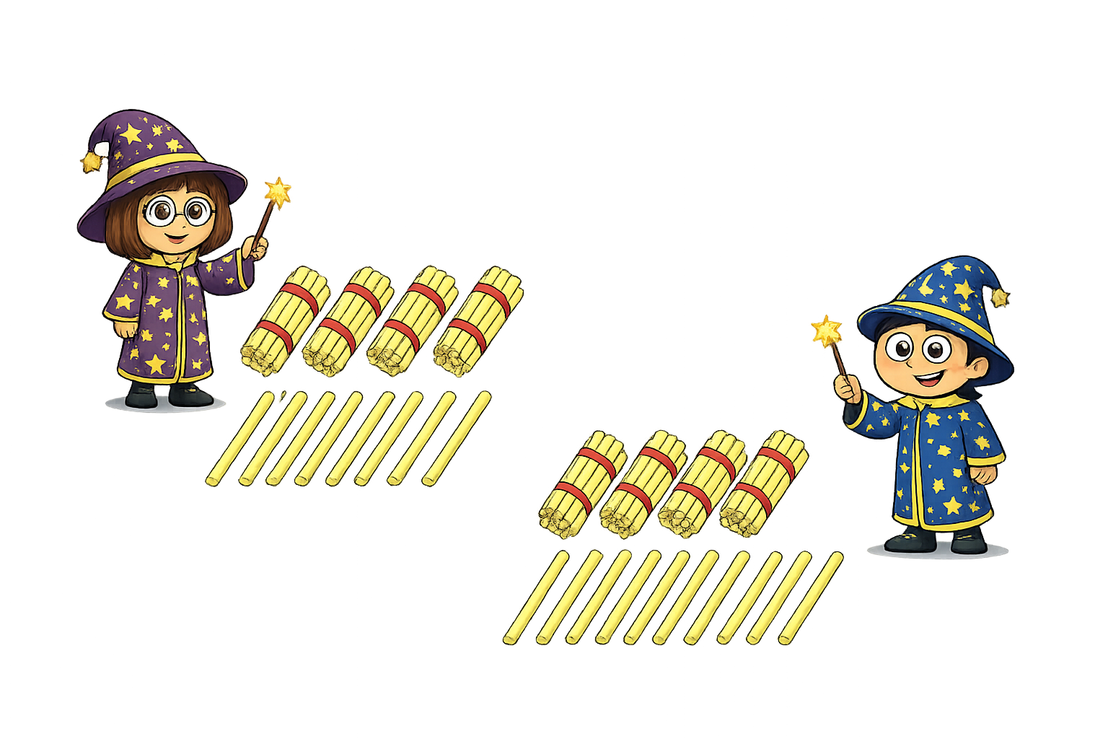



True or False
I have 29 straws
I have one more straw than Amy
True

