Slide 1
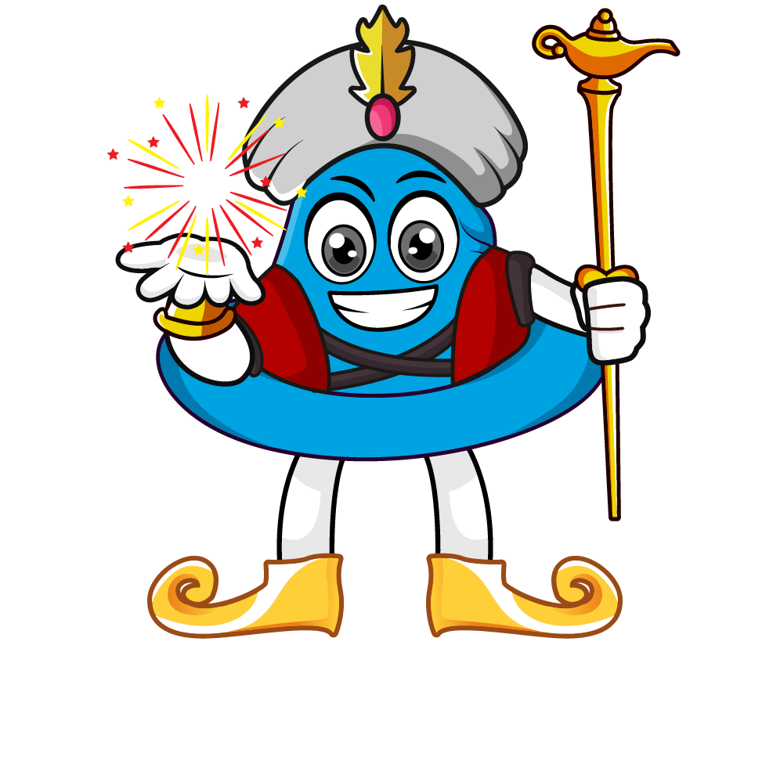

Lesson 1:
Calculate with metric measures
www.arithmagicians.com

Slide 2

Recap:
1 cm = ? mm
10 mm
1 m = ? cm
100 cm
1 kg = ? g
1000 g
1 L = ? ml
1000 ml
1 km = ? m
1000 m

Slide 3

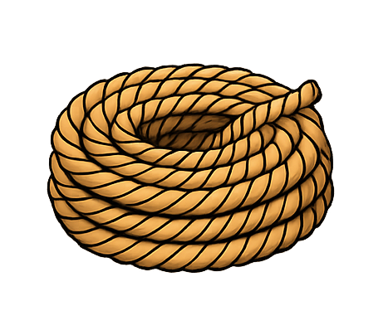
A rope is 5 m long.
75 cm is cut off.
How much rope is left in cm?
500 cm
?
75cm
?
425 cm
500 - 75 =

Slide 4
A race is 3 km long.
Sam has already run 1,450 m.
How much further does he need to run in m?
3000 m
1450m
?
?
1550m
3000 – 1450 =

Slide 5

A bag of flour weighs 1.5 kg.
A bag of sugar weighs 750 g.
What is the total mass in grams?
?
1500g
750g
?
2250g
1500 + 750 =

Slide 6
A jug contains 1.5 litres of juice.
350 ml is poured into cups.
How much juice is left in ml?
1500 ml
?
350ml
?
1150 ml
1500 - 350 =

