Slide 1
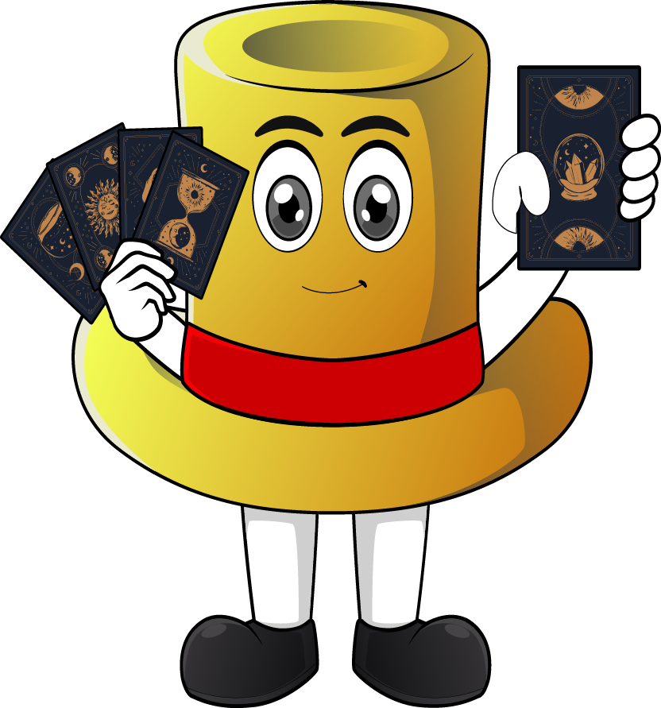

Lesson 1:
Convert decimals to fractions: word problems
www.arithmagicians.com

Slide 2

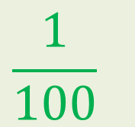




Recap: write these
decimas as fractions
$$\frac{1}{2}$$
a) 0.5 = ?
$$\frac{1}{4}$$
b) 0.25 = ?
$$\frac{1}{10}$$
c) 0.1 = ?
$$\frac{1}{100}$$
d) 0.01 = ?
$$\frac{3}{4}$$
e) 0.75 = ?

Slide 3


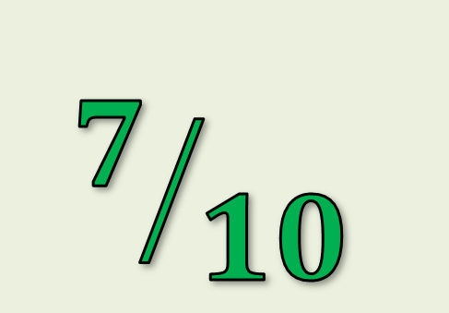
A bottle is filled to 0.7 of its full capacity.
What fraction of the bottle is filled?
$$7/{10}$$

Slide 4

A pizza has 0.25 of it left.
What fraction of the pizza is left?
¼

Slide 5

A ribbon is 0.75 metres long.
Write this decimal as a fraction.
¾

Slide 6
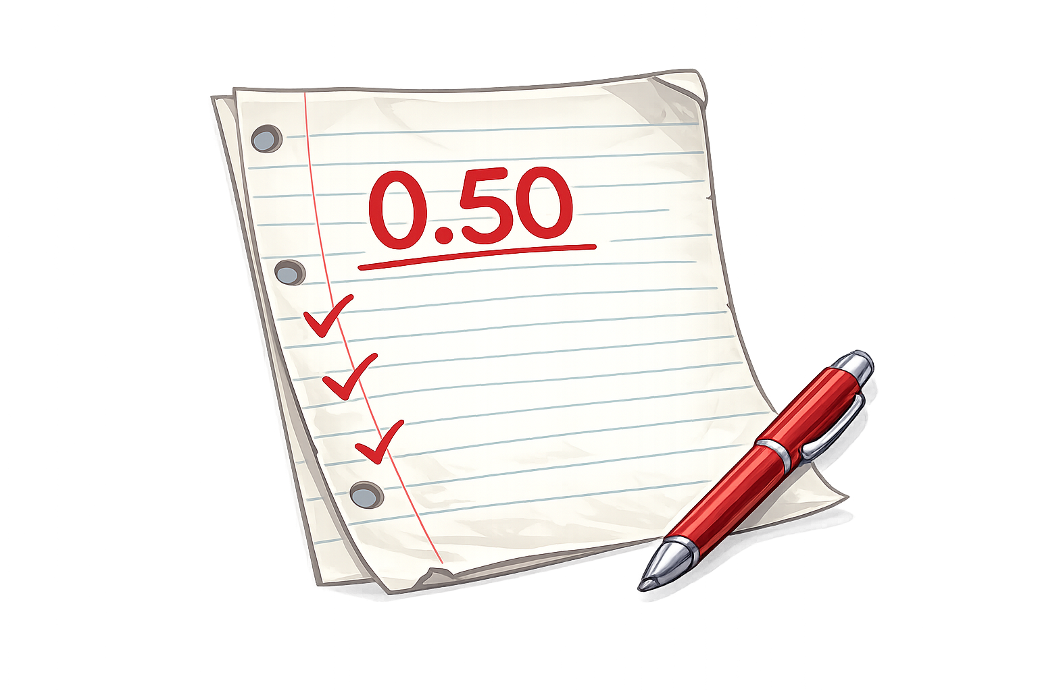
A test score was 0.50
Write this as a fraction in its simplest form.
½

