Slide 1

Lesson 2:
Add or subtract 1 or 2
www.arithmagicians.com

Slide 2


-1
-1
-1
-1
-1
-1
-1
-1
-1
-1
30
31
32
33
34
35
36
37
38
39
40
Get ready to count back in 1s

Slide 3


Recap:
29
30 - 1 = ?
28
2) 30 - 2 = ?
30
3) 31 - 1 = ?
4) 31 - 2 = ?
29

Slide 4


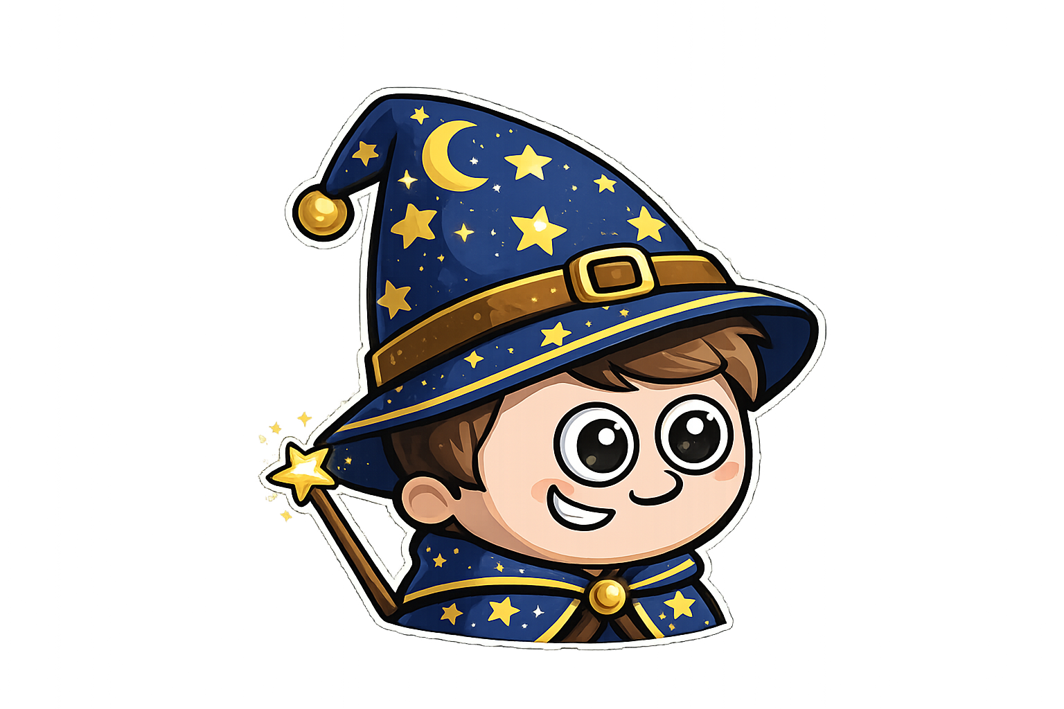
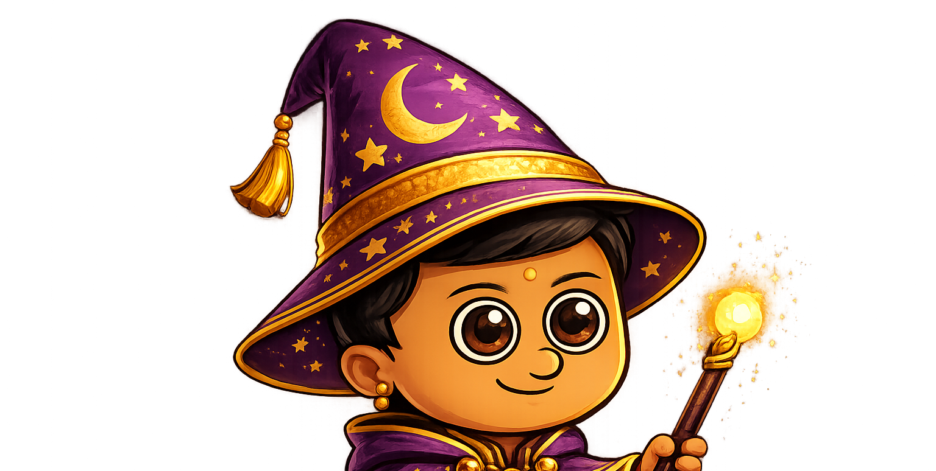
Sam has 6 sweets.
Amy has 2 more sweets than Sam.
Ali has 1 fewer sweet than Sam.

Slide 5

Amy has 1 more apple than Sam.
Sam has 5 apples.
Ali has 2 less apples than Sam.
Amy
Sam
Ali
Finally, I work out Ali’s apples.
Next, I work out Amy’s apples.
First, I start with what I know

Slide 6
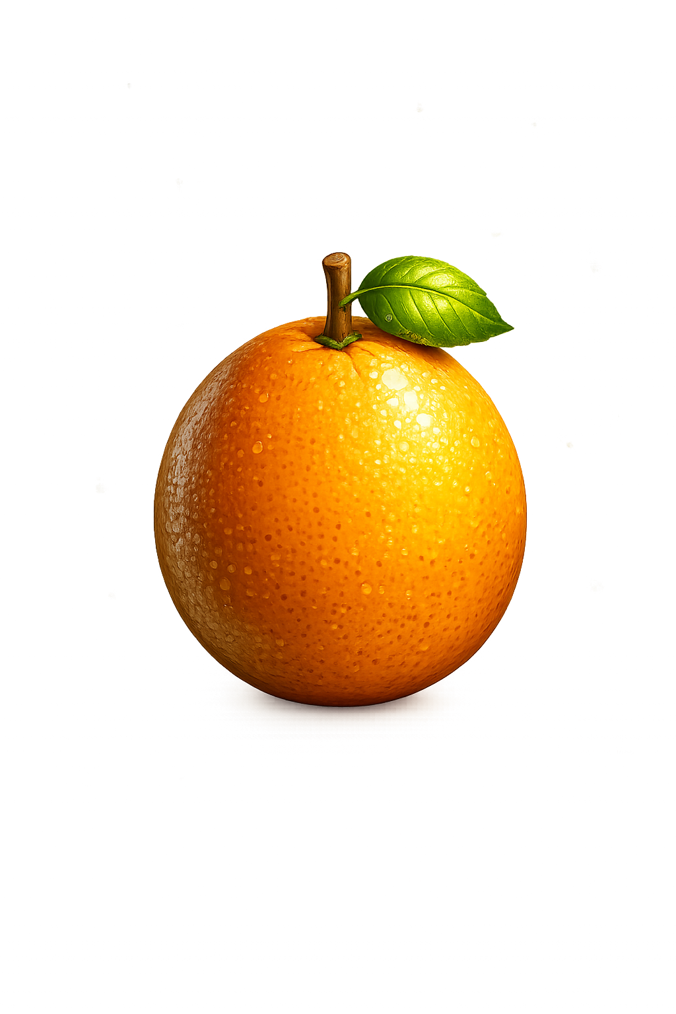
Your Turn
Amy has 2 more oranges than Sam.
Sam has 4 oranges.
Ali has 1 less orange than Sam.
Amy
Draw the oranges
for each wizard.
Sam
Ali

Slide 7

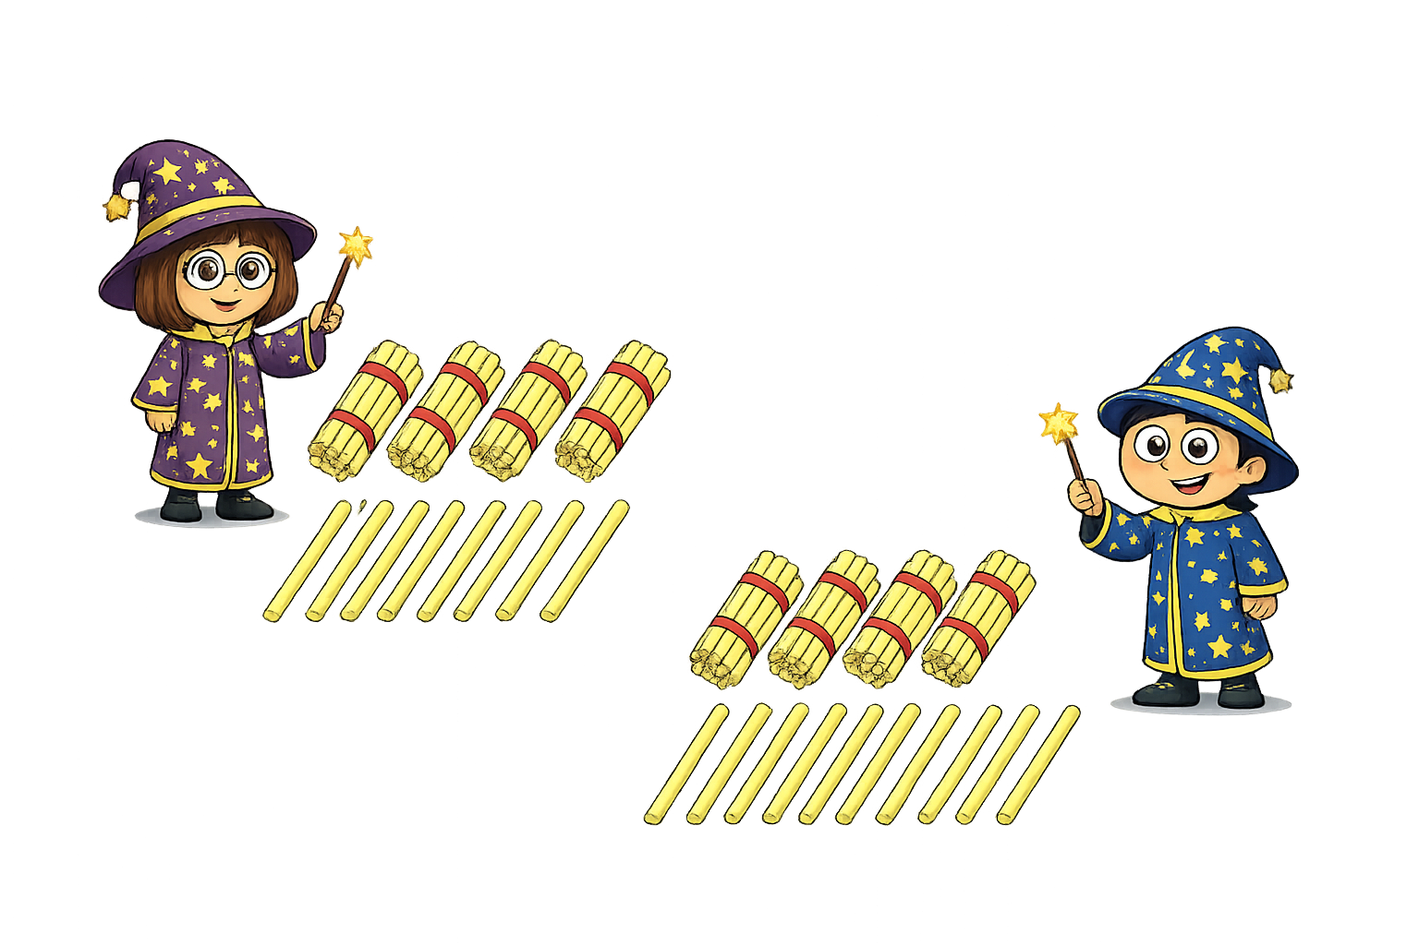


True or False
I have 30 straws
I have one more straw than Amy
False

