Slide 1
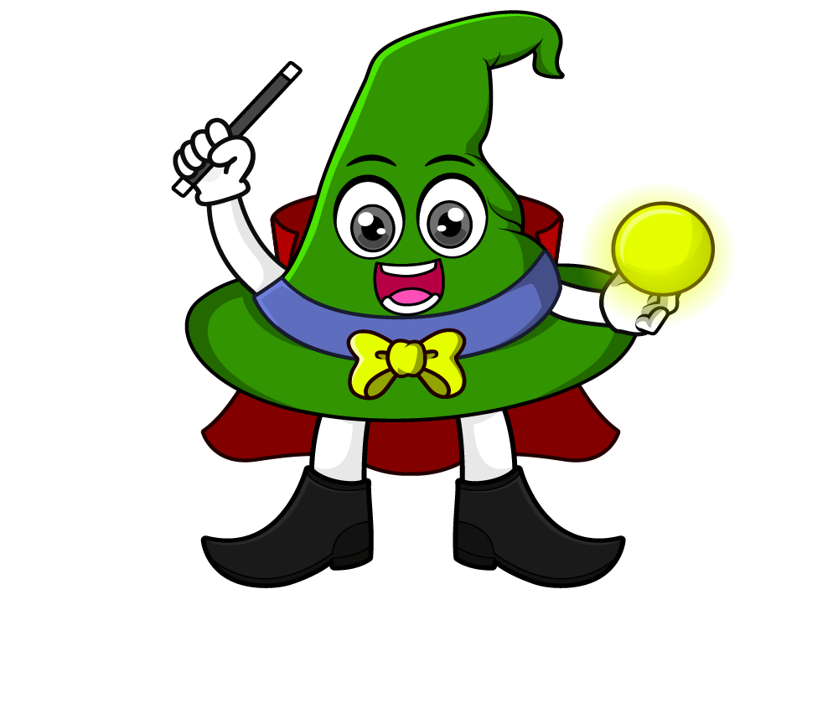

Lesson 2:
Calculate with metric measures
www.arithmagicians.com

Slide 2

Recap:
1.5 cm = ? mm
15 mm
3 m = ? cm
300 cm
2.3 kg = ? g
2300 g
4.9 L = ? ml
4900 ml
10 km = ? m
10,000 m

Slide 3

A bag of potatoes weighs 2.5 kg. A bag of carrots weighs 500 g. What is the total mass in grams?
?
2500g
500g
?
3000g
2500 + 500 =

Slide 4
A jug contains 2 litres of juice. 250 ml is poured into cups. How much juice is left in ml?
2000 ml
?
250ml
?
1750 ml
2000 - 250 =

Slide 5

A rope is 10 m long. 400 cm is cut off. How much rope is left in cm?
1000 cm
?
400cm
?
600 cm
1000 - 400 =

Slide 6
A race is 5 km long. Ali has already run 1300 m. How much further does he need to run in m?
5000 m
1300m
?
?
3700m
5000 – 1300 =

