Slide 1


Lesson 2:
Convert decimals to fractions: word problems
www.arithmagicians.com

Slide 2

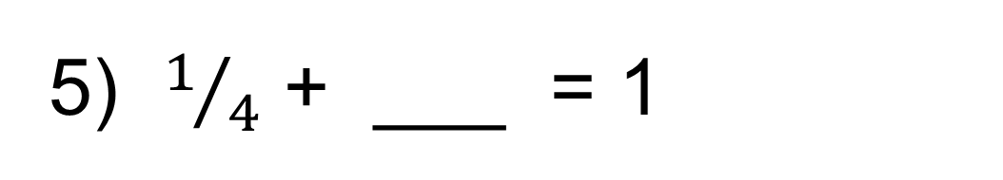
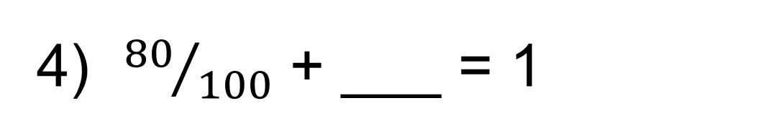
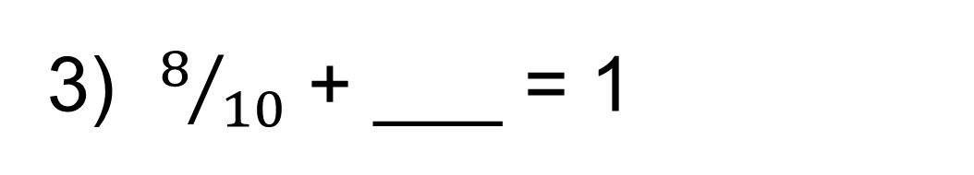
Recap: write the
answers as decimals
1) 0.6 + ___ = 1
0.4
2) 0.06 + ___ = 1
0.94
3) $8/{10}$ + ___ = 1
0.2
4) ${80}/{100}$ + ___ = 1
0.2
5) $1/4$ + ___ = 1
0.75

Slide 3


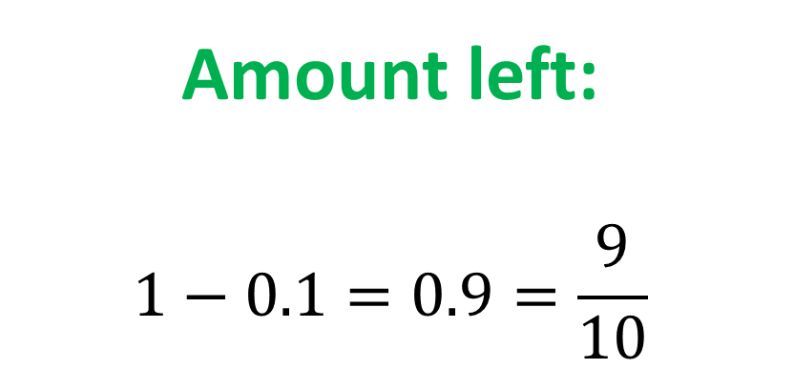
Sam eats 0.1 of a pizza. What fraction of the pizza is left?
Amount left:
$$1−0.1=0.9=\frac{9}{10}$$

Slide 4

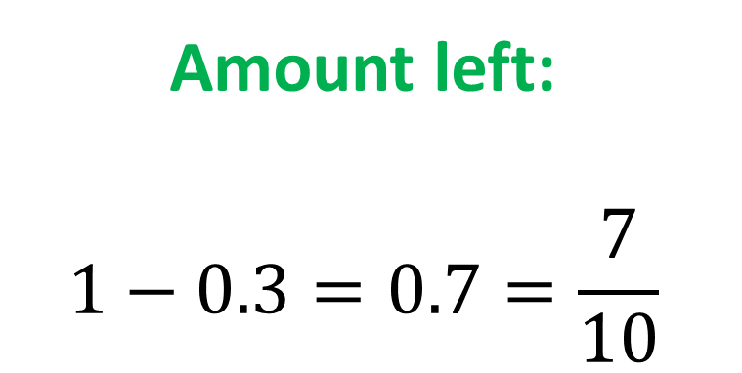
Amy eats 0.3 of a chocolate bar. What fraction is left?
Amount left:
$$1−0.3=0.7=\frac{7}{10}$$

Slide 5
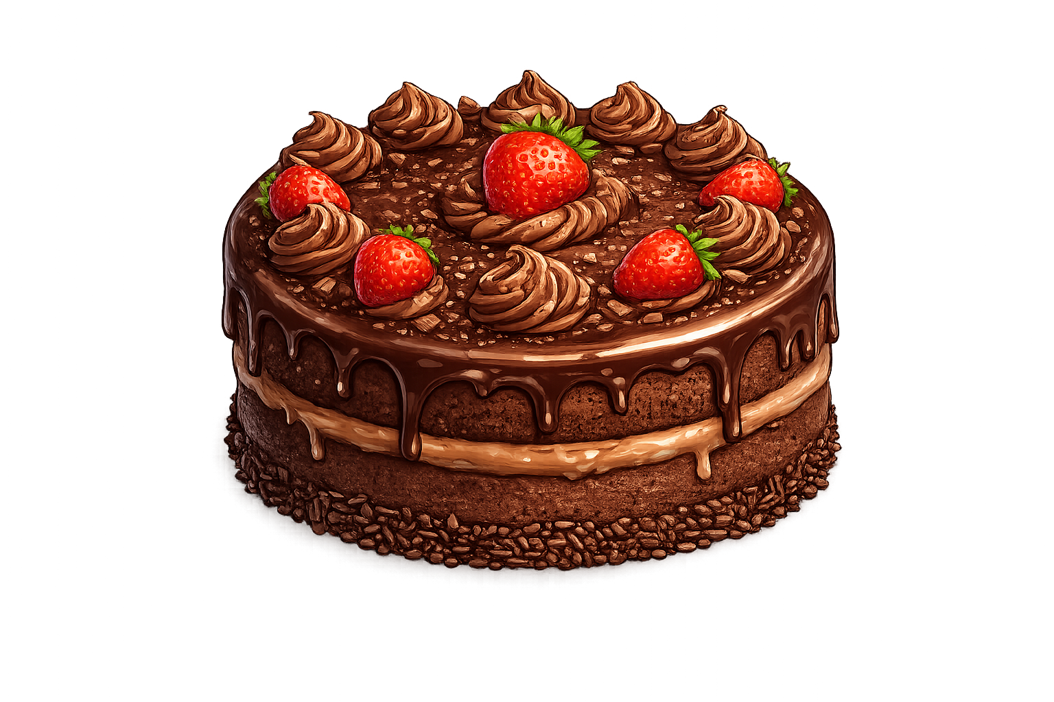
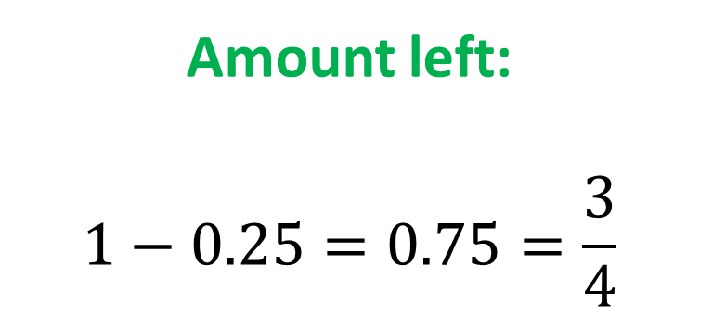
A cake has 0.25 eaten. What fraction of the cake is left?
Amount left:
$$1−0.25=0.75=\frac{3}{4}$$

Slide 6

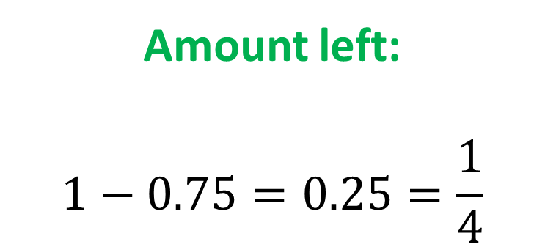
A ribbon is cut so that 0.75 is used. What fraction is left?
Amount left:
$$1−0.75=0.25=\frac{1}{4}$$

