Slide 1

Lesson 3:
x10 Tables
Word Problems
www.arithmagicians.com

Slide 2

+10
+10
+10
+10
+10
+10
+10
+10
+10
+10
0
10
20
30
40
50
60
70
80
90
100
Get ready to count up in 10s

Slide 3
-10
-10
-10
-10
-10
-10
-10
-10
-10
10
20
30
40
50
60
70
80
90
100
Get ready to count back in 10s

Slide 4

Recap:
3
10
1) 30 ÷ 10 =
4) 10 x ? = 100
2) 20 ÷ 10 =
2
11
5) 10 x ? = 110
3) 50 ÷ 10 =
5
7
6) ? x 10 = 70

Slide 5

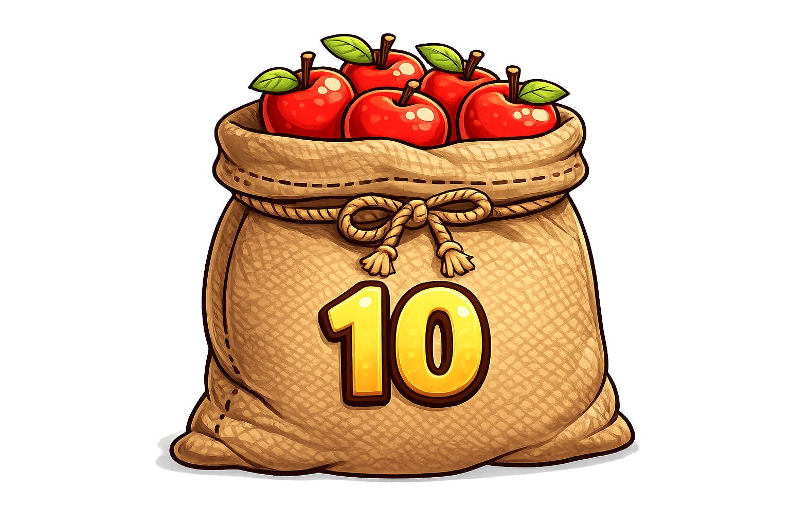
There are 10 apples in each bag. Ali has 11 bags. How many apples are there altogether?
11 x 10 = 110

Slide 6

Each toy costs 10p. Amy buys 9 toys. How much does she pay altogether?
10 x 9 = 90p

Slide 7

There are 10 cupcakes on each plate. The teacher sets out 10 plates. How many cupcakes are there in total?
10 x 10 = 100

Slide 8
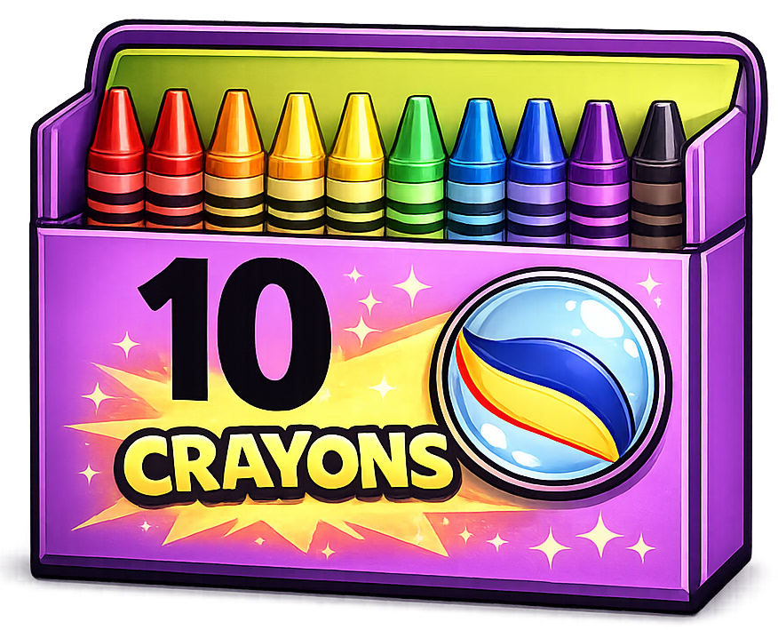
There are 10 crayons in each box. The class has 12 boxes. How many crayons are there altogether?
10 x 12 = 120

