Slide 1

Lesson 3:
Add or subtract 1 or 2
www.arithmagicians.com

Slide 2


-1
-1
-1
-1
-1
-1
-1
-1
-1
-1
40
41
42
43
44
45
46
47
48
49
50
Get ready to count back in 1s

Slide 3


Recap:
39
40 - 1 = ?
38
2) 40 - 2 = ?
40
3) 41 - 1 = ?
4) 41 - 2 = ?
39

Slide 4


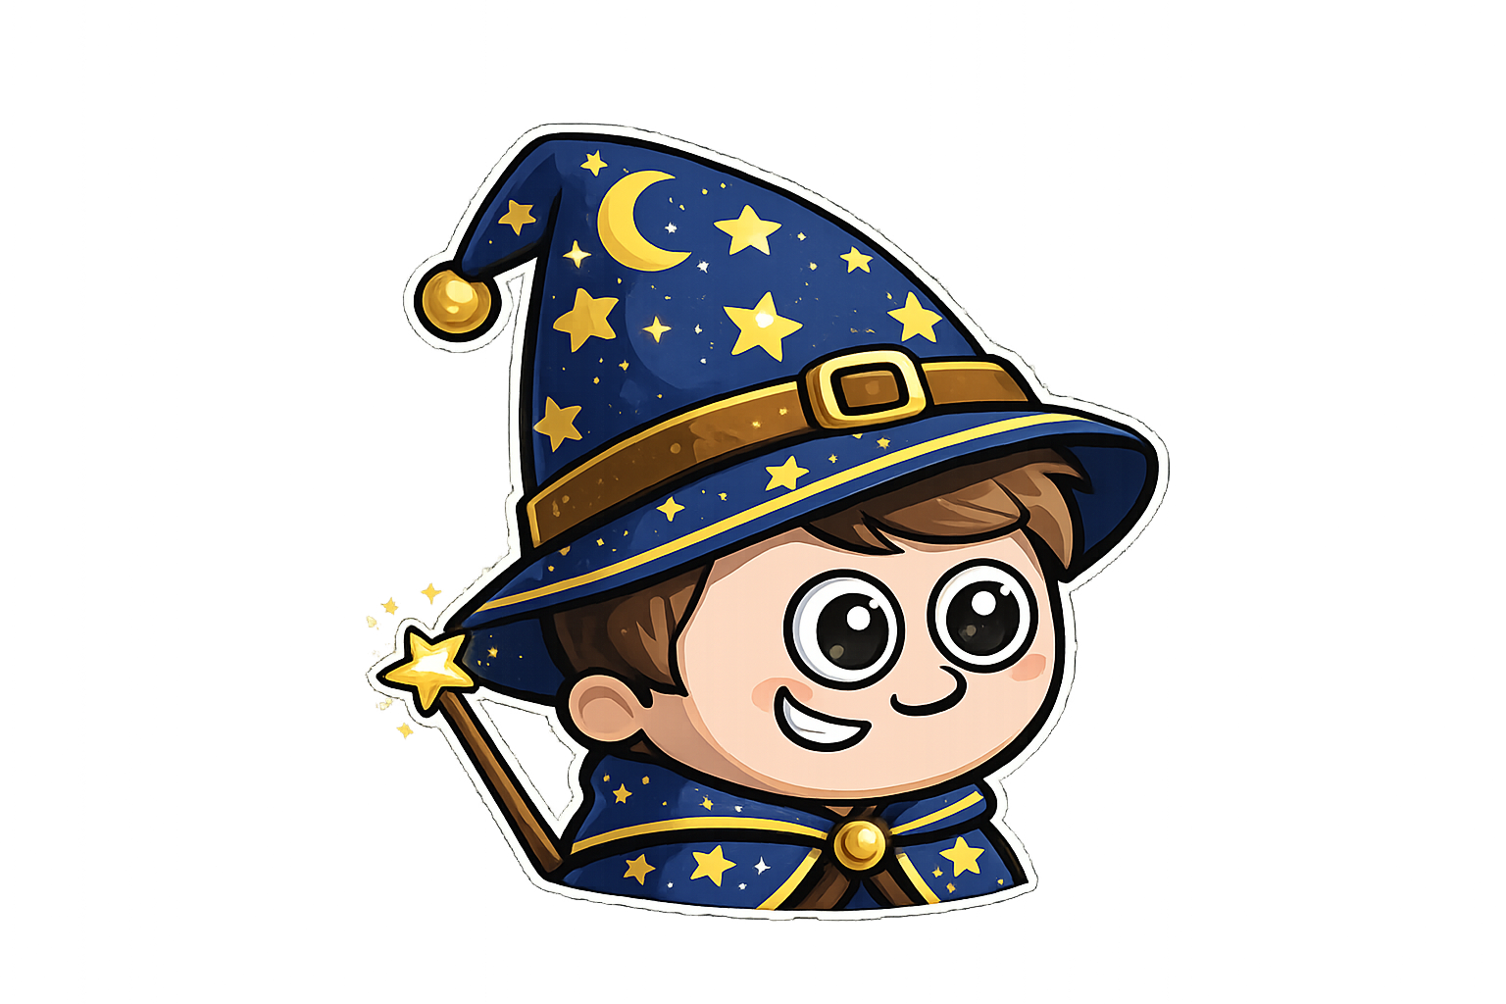
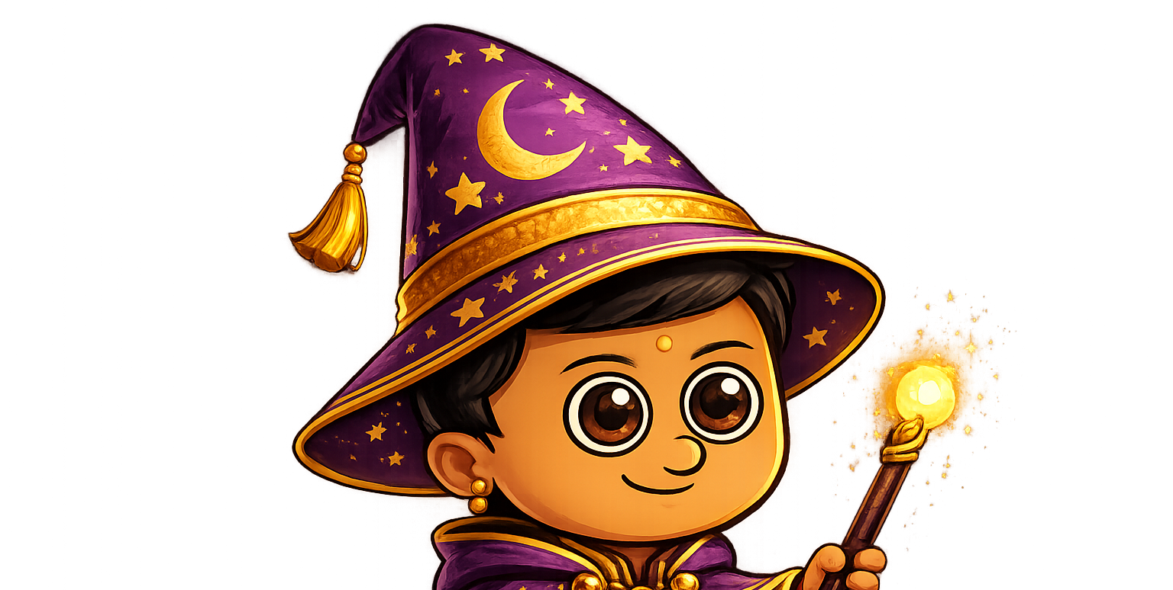
Amy has 6 sweets.
Sam has 2 more sweets than Amy.
Ali has 1 fewer sweet than Amy.

Slide 5

Sam has 1 more apple than Amy.
Amy has 5 apples.
Ali has 2 less apples than Amy
Sam
Amy
Ali
Next, I work out Sam’s apples.
Finally, I work out Ali’s apples.
First, I start with what I know

Slide 6
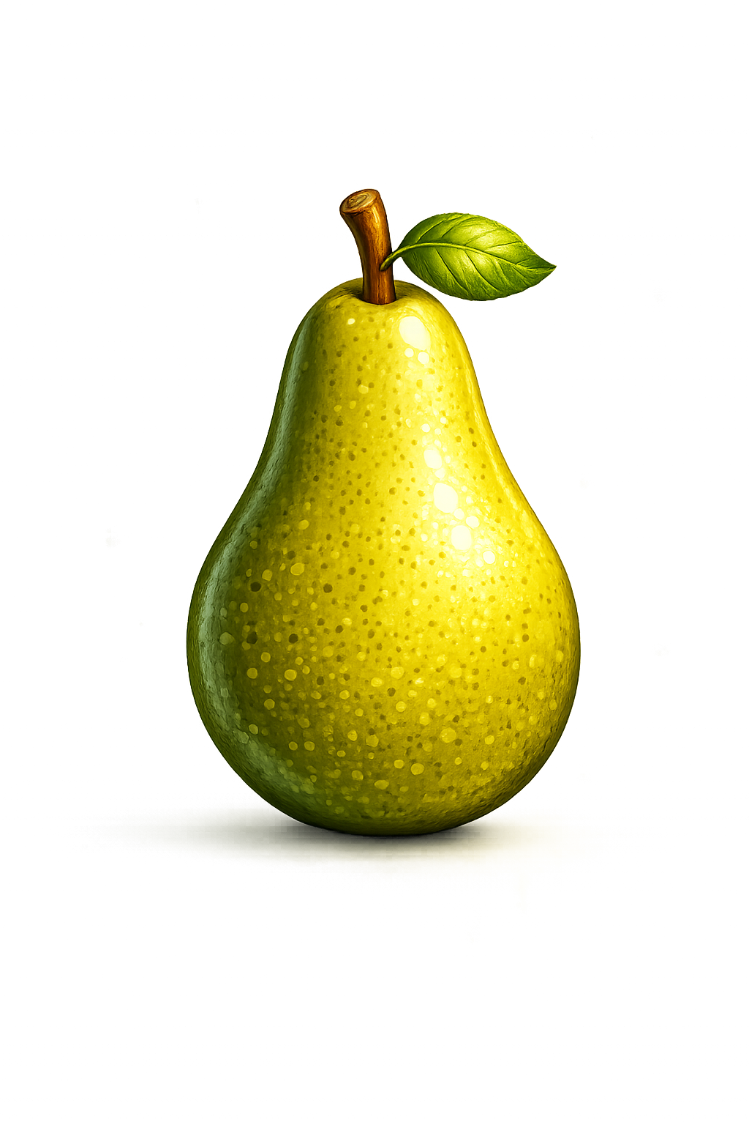
Your Turn
Sam has 2 more pears than Amy.
Amy has 4 pears.
Ali has 1 less pear than Amy.
Sam
Draw the pears
for each wizard.
Amy
Ali

Slide 7

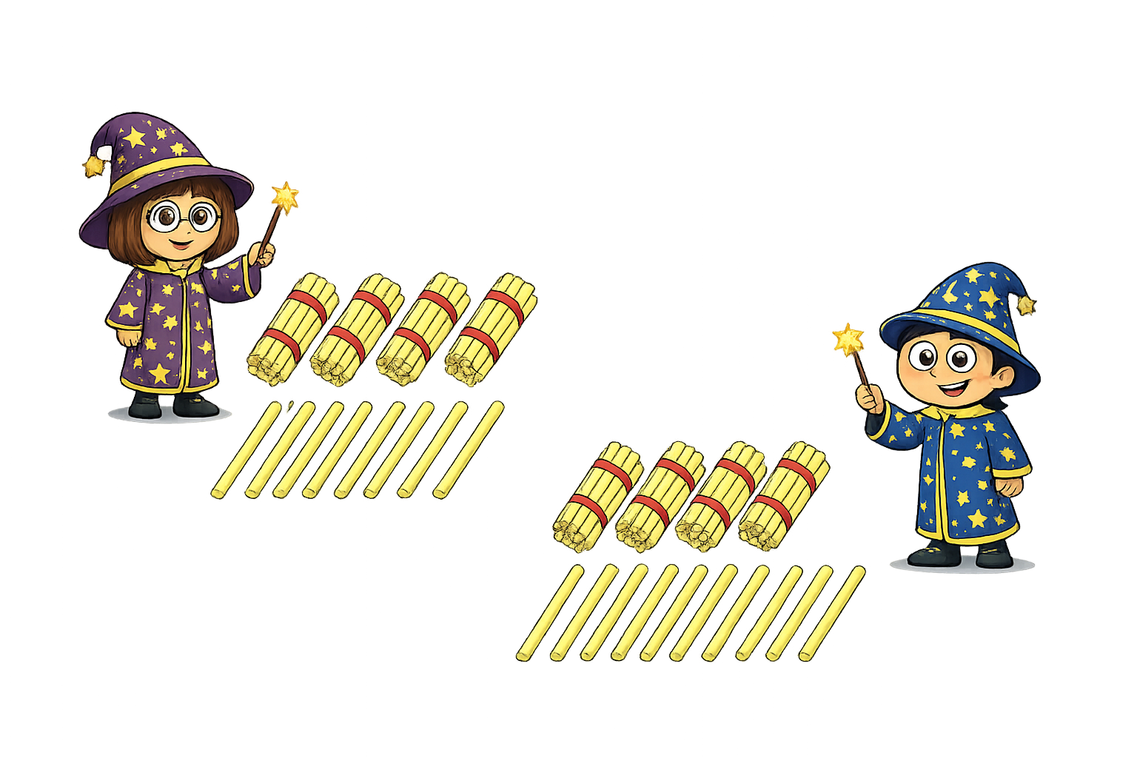



True or False
I have 2 less straw than sam
I have 30 straws
True

