Slide 1
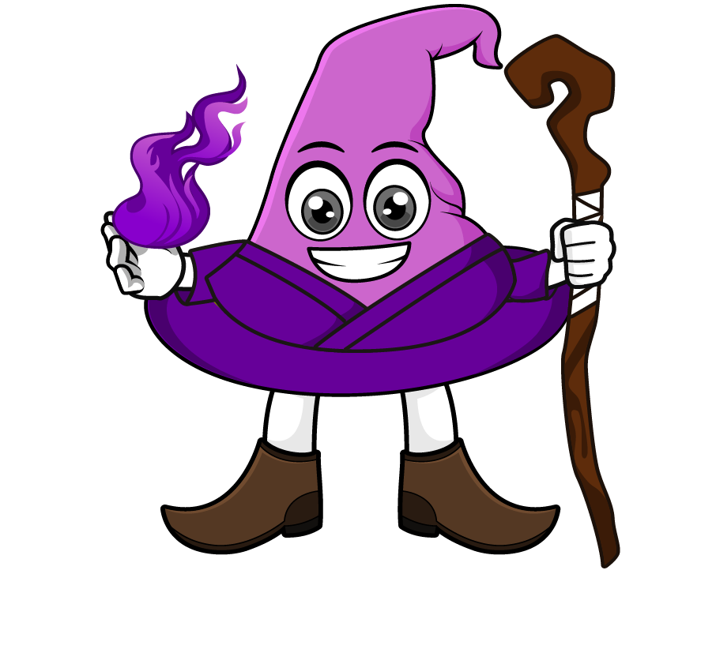

Lesson 3:
Calculate with metric measures
www.arithmagicians.com

Slide 2

Recap:
9.5 cm = ? mm
95 mm
4 m = ? cm
400 cm
6.3 kg = ? g
6300 g
8.9 L = ? ml
8900 ml
0.5 km = ? m
500 m

Slide 3

A parcel weighs 3 kg. The box itself weighs 450 g. What is the mass of the item inside?
3000 g
450g
? g
?
2550g
3000 - 450 =

Slide 4
A water bottle holds 750 ml. Ben drinks 250 ml in the morning
and 300 ml in the afternoon. How much water is left in the bottle?
750 ml
250ml
300ml
? ml
?
200 ml
750 - 550 =

Slide 5

A shop sells apples in bags of 500 g. Mrs Khan buys 4 bags. What is the total mass of the apples?
? g
500g
500g
500g
500g
?
1000 g
500 x 4 =

Slide 6
A recipe needs 1 litre of milk. Mia has 3 bottles of 250 ml each. How much more milk does she need?
1000 ml
250ml
250ml
250ml
?
?
250ml
1000 – 750 =

