Slide 1
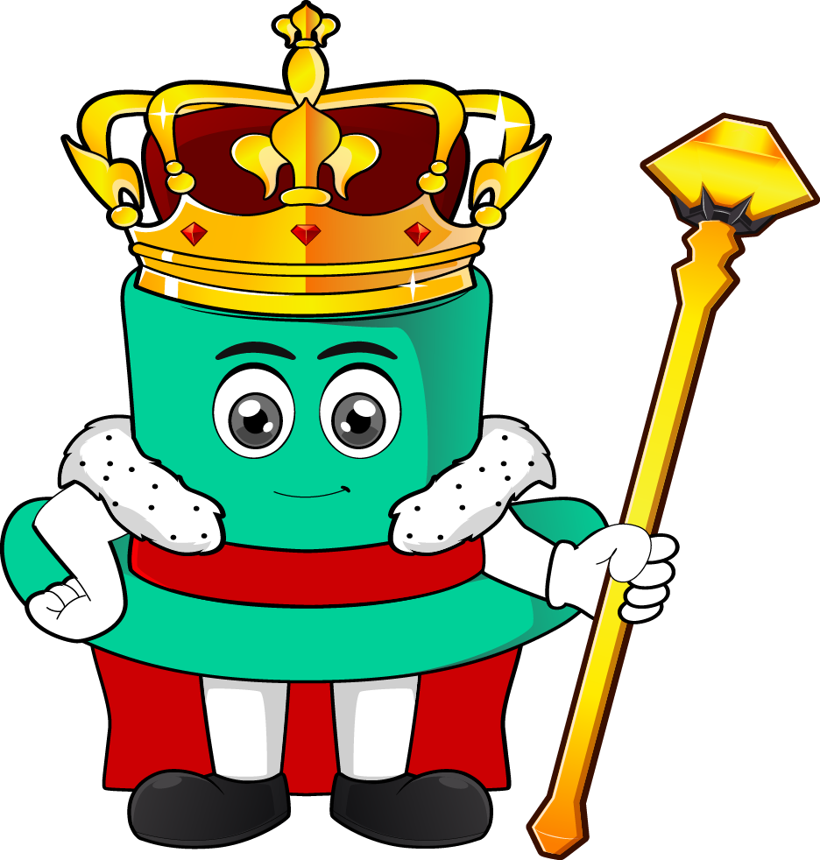

Lesson 3:
Solve problems with time.
www.arithmagicians.com

Slide 2

Recap:
Convert to minutes
1 hour =
60 minutes
Half an hour =
30 minutes
¼ of an hour =
15 minutes
¾ of an hour =
45 minutes

Slide 3

Ali’s football training starts at 4:15 pm.
The football training lasts for 25 minutes.
What time does Ali’s football training end?
+ 25 minutes
? pm
4:15 pm
4:40 pm

Slide 4
Sara’s swimming lesson starts at 3:40 pm.
The swimming lesson lasts for 40 minutes.
What time does Sara’s swimming lesson end?
+ 40 minutes
4:20 pm
3:40 pm
? pm

Slide 5


Your Turn
Ben’s reading club starts at 5:25 pm.
The reading club lasts for 35 minutes.
What time does Ben’s reading club end?
+ 35 minutes
6:00 pm
5:25 pm
? pm

Slide 6
Your Turn
Noah’s football match starts at 6:30 pm.
The match lasts for 40 minutes.
What time does the match end?
+ 40 minutes
?
6:30 pm
7:10 pm

Slide 7

True or False
20 minutes after
3:45 pm is 4:05 pm.
True

