Slide 1


Lesson 3:
Convert fractions to decimals: word problems
www.arithmagicians.com

Slide 2

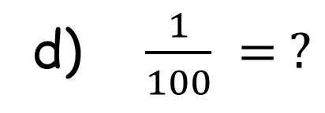
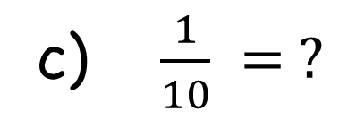
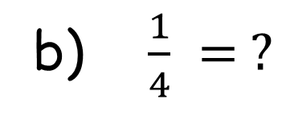
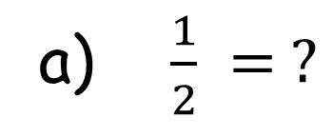
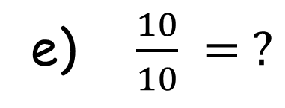
Recap: write these
fractions as decimals
a) $\frac{1}{2} = ?$
0.5
b) $\frac{1}{4} = ?$
0.25
c) $\frac{1}{10} = ?$
0.1
d) $\frac{1}{100} = ?$
0.01
e) $\frac{10}{10} = ?$
1

Slide 3



A water bottle is $\frac{3}{10}$ full. Write the amount of water as a decimal.
0.3

Slide 4


A ribbon is $\frac{3}{4}$ of a metre long. Write the length as a decimal.
0.75

Slide 5
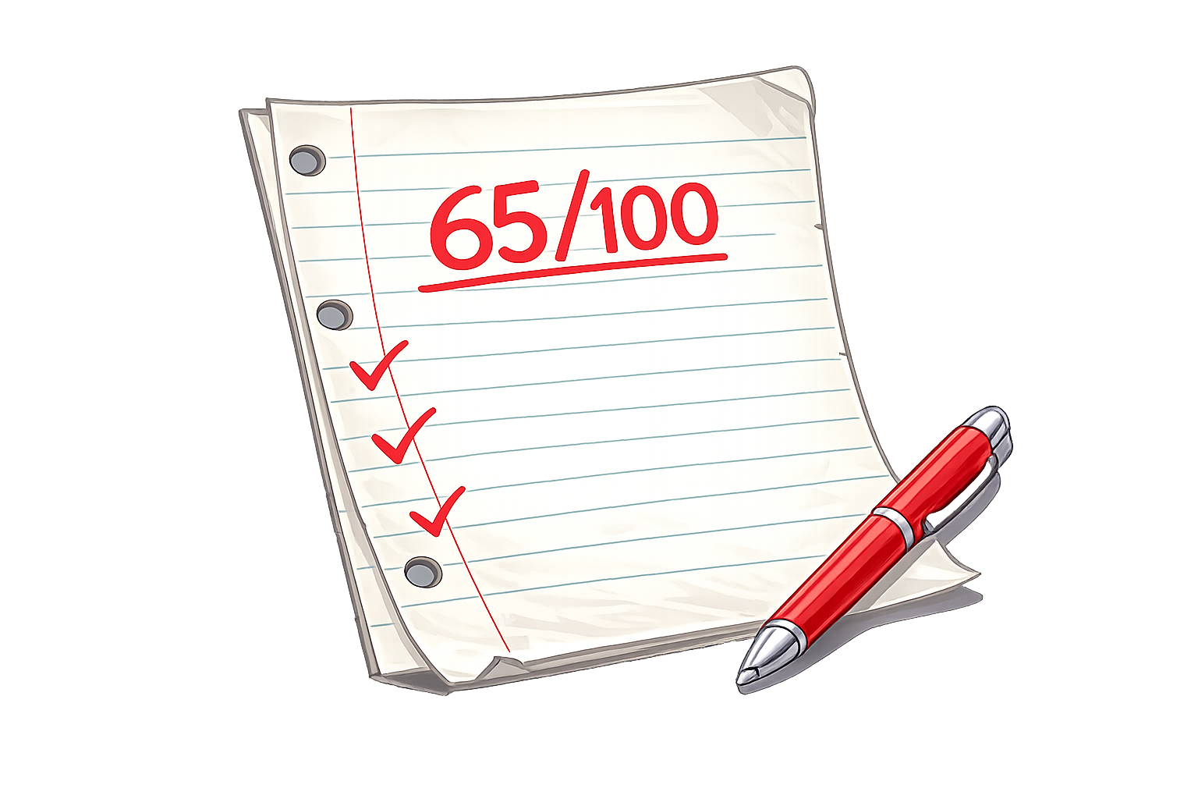

A test score is $\frac{65}{100}$ Write this as a decimal.
0.65

Slide 6
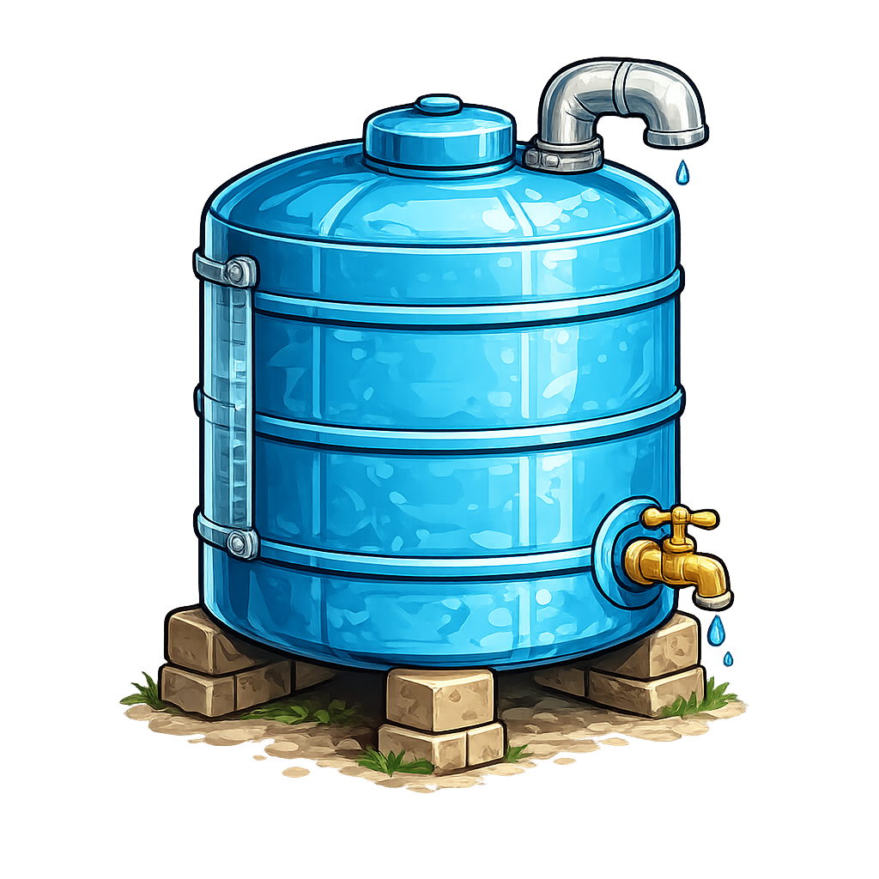

A tank is $\frac{9}{10}$ full. What is this as a decimal?
0.9

