Slide 1

Lesson 4:
Add or subtract 1 or 2
www.arithmagicians.com

Slide 2


-1
-1
-1
-1
-1
-1
-1
-1
-1
-1
50
51
52
53
54
55
56
57
58
59
60
Get ready to count back in 1s

Slide 3


Recap:
59
60 - 1 = ?
58
2) 60 - 2 = ?
60
3) 61 - 1 = ?
4) 61 - 2 = ?
59

Slide 4


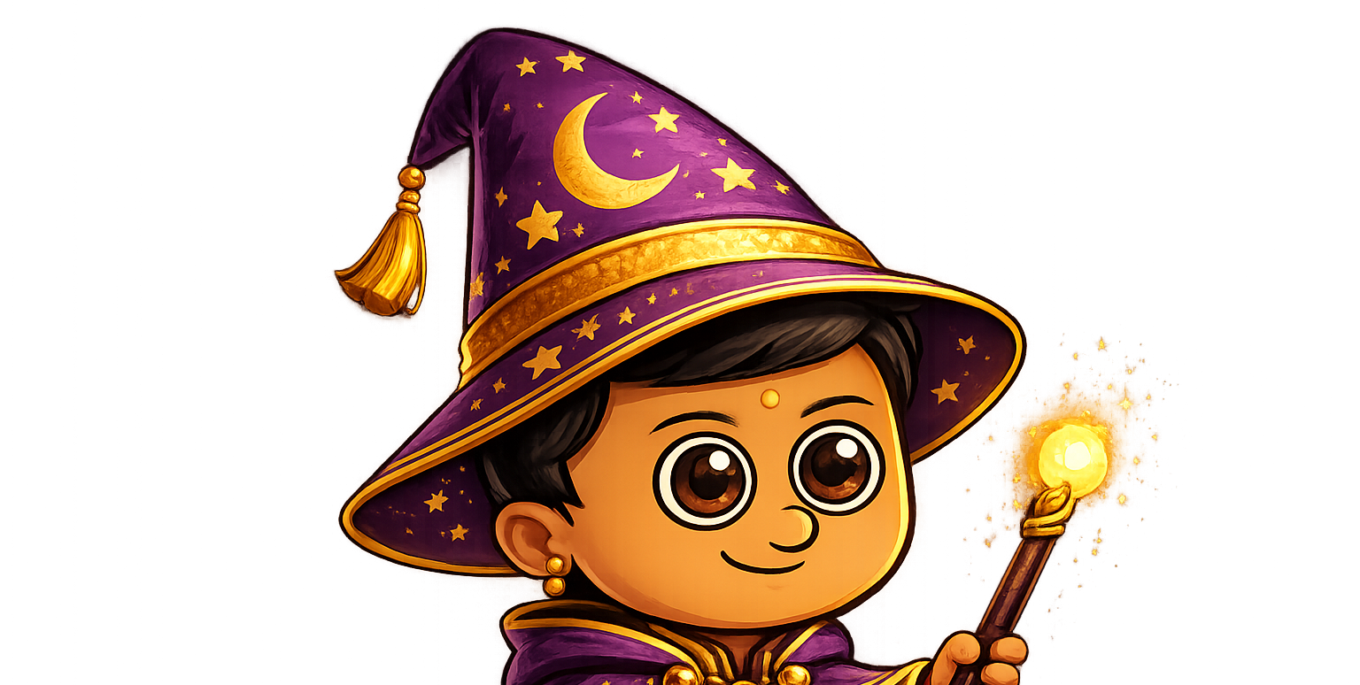
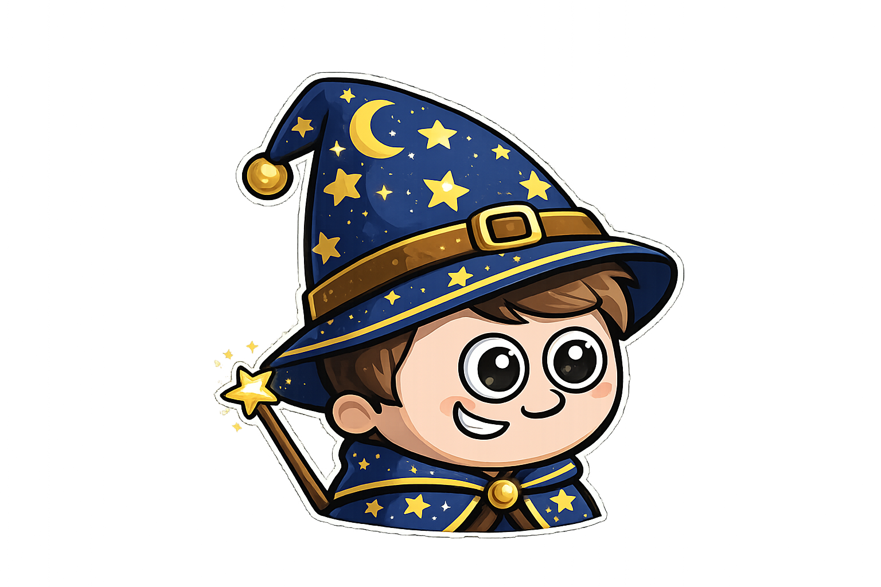
Amy has 6 sweets.
Ali has 2 more sweets than Amy.
Sam has 1 fewer sweet than Amy.

Slide 5

Sam has 1 more apple than Ali.
Amy has 2 less apples than Ali
Ali has 5 apples.
Sam
Amy
Ali
Next, I work out Sam’s apples.
Finally, I work out Amy’s apples.
First, I start with what I know

Slide 6

Your Turn
Sam has 2 more squares than Ali.
Amy has 1 less square than Ali.
Ali has 4 squares.
Sam
Draw the squares
for each wizard.
Amy
Ali

Slide 7

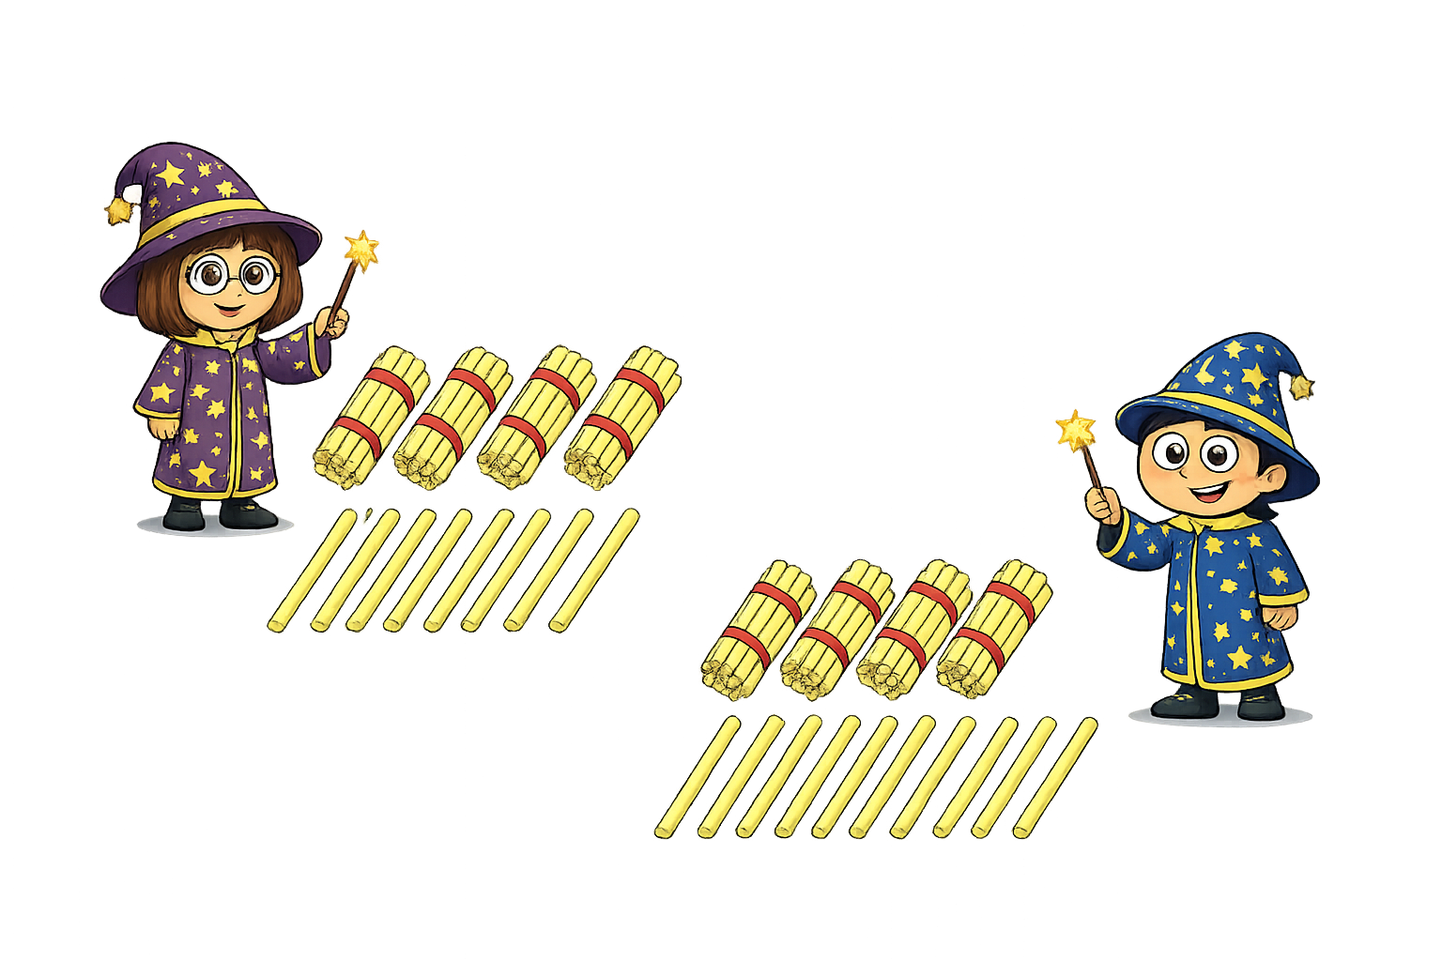

True or False
When I add 1 to my number, I get 20. What is my number?
The number must be 21
False: what mistake did Sam make?

