Slide 1
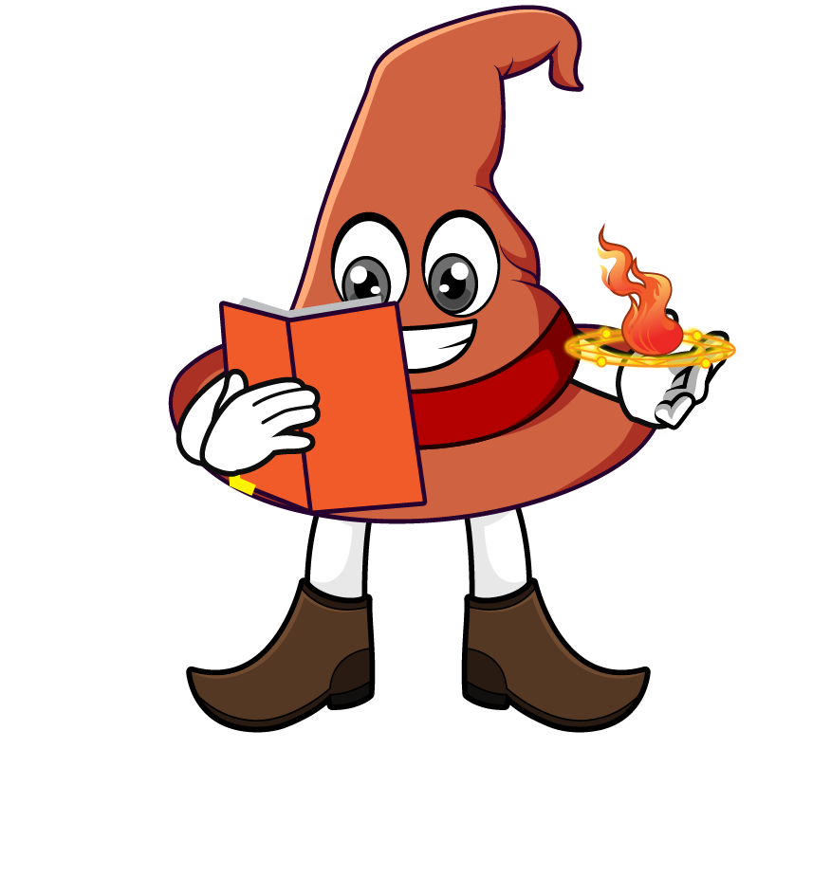

Lesson 4:
Calculate with metric measures
www.arithmagicians.com

Slide 2

Recap:
4.5 cm = ? mm
45 mm
5 m = ? cm
500 cm
2.3 kg = ? g
2300 g
9.9 L = ? ml
9900 ml
0.2 km = ? m
200 m

Slide 3

A recipe needs 1.25 L of milk.
Ben has 4 bottles of 250 ml each.
How much more milk does he need?
1250 ml
250ml
250ml
250ml
250ml
?
?
250ml
1250 – 1000 =

Slide 4
A shop sells pears in bags of 300 g.
Tom buys 4 bags.
What is the total mass of the apples?
? g
300g
300g
300g
300g
?
1200 g
300 x 4 =

Slide 5

A parcel weighs 5 kg.
The box itself weighs 500 g.
What is the mass of the item inside?
5000 g
500g
? g
?
4500g
5000 - 500 =

Slide 6
A water bottle holds 1L.
Ali drinks 250 ml in the morning
and 500 ml in the afternoon.
How much water is left in the bottle?
1000 ml
250ml
500ml
? ml
?
250 ml
1000 - 750 =

