Slide 1
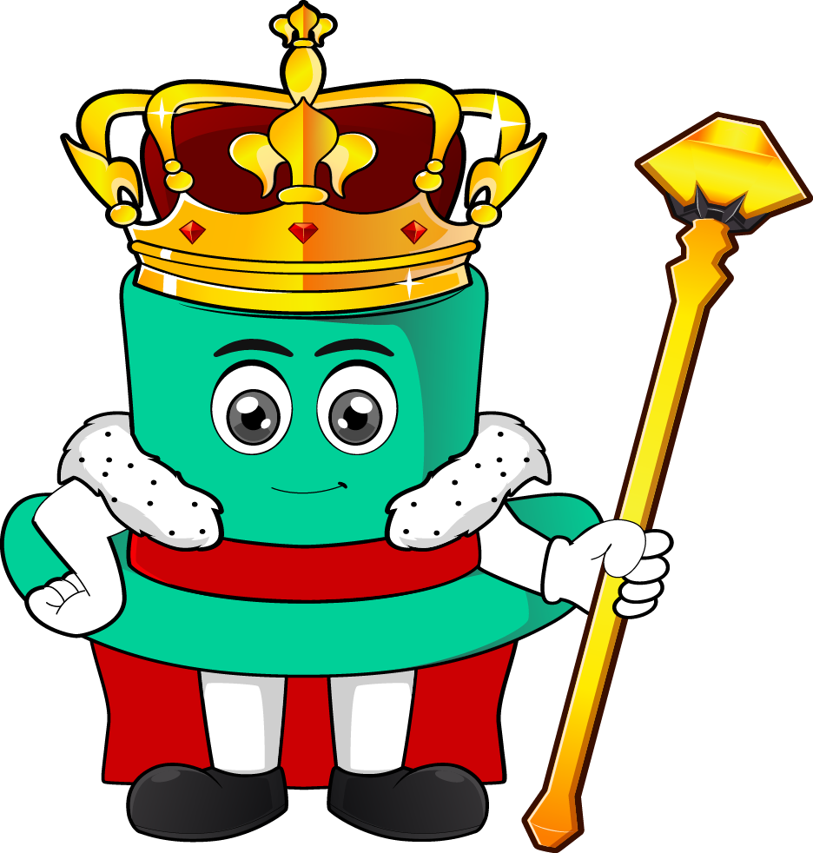

Lesson 4:
Convert fractions to decimals: word problems
www.arithmagicians.com

Slide 2

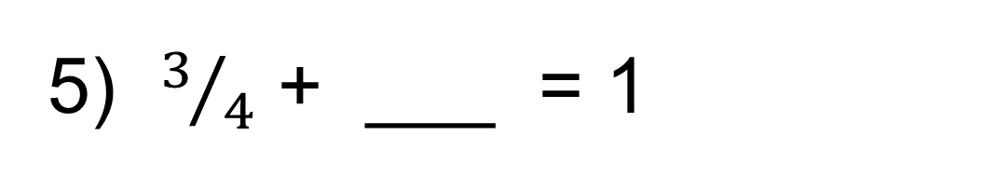
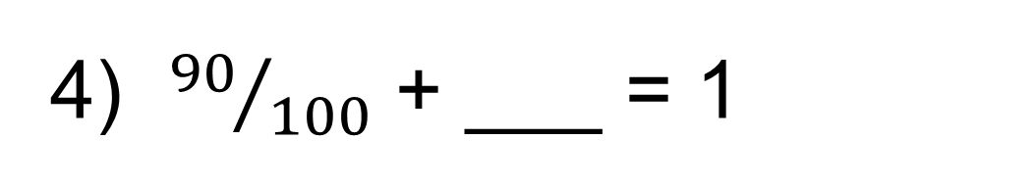
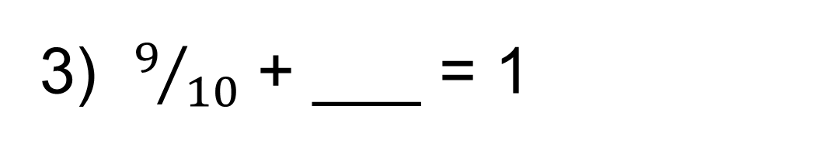
Recap: write the
answers as decimals
1) 0.5 + ___ = 1
0.5
2) 0.05 + ___ = 1
0.95
3) $9/{10}$ + ___ = 1
0.1
4) ${90}/{100}$ + ___ = 1
0.1
5) $3/4$ + ___ = 1
0.25

Slide 3

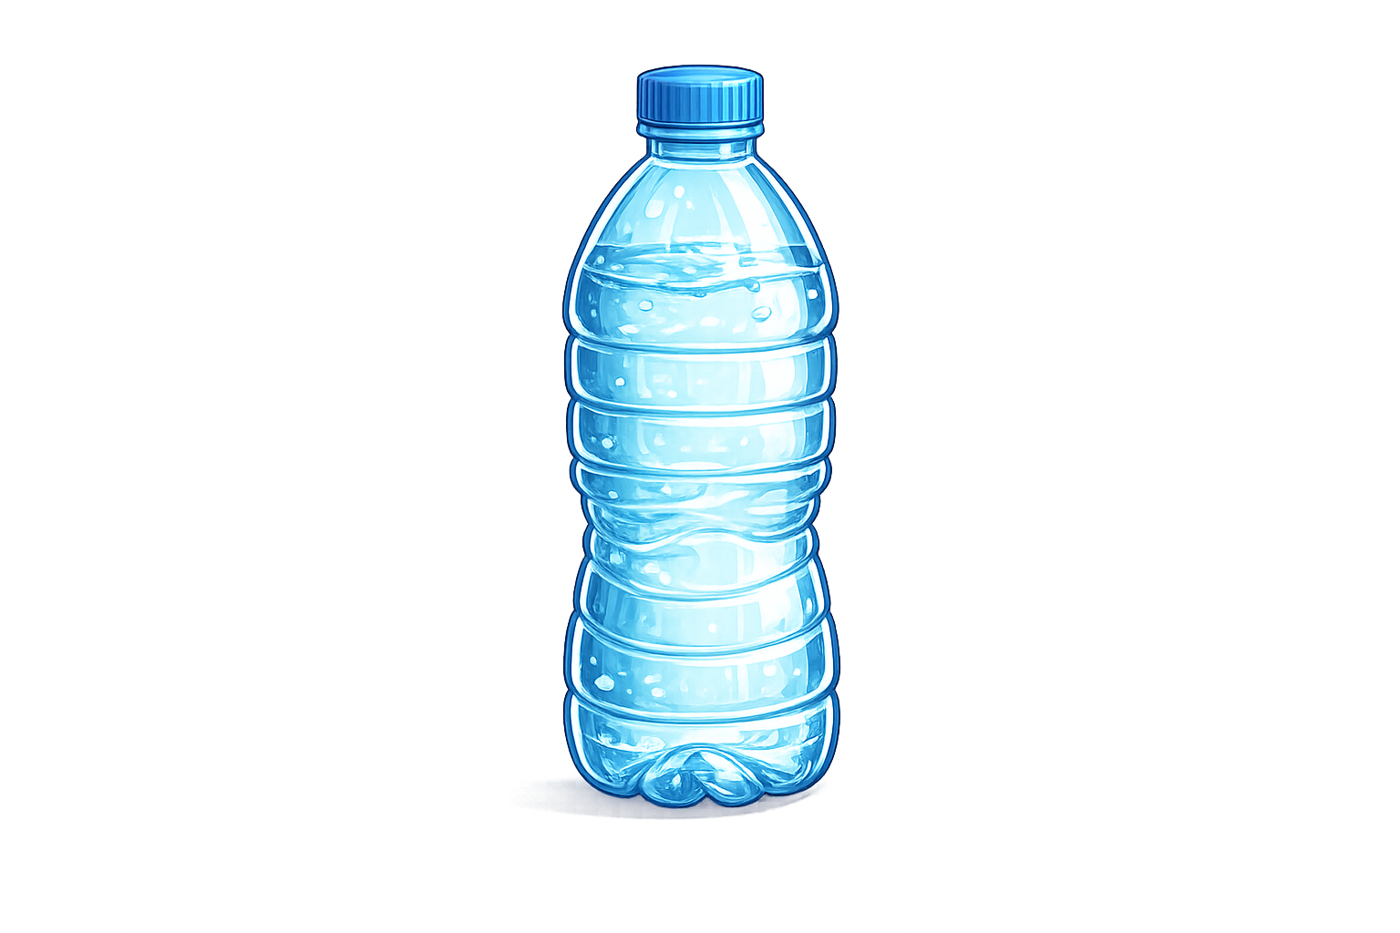
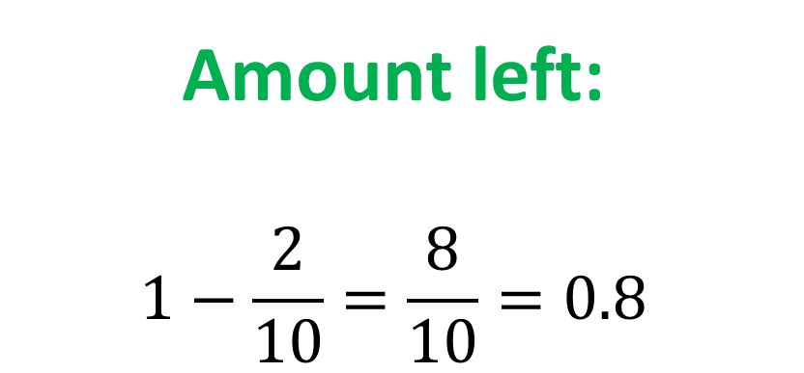
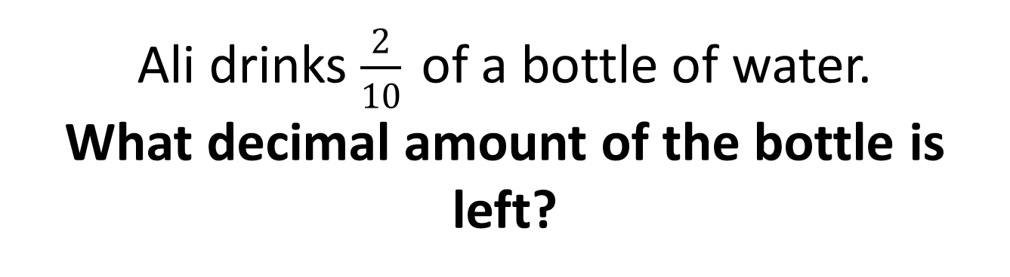
Ali drinks $\frac{2}{10}$ of a bottle of water. What decimal amount of the bottle is left?
Amount left:
$$1−\frac{2}{10}=\frac{8}{10}=0.8$$

Slide 4
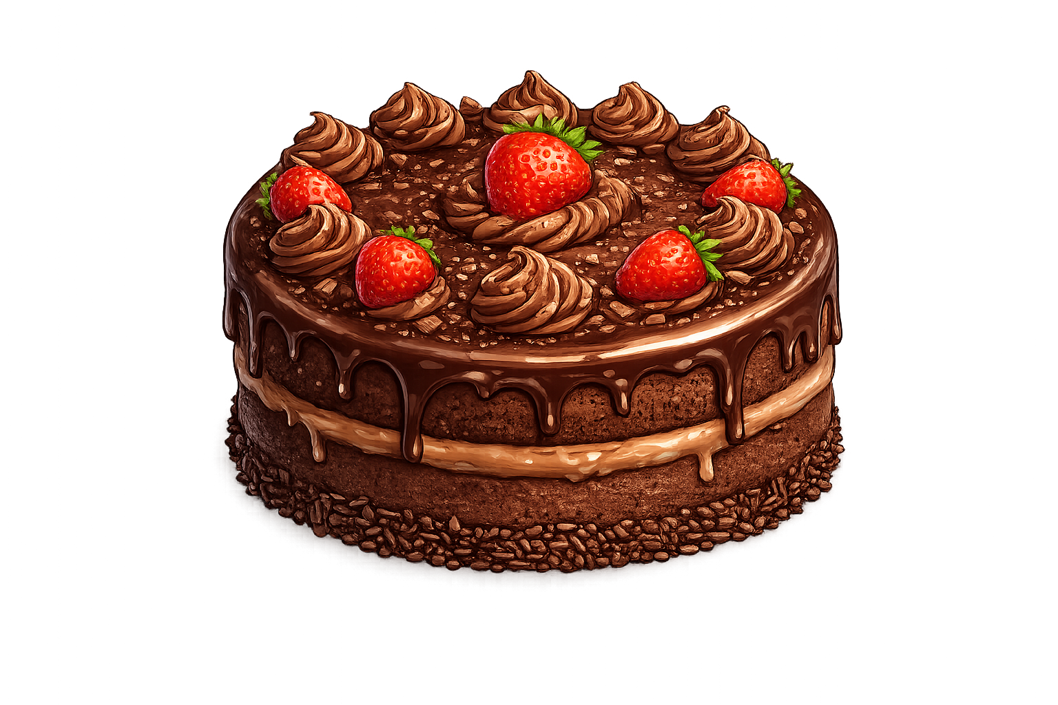
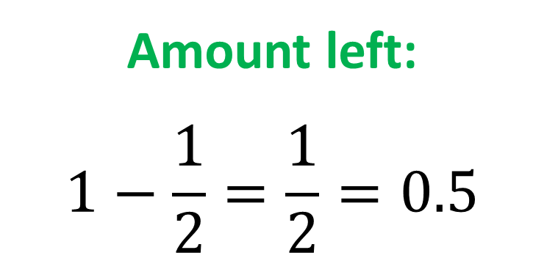
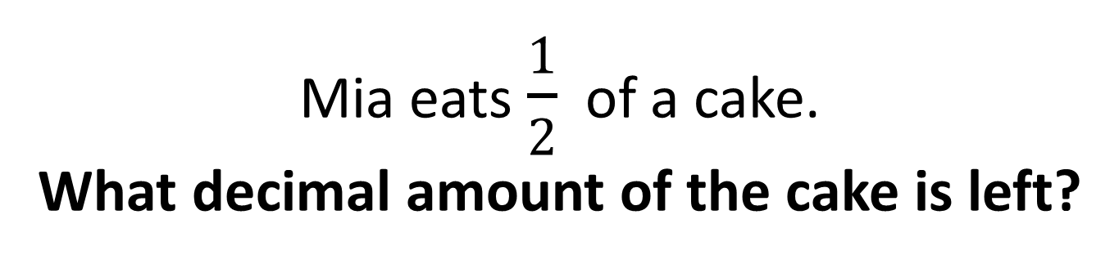
Mia eats $\frac{1}{2}$ of a cake. What decimal amount of the cake is left?
Amount left:
$$1−\frac{1}{2}=\frac{1}{2}=0.5$$

Slide 5
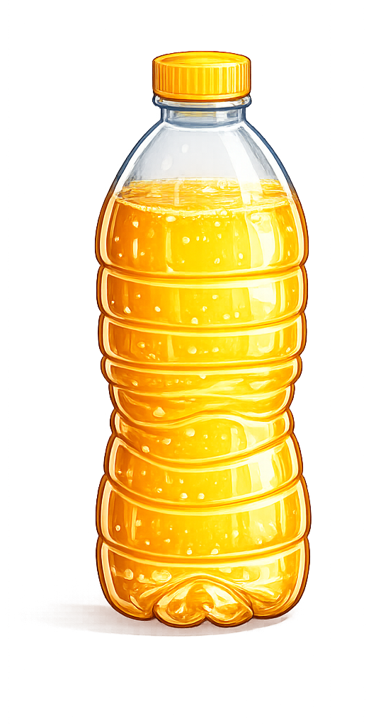
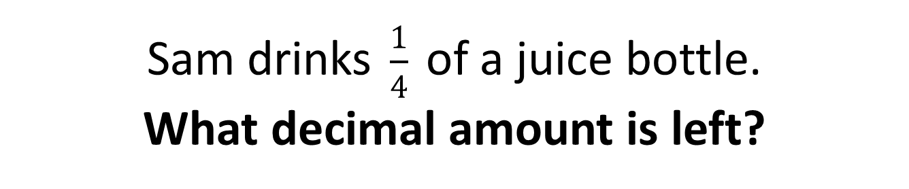
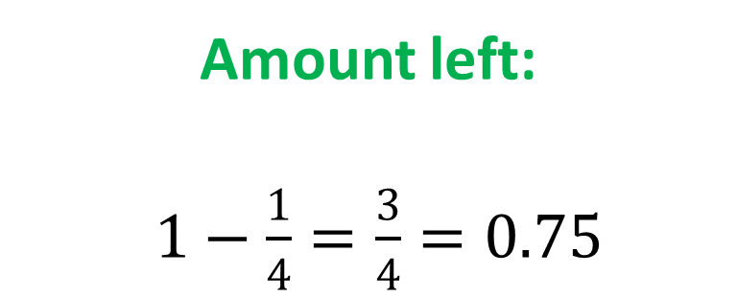
Sam drinks $\frac{1}{4}$ of a juice bottle. What decimal amount is left?
Amount left:
$1−\frac{1}{4}=\frac{3}{4}=0.75$

Slide 6
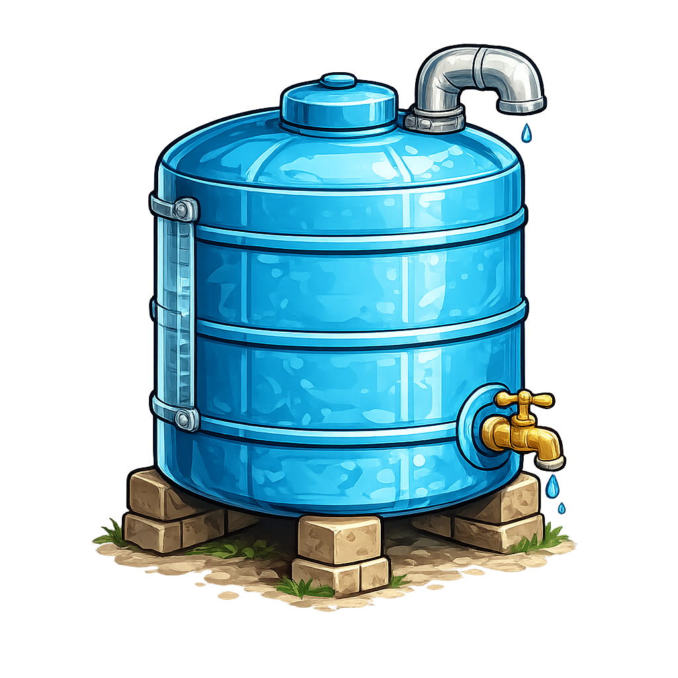

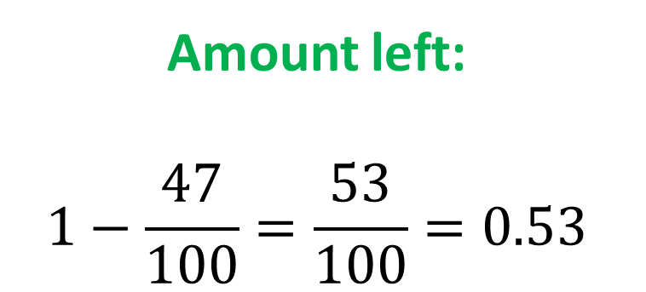
A tank uses $\frac{47}{100}$ of its water. What decimal amount is left?
Amount left:
$$1−\frac{47}{100}=\frac{53}{100}=0.53$$

