Slide 1
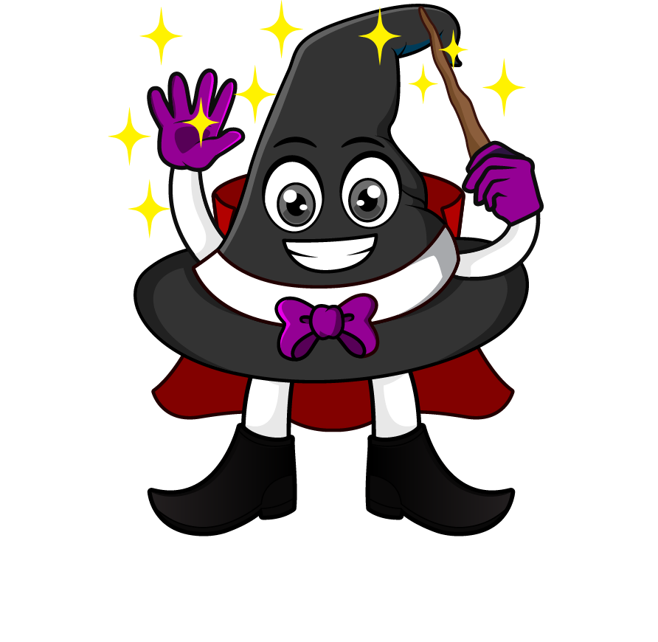

Lesson 5:
Assess and Review
www.arithmagicians.com

Slide 2

Recap:
2.5 cm = ? mm
25 mm
10 m = ? cm
1000 cm
4.3 kg = ? g
4300 g
2.2 L = ? ml
2200 ml
0.1 km = ? m
100 m

Slide 3
A jug contains 1.5 litres of juice.
450 ml is poured into cups.
How much juice is left in ml?
1500 ml
?
450ml
?
1050 ml
1500 - 450 =

Slide 4
A parcel weighs 1 kg.
The box itself weighs 150 g.
What is the mass of the item inside?
1000 g
150g
? g
?
850g
1000 - 150 =

Slide 5

A water bottle holds 1L.
Rosie drinks 300 ml in the morning
and 200 ml in the afternoon.
How much water is left in the bottle?
1000 ml
300ml
200ml
? ml
?
500 ml
1000 - 500 =

Slide 6
A recipe needs 2 litre of milk.
Amy has 3 bottles of 500 ml each.
How much more milk does she need?
2000 ml
500ml
500ml
500ml
?
?
500ml
2000 – 1500 =

