Slide 1


Lesson 5:
Assess and Review
www.arithmagicians.com

Slide 2

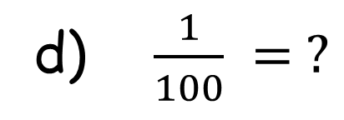
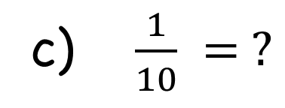
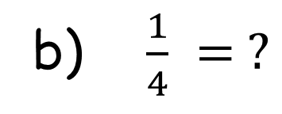
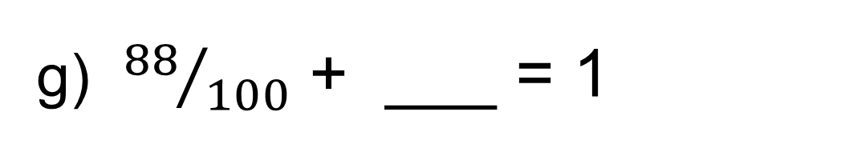
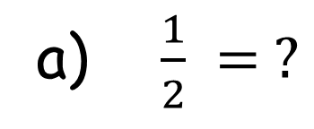
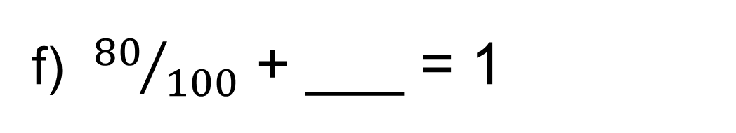
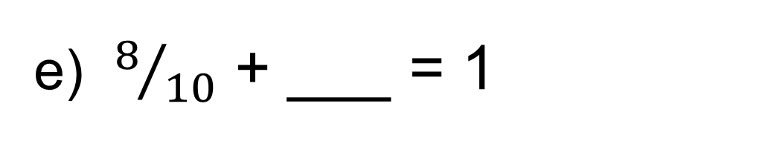
Recap: write the
answers as decimals
a) $\frac{1}{2} = ?$
e) $8/{10}$ + ___ = 1
0.5
0.2
f) ${80}/{100}$ + ___ = 1
b) $\frac{1}{4} = ?$
0.25
0.2
g) ${88}/{100}$ + ___ = 1
c) $\frac{1}{10} = ?$
0.1
0.12
d) $\frac{1}{100} = ?$
0.01

Slide 3


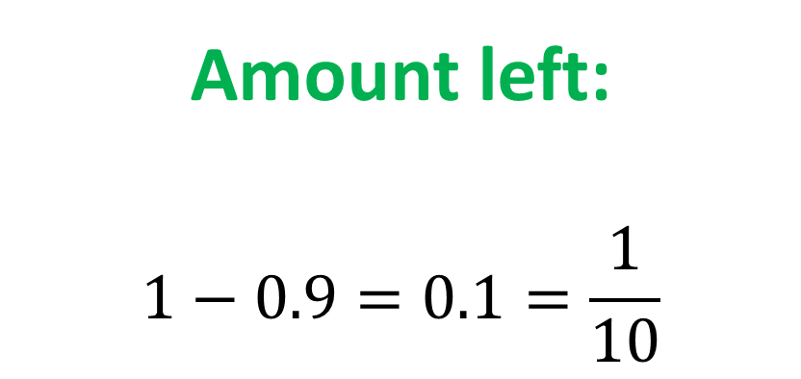
Sam eats 0.9 of a pizza. What fraction of the pizza is left?
Amount left:
$$1−0.9=0.1=\frac{1}{10}$$

Slide 4
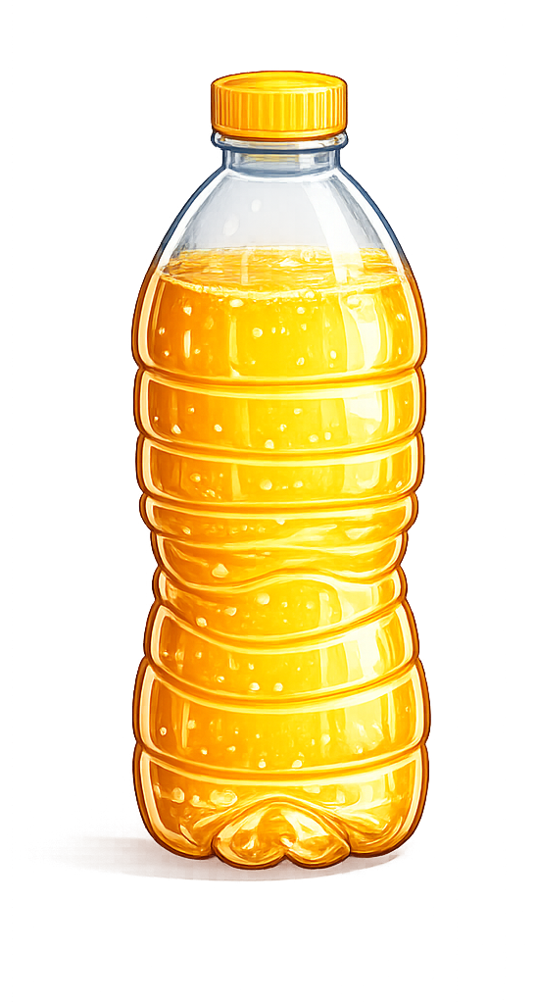
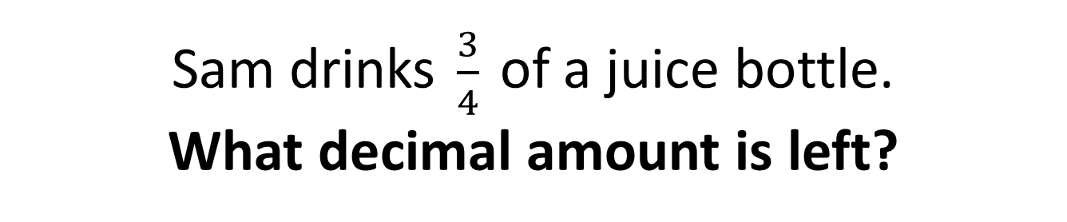
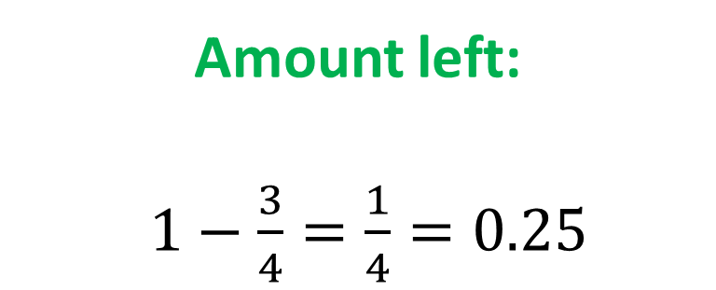
Sam drinks $\frac{3}{4}$ of a juice bottle. What decimal amount is left?
Amount left:
$1−\frac{3}{4}=\frac{1}{4}=0.25$

Slide 5

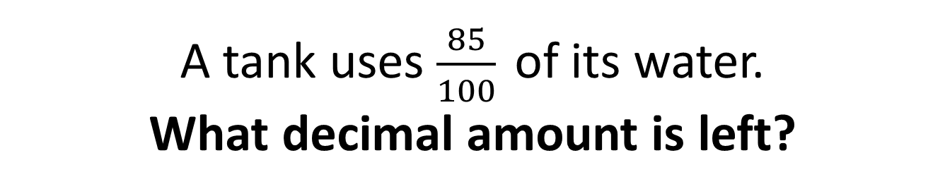
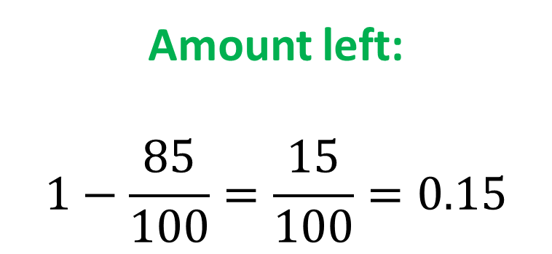
A tank uses $\frac{85}{100}$ of its water. What decimal amount is left?
Amount left:
$$1−\frac{85}{100}=\frac{15}{100}=0.15$$

Slide 6
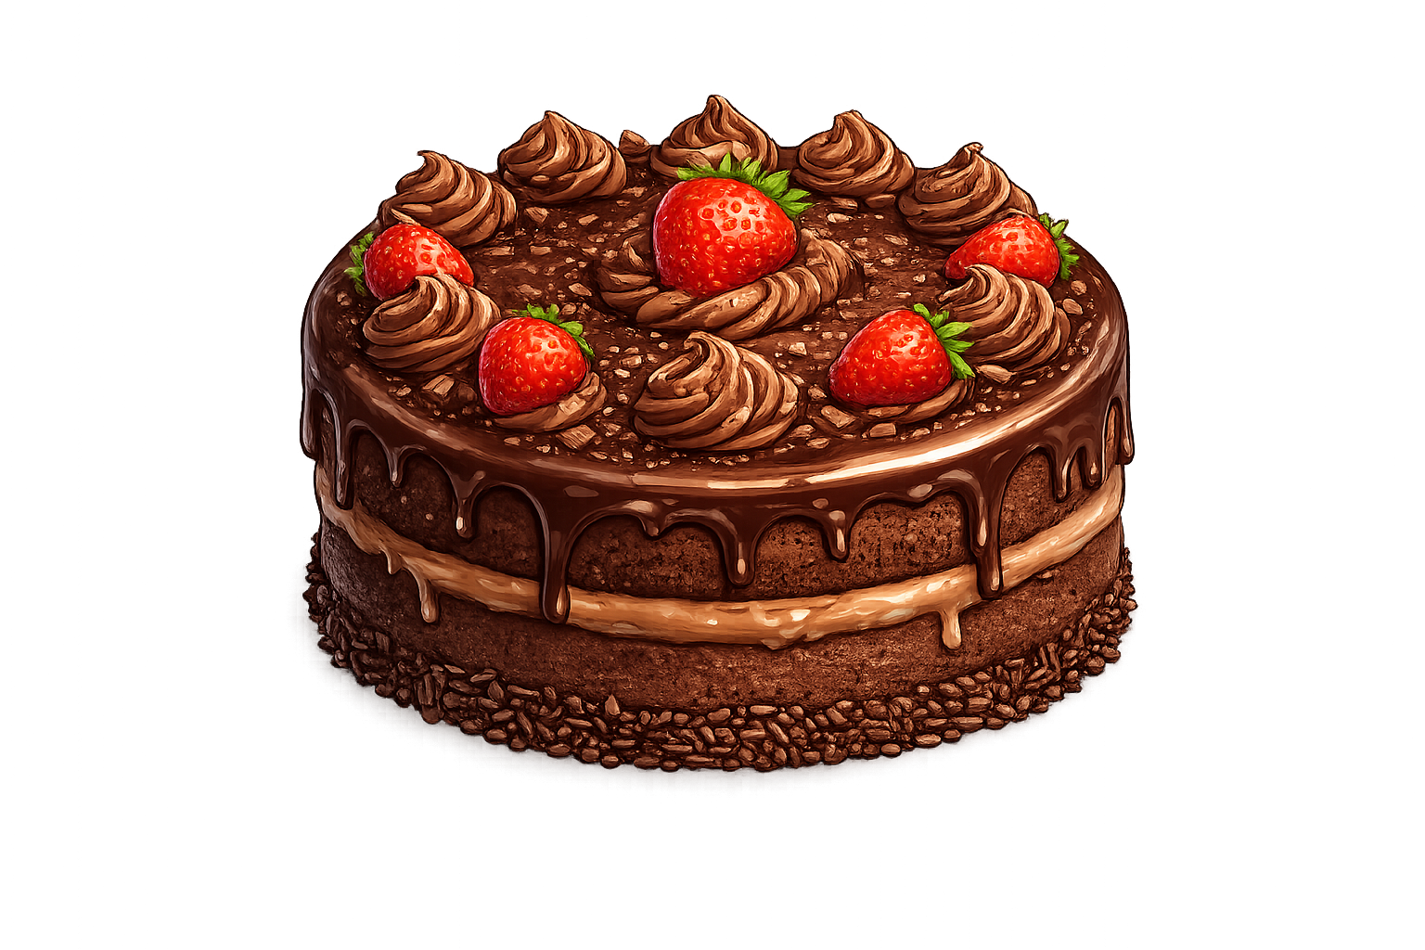
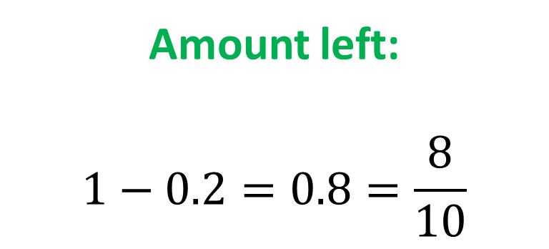
A cake has 0.2 eaten. What fraction of the cake is left?
Amount left:
$$1−0.2=0.8=\frac{8}{10}$$

