Slide 1


Lesson 1:
Recap:
Convert metric units
www.arithmagicians.com

Slide 2

Recap:
10
1 cm = ? mm
Tip: Use the ruler to help you

Slide 3

Recap:
100
1m = ? cm
10 cm
1m
Tip: Use the diagram to help you

Slide 4
Recap:
1000 m
1 km = ? m
100m
Tip: Use the diagram to help you

Slide 5

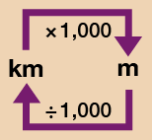
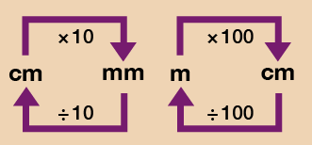
a) 8.3 cm = ? mm
b) 220 mm = ? cm
c) 5.7 m = ? cm
d) 11.3 km = ? m
e) 860 m = ? km
83 mm
22 cm
Use the conversion chart to help you.
570 cm
11300 m
0.86 km

Slide 6

True or False
7 g > 0.7 kg
7 g is greater than 0.7 kg because 7 is a greater number.
False: can you explain why?

