Slide 1


Lesson 1:
Recap: Read time shown in Roman numerals
www.arithmagicians.com

Slide 2


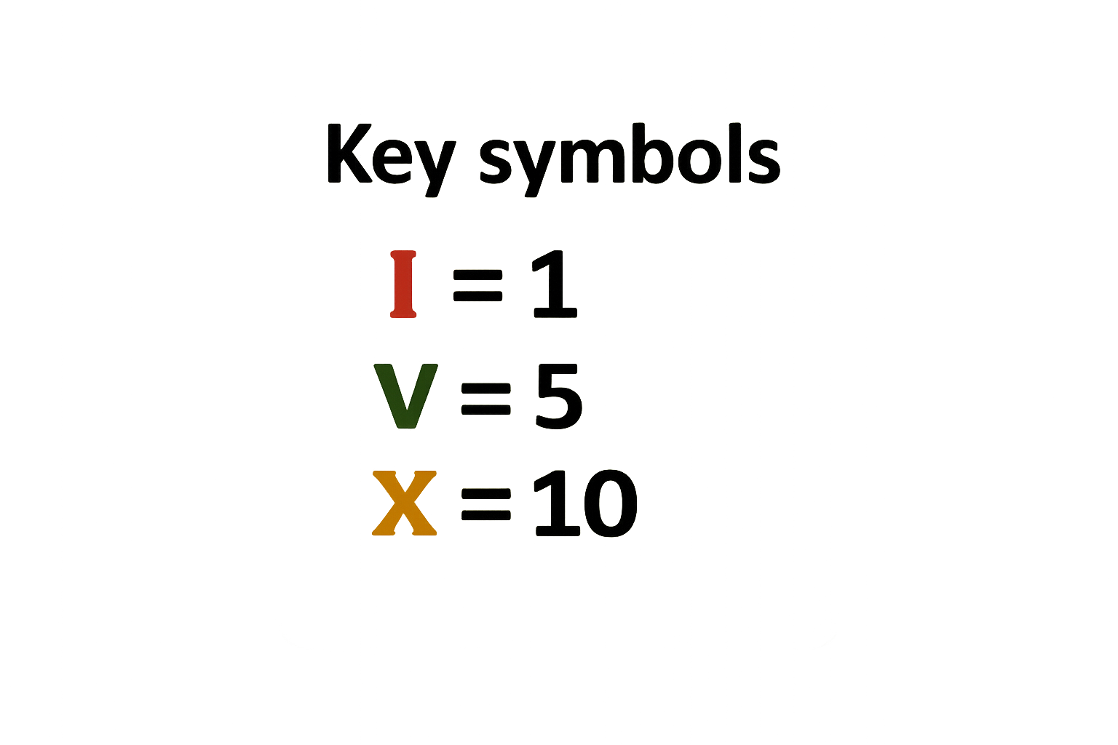
Roman numerals use letters
With just these 3 symbols, we can make all the numbers up to 12.

Slide 3

Write the Roman numerals from 1 to 12.
I = 1 VII = 7
II = 2 VIII = 8
III = 3 IX = 9
IV = 4 X = 10
V = 5 XI = 11
VI = 6 XII = 12

Slide 4

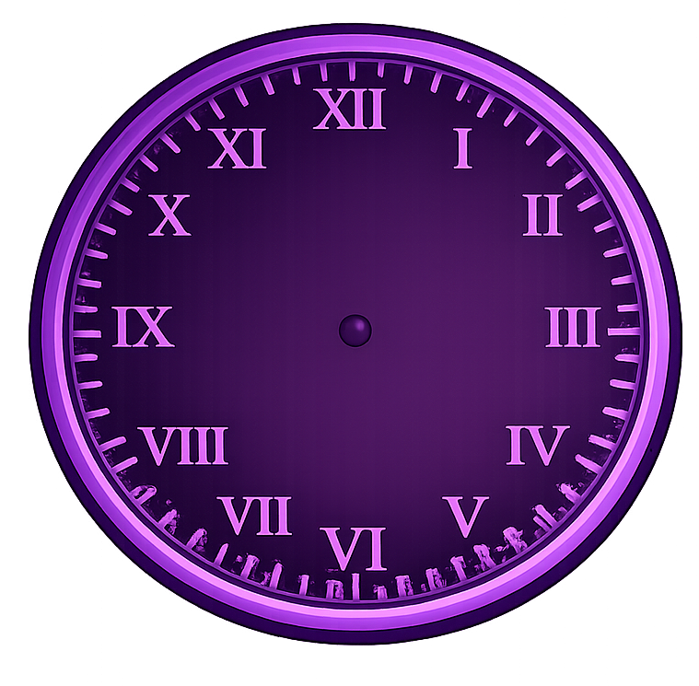
What time is shown by the clock?
2 o’clock

Slide 5
What time is shown by the clock?
9 o’clock

Slide 6
What time is shown by the clock?
Half past 1

Slide 7

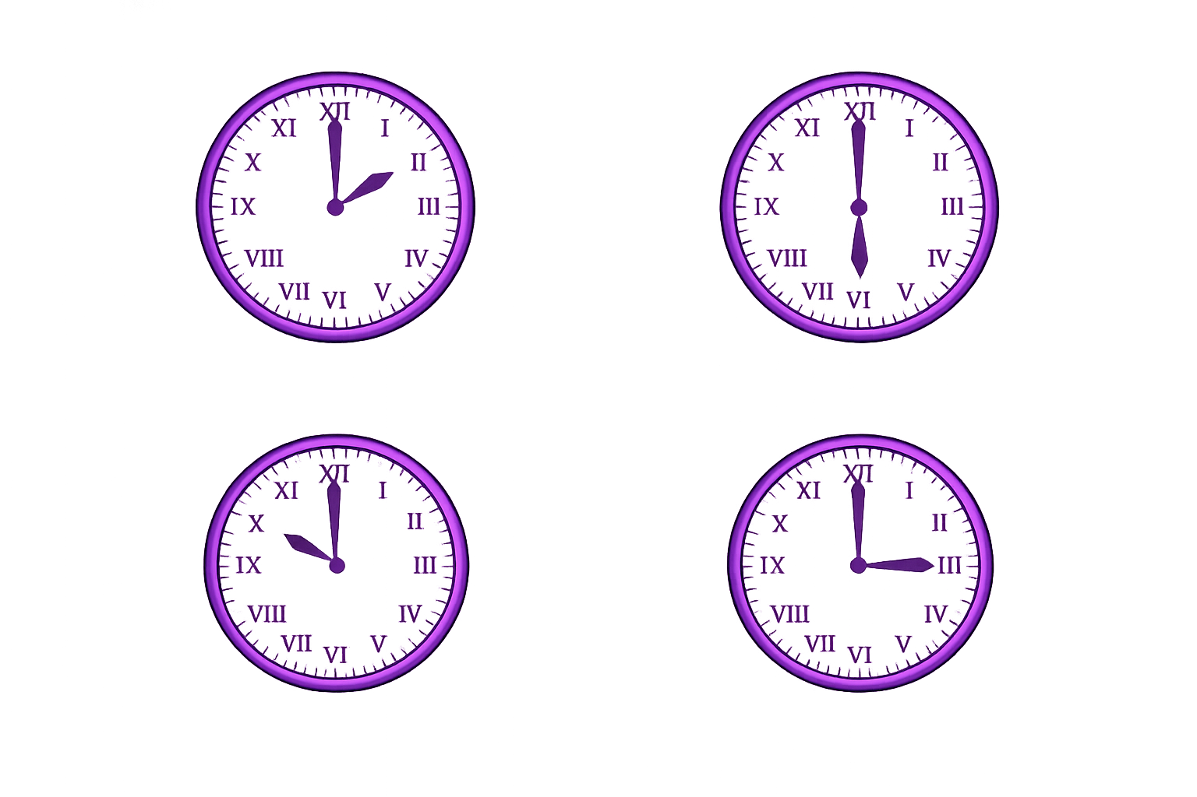
Your Turn
6 o’clock
10 o’clock
a)
b)
c)
d)
12 o’clock
Half past 7

Slide 8
True or False
If V = 5, then VV must equal 10
False: Can you explain why?

