Slide 1


Lesson 1:
Recap: Tenths as decimals
www.arithmagicians.com

Slide 2

Get ready to
count up in tenths
0
1
$\frac{\text{0}}{\text{10}}$
$\frac{\text{1}}{\text{10}}$
$\frac{\text{2}}{\text{10}}$
$\frac{\text{3}}{\text{10}}$
$\frac{\text{4}}{\text{10}}$
$\frac{\text{5}}{\text{10}}$
$\frac{\text{6}}{\text{10}}$
$\frac{\text{7}}{\text{10}}$
$\frac{\text{8}}{\text{10}}$
$\frac{\text{9}}{\text{10}}$
$\frac{\text{10}}{\text{10}}$

Slide 3
$\frac{\text{2}}{\text{10}}$
$\frac{\text{4}}{\text{10}}$
$\frac{\text{3}}{\text{10}}$
$\frac{\text{1}}{\text{10}}$
 | $\frac{\text{1}}{\text{10}}$ | $\frac{\text{1}}{\text{10}}$ | $\frac{\text{1}}{\text{10}}$ | $\frac{\text{1}}{\text{10}}$ | $\frac{\text{1}}{\text{10}}$ | $\frac{\text{1}}{\text{10}}$ | $\frac{\text{1}}{\text{10}}$ | $\frac{\text{1}}{\text{10}}$ | $\frac{\text{1}}{\text{10}}$
3 tenths
1 tenth
4 tenths
2 tenths
0.1
 | 0.1 | 0.1 | 0.1 | 0.1 | 0.1 | 0.1 | 0.1 | 0.1 | 0.1
0.2
0.3
0.4

Slide 4

$\frac{\text{9}}{\text{10}}$
?
$\frac{\text{1}}{\text{10}}$
 | $\frac{\text{1}}{\text{10}}$ | $\frac{\text{1}}{\text{10}}$ | $\frac{\text{1}}{\text{10}}$ | $\frac{\text{1}}{\text{10}}$ | $\frac{\text{1}}{\text{10}}$ | $\frac{\text{1}}{\text{10}}$ | $\frac{\text{1}}{\text{10}}$ | $\frac{\text{1}}{\text{10}}$ | $\frac{\text{1}}{\text{10}}$
? tenths
9 tenths
0.1
 | 0.1 | 0.1 | 0.1 | 0.1 | 0.1 | 0.1 | 0.1 | 0.1 | 0.1
?
0.9

Slide 5
$\frac{\text{10}}{\text{10}}$
?
$\frac{\text{1}}{\text{10}}$
 | $\frac{\text{1}}{\text{10}}$ | $\frac{\text{1}}{\text{10}}$ | $\frac{\text{1}}{\text{10}}$ | $\frac{\text{1}}{\text{10}}$ | $\frac{\text{1}}{\text{10}}$ | $\frac{\text{1}}{\text{10}}$ | $\frac{\text{1}}{\text{10}}$ | $\frac{\text{1}}{\text{10}}$ | $\frac{\text{1}}{\text{10}}$
? tenths
10 tenths
0.1
 | 0.1 | 0.1 | 0.1 | 0.1 | 0.1 | 0.1 | 0.1 | 0.1 | 0.1
?
1

Slide 6
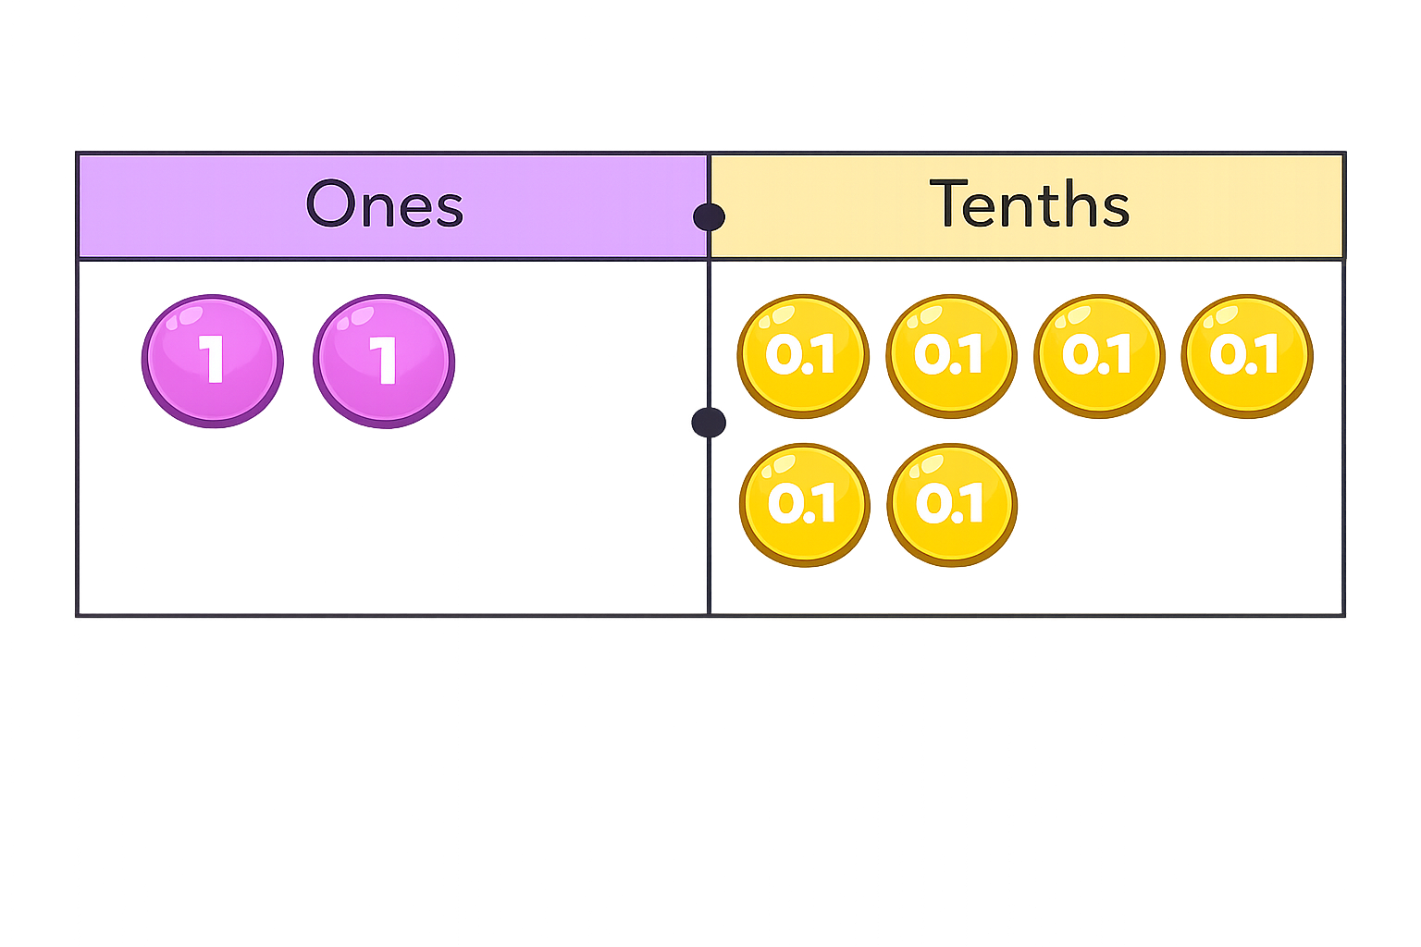
There are wholes and tenths.
The number is
2
6
2.6

Slide 7
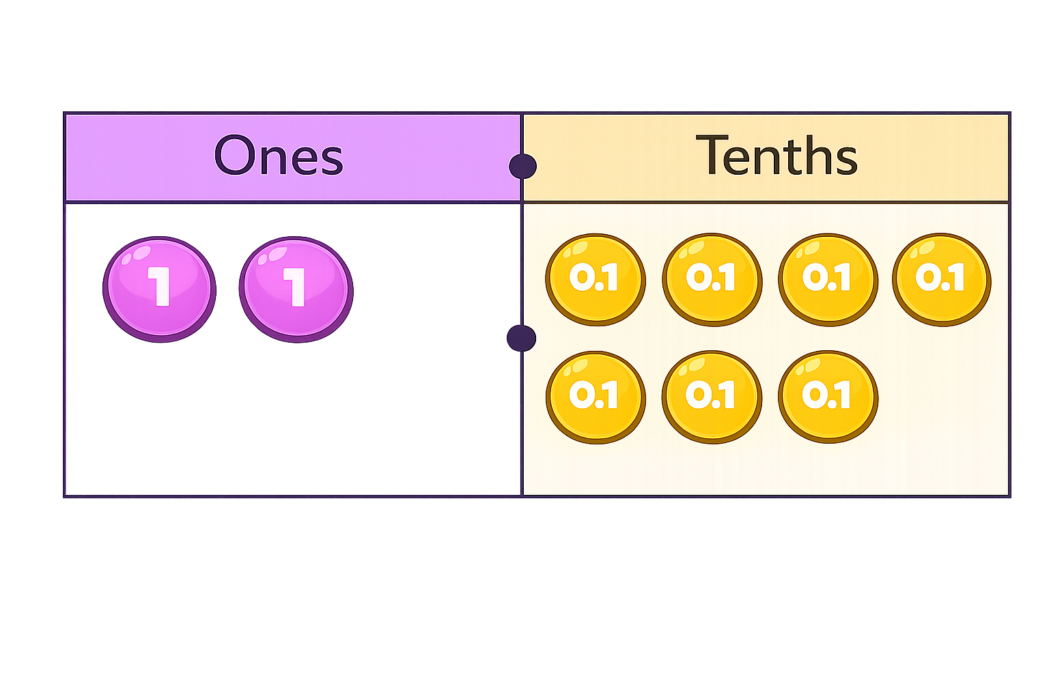

There are ones and tenths.
ones $+$ tenths $=$ $+$ $=$
0
7
0
7
0
0.7
0.7

Slide 8


Your Turn
Match the equivalent fractions and decimals.
9/10
0.1
1/10
0.7
4/10
1
7/10
0.9
10/10
0.4

