Slide 1
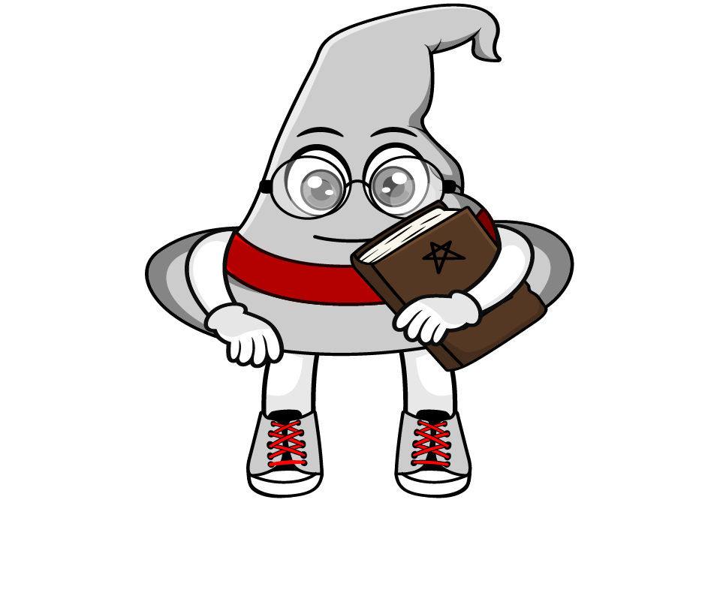

Lesson 2:
Recap: Adding lengths in different units
www.arithmagicians.com

Slide 2

Recap:
10
1 cm = ? mm
Tip: Use the ruler to help you

Slide 3

Recap:
100
1m = ? cm
10 cm
1m
Tip: Use the diagram to help you

Slide 4
Recap:
1000 m
1 km = ? m
100m
Tip: Use the diagram to help you

Slide 5


Solve:
5km + 50m = ? m
x1000
= 5050m
5000m + 50m
First, convert the units into m. Then add.

Slide 6


Your Turn
9.5 cm
1) 45 mm + 5 cm = ? cm
2150 mm
2) 2 m + 150 mm = ? mm
120 cm
3) 1 m + 10 cm + 100mm = ? cm
3500 m
4) 2 km + 1500 m = ? m
2.1 km
5) 1 km + 100 m + 1000 m = ? km

Slide 7
True or False
4km + 40m = 440km
False: Can you explain why?

