Slide 1


Lesson 2:
Recap: Hundredths as decimals
www.arithmagicians.com

Slide 2

Get ready to
count up in hundredths
0
1
$\frac{\text{0}}{\text{100}}$
$\frac{\text{10}}{\text{100}}$
$\frac{\text{20}}{\text{100}}$
$\frac{\text{30}}{\text{100}}$
$\frac{\text{40}}{\text{100}}$
$\frac{\text{50}}{\text{100}}$
$\frac{\text{60}}{\text{100}}$
$\frac{\text{70}}{\text{100}}$
$\frac{\text{80}}{\text{100}}$
$\frac{\text{90}}{\text{100}}$
$\frac{\text{100}}{\text{100}}$

Slide 3

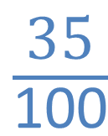
Hundredths
What fraction is shaded?
$\frac{\text{35}}{\text{100}}$

Slide 4
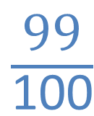
Hundredths
What fraction is shaded?
$\frac{\text{99}}{\text{100}}$

Slide 5

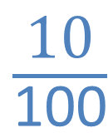
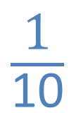
Hundredths
What fraction is shaded?
$\frac{\text{10}}{\text{100}}$
$\frac{\text{1}}{\text{10}}$
or
?

Slide 6




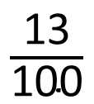
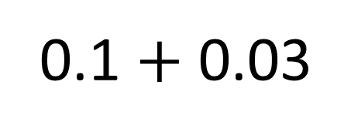
What is 13/100 as a decimal?
$\frac{\text{13}}{\text{100}}$
0.1 $+$ 0.03
0.13

Slide 7

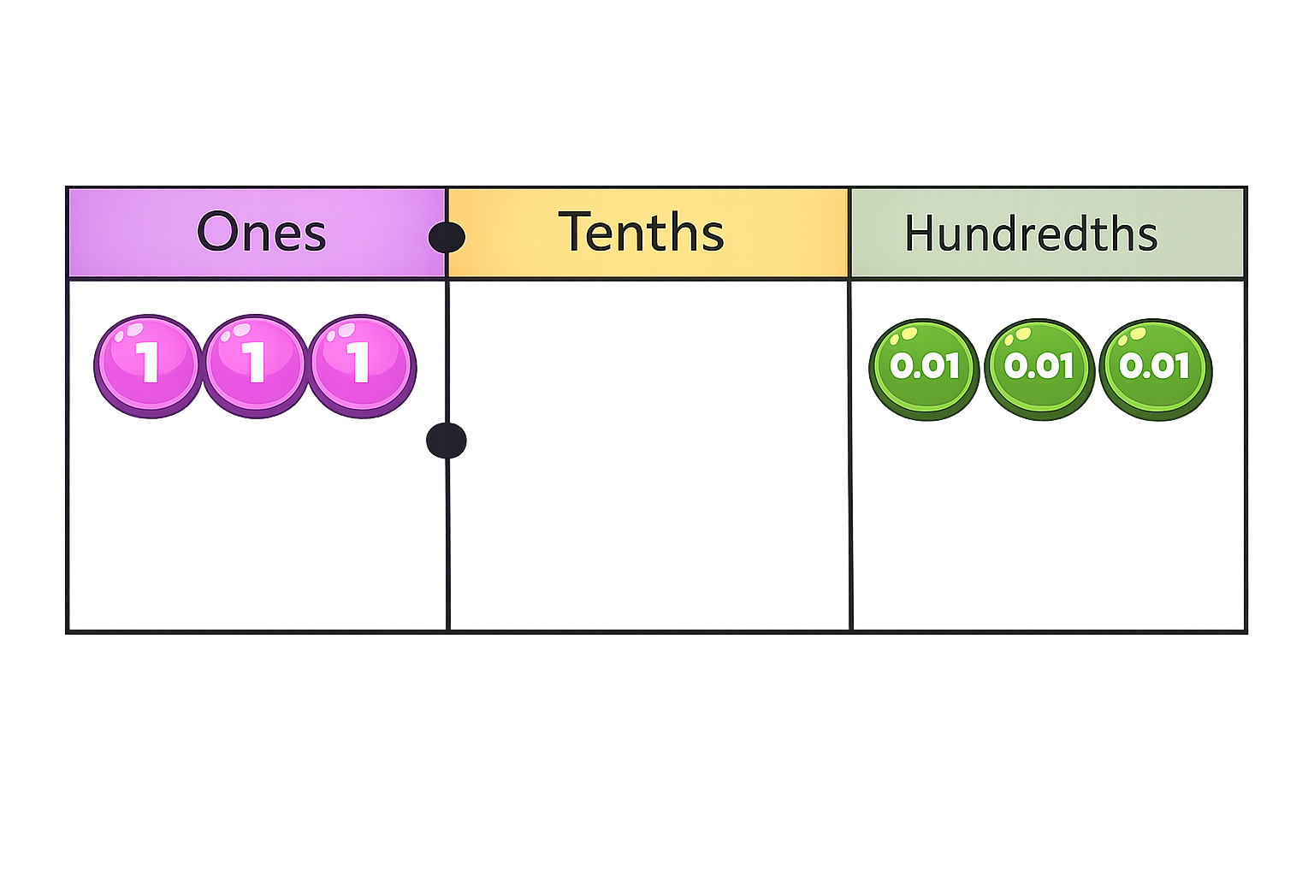
There are ones.
There are tenths.
There are hundredths.
The number represented is
3
0
3
3.03

Slide 8

What number is represented in the place value chart?
There are ones.
There are tenths.
There are hundredths.
The number represented is
0
0
6
0.06

Slide 9
Match the equivalent fractions and decimals.
50/100
0.5
37/100
0.09
9/100
0.37

Slide 10


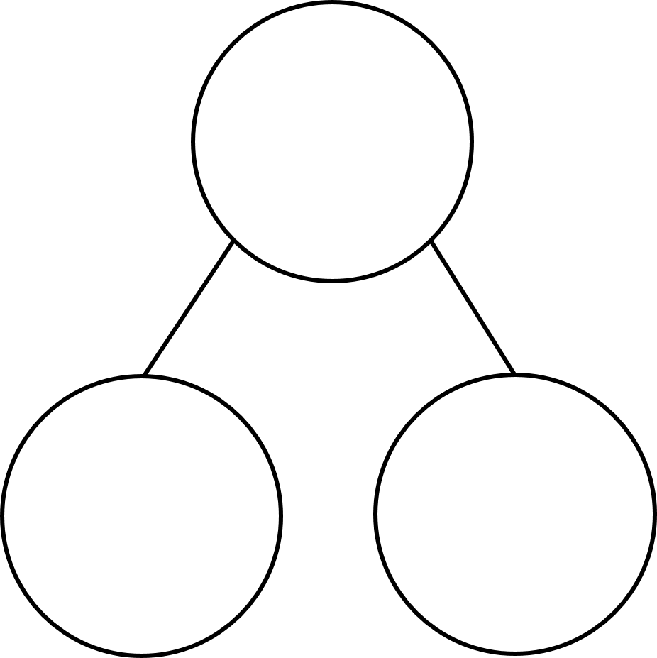
Your Turn
Partition 54 hundredths as
decimals in at least 4 different ways.
One example has been done for you.
0.54
0.54
0.54
0.54
0.5
0.04
0.4
0.14
0.3
0.24
0.2
0.34

