Slide 1


Lesson 3:
Recap: Adding different units
www.arithmagicians.com

Slide 2

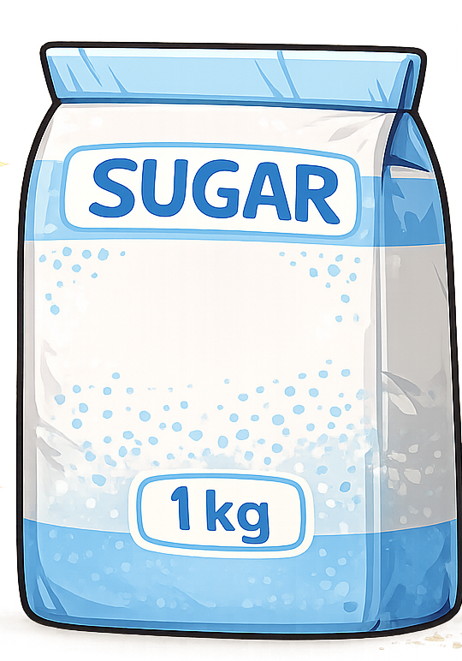
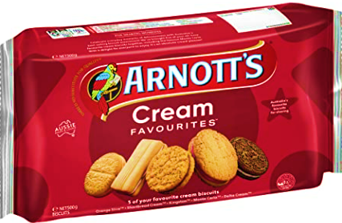
Recap:
1 kg = ? g
1000 g
=
500g
500g
Tip: Use the diagram to help you

Slide 3
Recap:
1000 ml
1 L = ? ml
Tip: Use the diagram to help you

Slide 4


Solve:
4L + 75ml = ? ml
x1000
= 4075ml
4000ml + 75ml
First, convert the units into ml. Then add.

Slide 5


Your Turn
1) 4 L + 250 ml = ? ml
4250 ml
6120 ml
2) 120 ml + 6 L = ? ml
9.45 kg
3) 9 kg + 450 g = ? kg
4) 1500 g + 3 kg = ? g
4500 g
11 kg
5) 1 kg + 10000 g = ? kg

Slide 6

True or False
2kg + 200g = 400g
False: Can you explain why?

