Slide 1


Lesson 3:
Recap: Tell the time
to the minute
www.arithmagicians.com

Slide 2

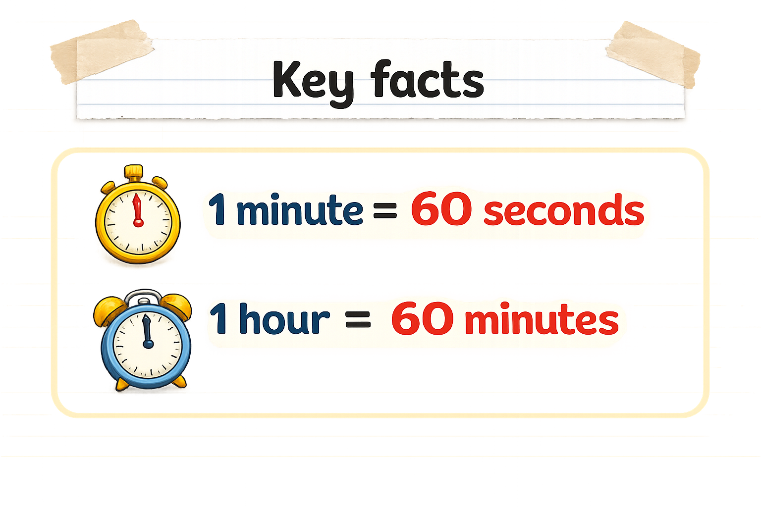
Recap:
?
?

Slide 3




Key Time Words
Minute Hand
The long hand that shows how many minutes have passed.
Hour Hand
The short hand that points to the main hour.
1 - minute interval
The gap between each number on the clock.

Slide 4

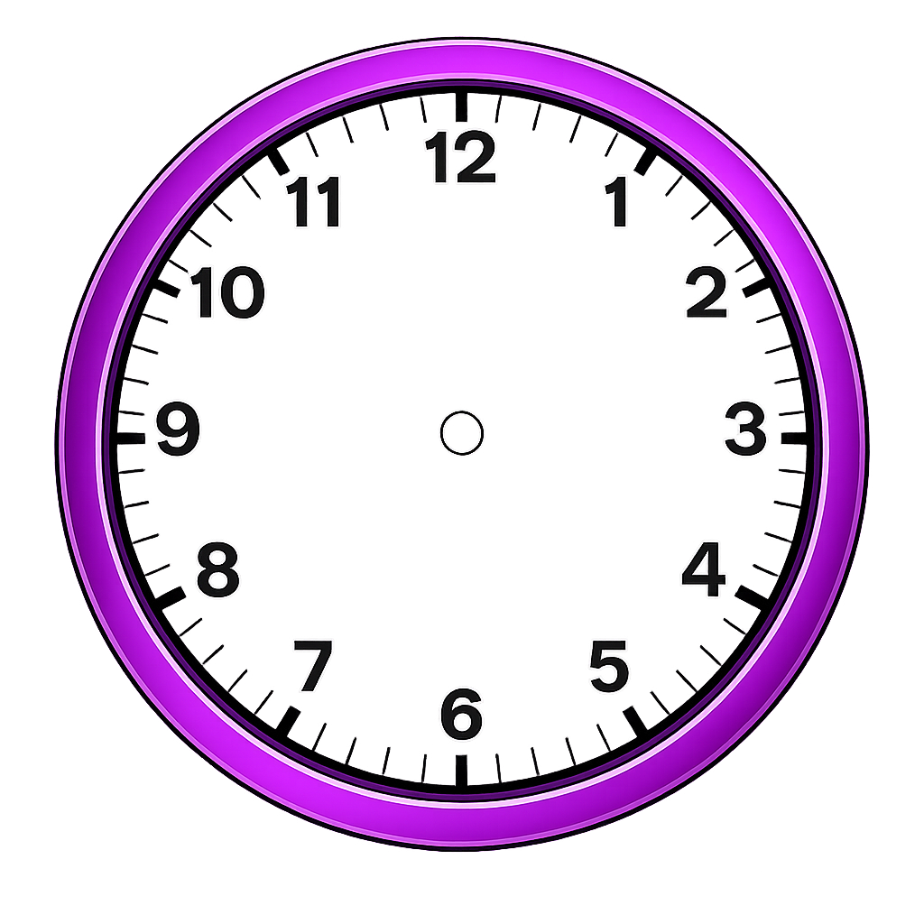
Each tiny interval on the clock face represents
1 minutes.
What time is shown by the clock?
What time is shown by the clock?
When it points to 3, it is 15 minutes past or ?
When it points to 6, it is 30 minutes past or ?
When it points to 9, it is 45 minutes past or ?

Slide 5


Your Turn
Write down the time shown in words
A
B
C
D
17 minutes past 5
7 minutes
past 5
49 minutes
past 2
or
11 minutes to 3
58 minutes
past 5
or
2 minutes to 6

Slide 6
True or False
The time shown is
8 minute past 4
False

