Slide 1


Lesson 3:
Recap: Halves as decimals
www.arithmagicians.com

Slide 2

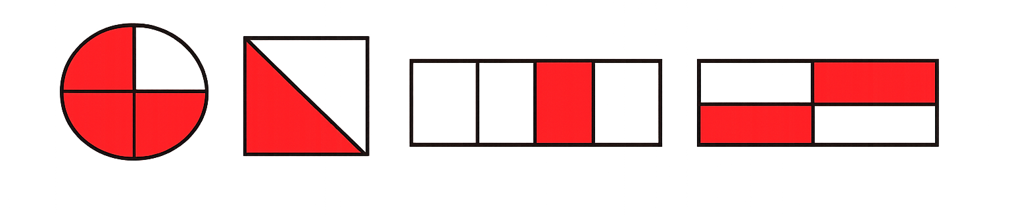
Which images have 0.5 shaded?
A
B
C
D

Slide 3








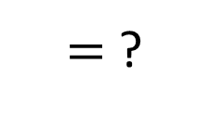






What fraction is shown in the representation?
$\frac{\text{1}}{\text{2}}$
$$= \frac{?}{10}$$
$=$ $\frac{?}{100}$
$$= \frac{?}{10}$$
$$= \frac{?}{100}$$
$=\frac{\text{5}}{\text{10}}$
$=\frac{\text{50}}{\text{100}}$
$\frac{\text{1}}{\text{2}}$
$=\frac{\text{5}}{\text{10}}$
$=\frac{\text{50}}{\text{100}}$
$\frac{\text{1}}{\text{2}}$
$=\frac{\text{5}}{\text{10}}$
$=\frac{\text{50}}{\text{100}}$
0.5
$=$ ?

Slide 4


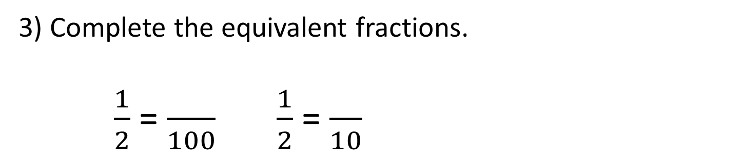
Your Turn
1) How many hundredths are shaded?
50
2) How many tenths are shaded?
5
3) Complete the equivalent fractions.
$\frac{1}{2}$ = $\frac{}{100}$ $\frac{1}{2}$ = $\frac{}{10}$
50
5
4) Write ½ as a decimal:
0.5

