Slide 1
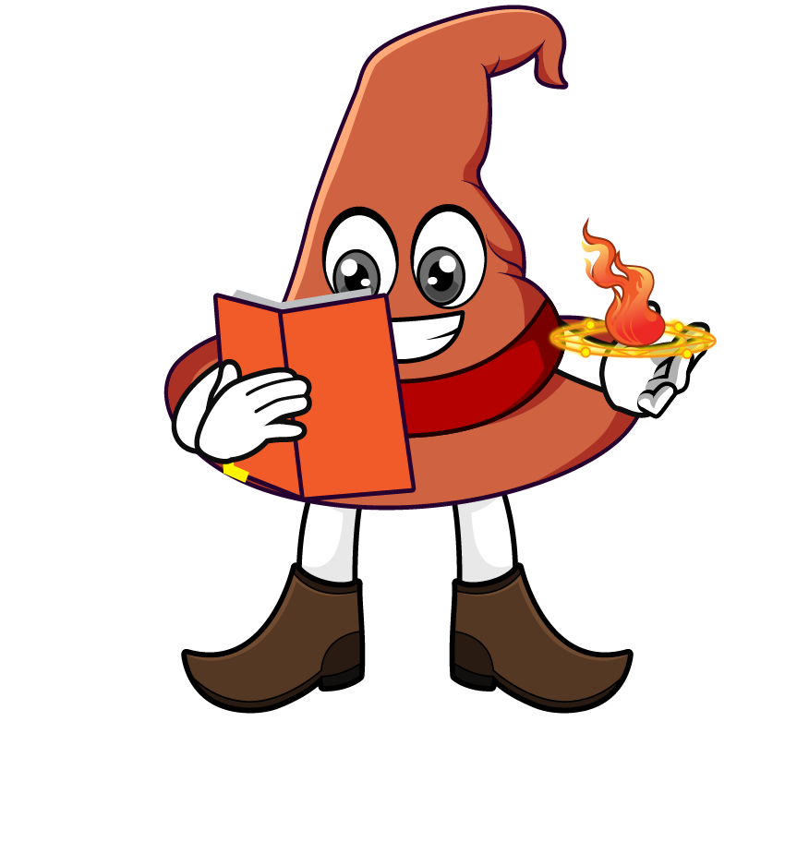

Lesson 4:
Recap: Convert units of measure involving fractions
www.arithmagicians.com

Slide 2

Recap:
Convert the fractions
into a decimal.
$1/2$ = ?
$1/5$ = ?
0.5
0.2
$1/4$ = ?
$1/{10}$ = ?
0.25
0.1
$3/4$ = ?
$1/{100}$ = ?
0.75
0.01

Slide 3

150cm
1 $\frac{1}{2}$ m = ? cm
I know that :
1m = 100cm
$\frac{1}{2}$ x 100 = 50 cm
Therefore :
So :
100 cm + 50 cm = 150cm
100cm
50cm
50cm

Slide 4
2750g
2 $\frac{3}{4}$ kg = ? g
I know that:
1kg = 1000g
$\frac{3}{4}$ x 1000 = 750 g
Therefore :
So :
2000 g + 750 g = 2750g
1000g
250g
250g
250g
250g

Slide 5
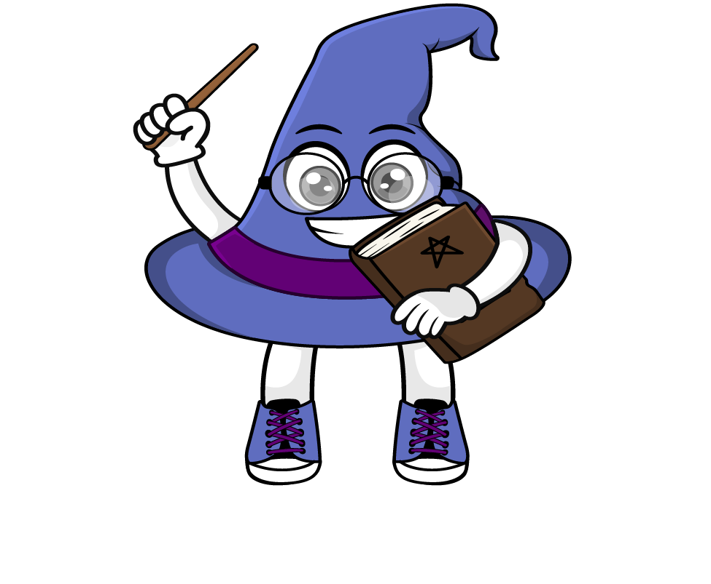
6m
3.5 m + 2 $\frac{1}{2}$ m = ? m
First, convert the mixed number into a decimal
Now add them all up.
2 $\frac{1}{2}$ m ​= 2.5 m
3.5 m + 2 $\frac{1}{2}$ m = 3.5 m + 2.5 m = 6 m

Slide 6


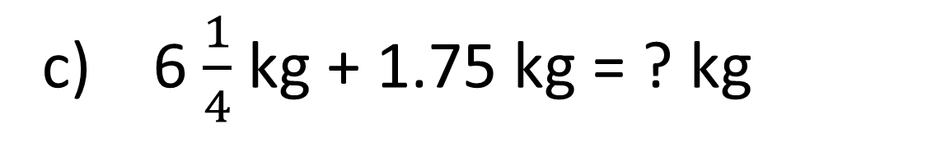
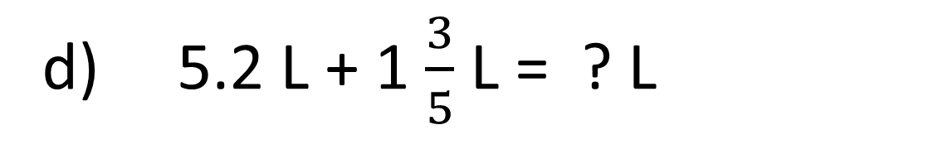
Your Turn
2500 m
a) 2 $\frac{1}{2}$ km = ? m
175 cm
b) 1 $\frac{3}{4}$ m = ? cm
8 kg
c) 6 $\frac{1}{4}$ kg + 1.75 kg = ? kg
6.8 L
d) 5.2 L + 1 $\frac{3}{5}$ L = ? L

Slide 7
True or False
2 $\frac{1}{2}$ kg + 50g = 3 kg
False

