Slide 1


Lesson 4:
Recap: Calculate missing time intervals in minutes
www.arithmagicians.com

Slide 2

Recap:
When the minute hand is pointing to 2,
it is ___ minutes past the hour.
b) When the minute hand is pointing to 4,
it is ___ minutes past the hour.
c) When the minute hand is pointing to 8,
it is ___ minutes past the hour.
10
20
40

Slide 3


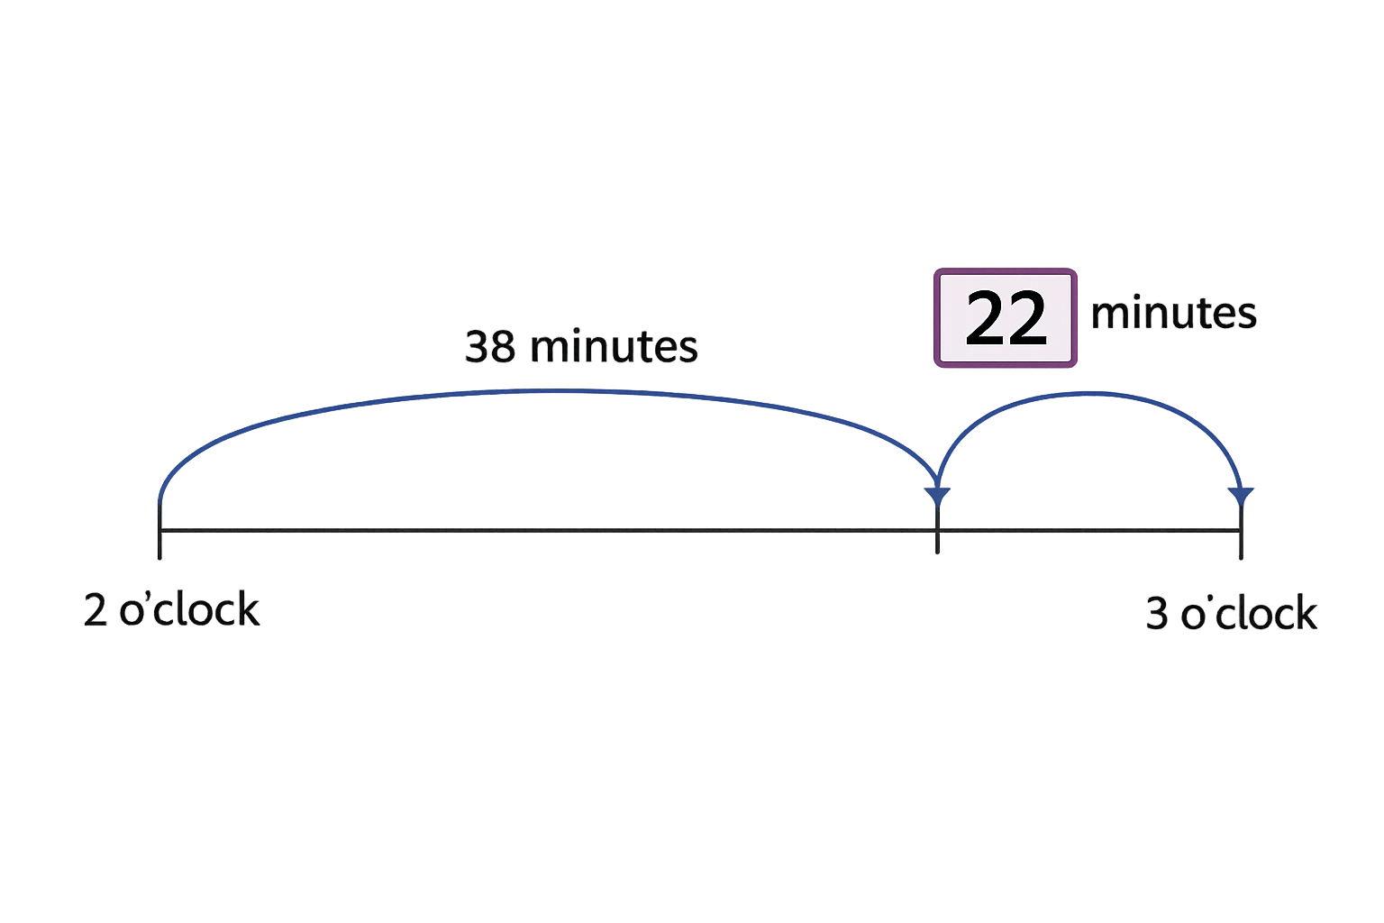
So:
60 – 38 = 22
I know that:
1 hour = 60 minutes
Therefore, the missing number is 22 minutes.
?

Slide 4

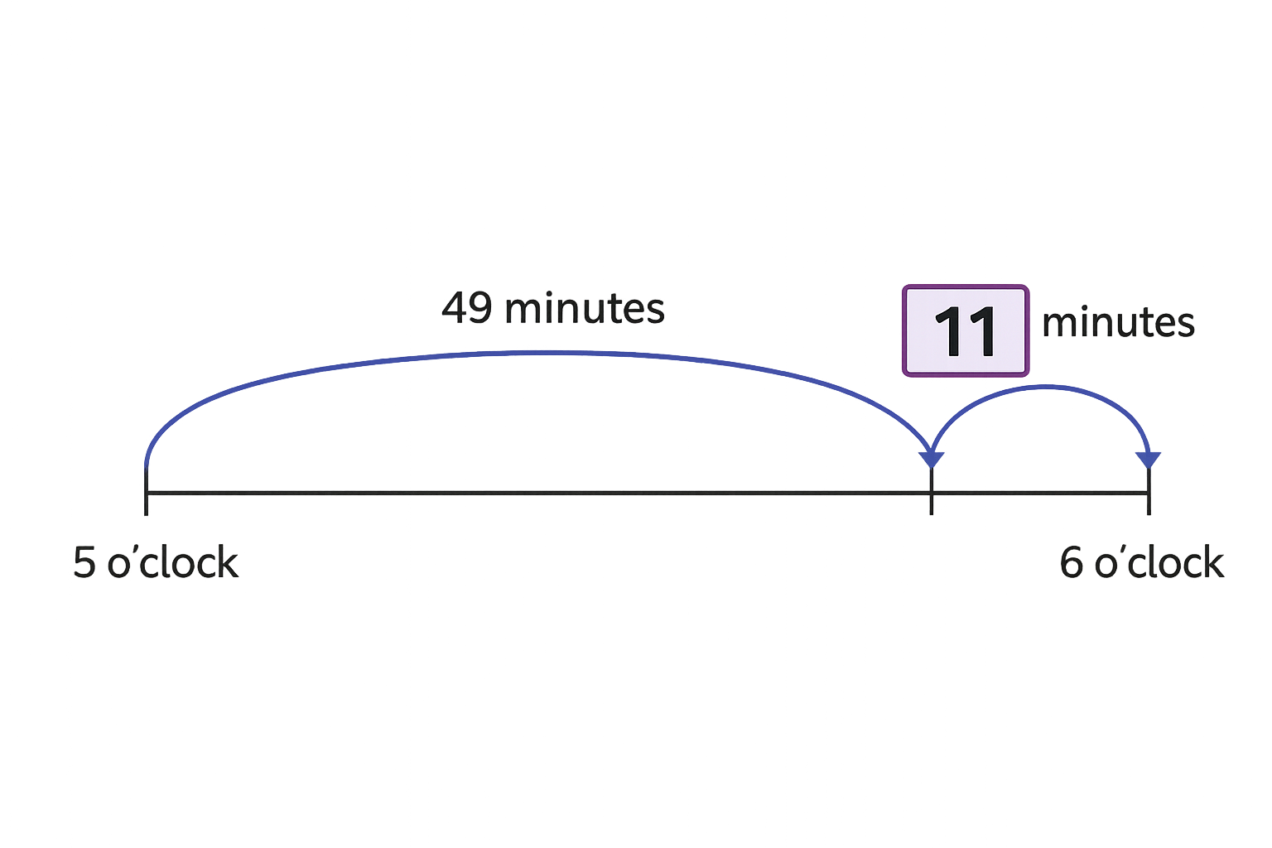

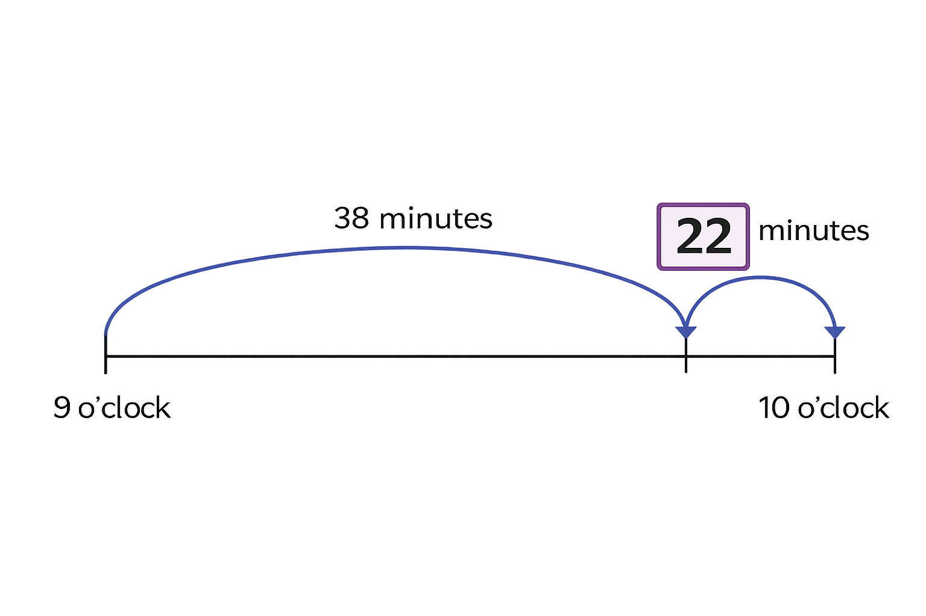
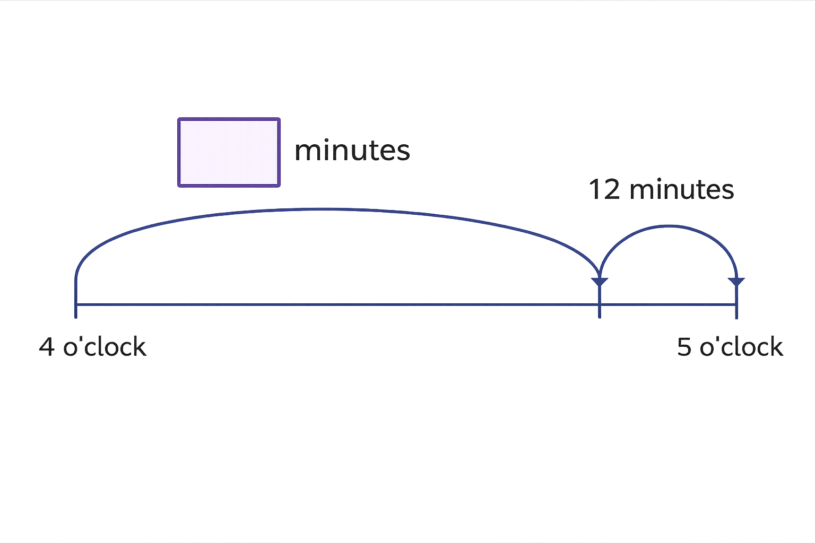
Your Turn
?
A)
?
B)
48
?
C)

Slide 5
True or False
If 12 minutes are left until 5 o’clock, then 48 minutes have passed.
True

