Slide 1


Lesson 4:
Recap: Quarters as decimals
www.arithmagicians.com

Slide 2

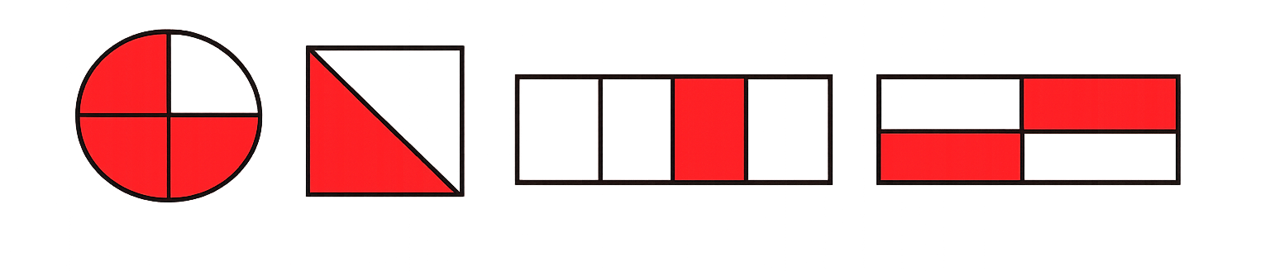
Which image has 0.25 shaded?
A
B
C
D

Slide 3
Which image has 0.75 shaded?
A
B
C
D

Slide 4

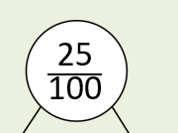
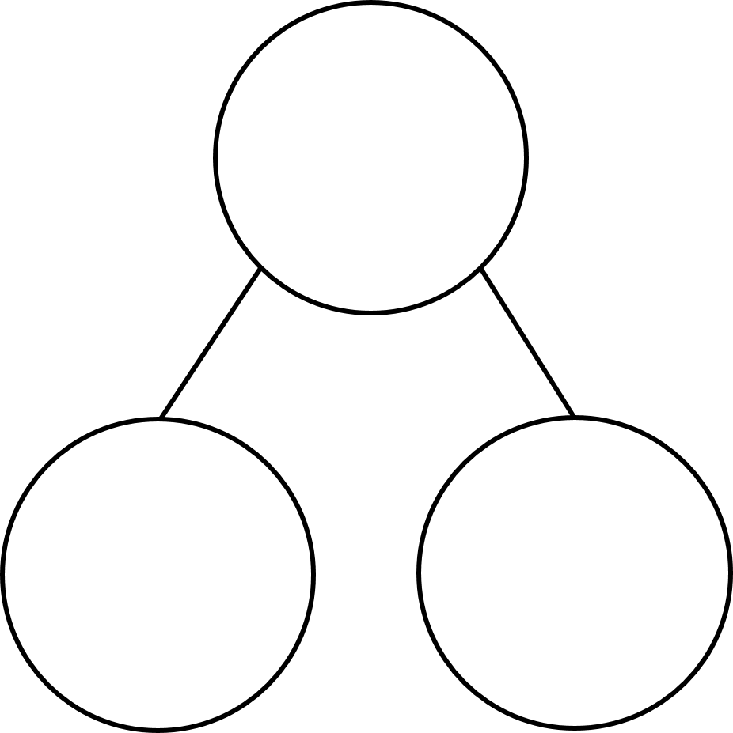

What fraction is shown in the representation?
$\frac{\text{25}}{\text{100}}$
0.25
$\frac{\text{20}}{\text{100}}$
$\frac{\text{5}}{\text{100}}$
$\frac{\text{2}}{\text{10}}$
0.05
0.2

Slide 5
What fraction is shown in the representation?
$=$ $\frac{?}{100}$
$\frac{\text{1}}{\text{4}}$
$=$ $\frac{25}{100}$
$=$ 0.25

Slide 6

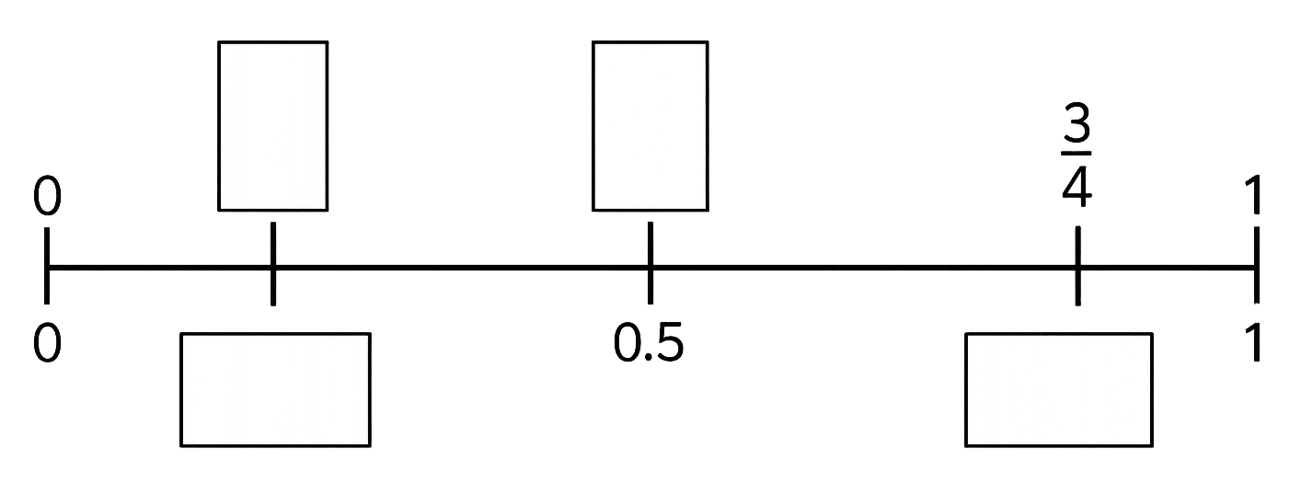
Complete the missing fractions and decimals on the number line.
¼
½
A
C
0
0
0.5
B
D
0.25
0.75

Slide 7


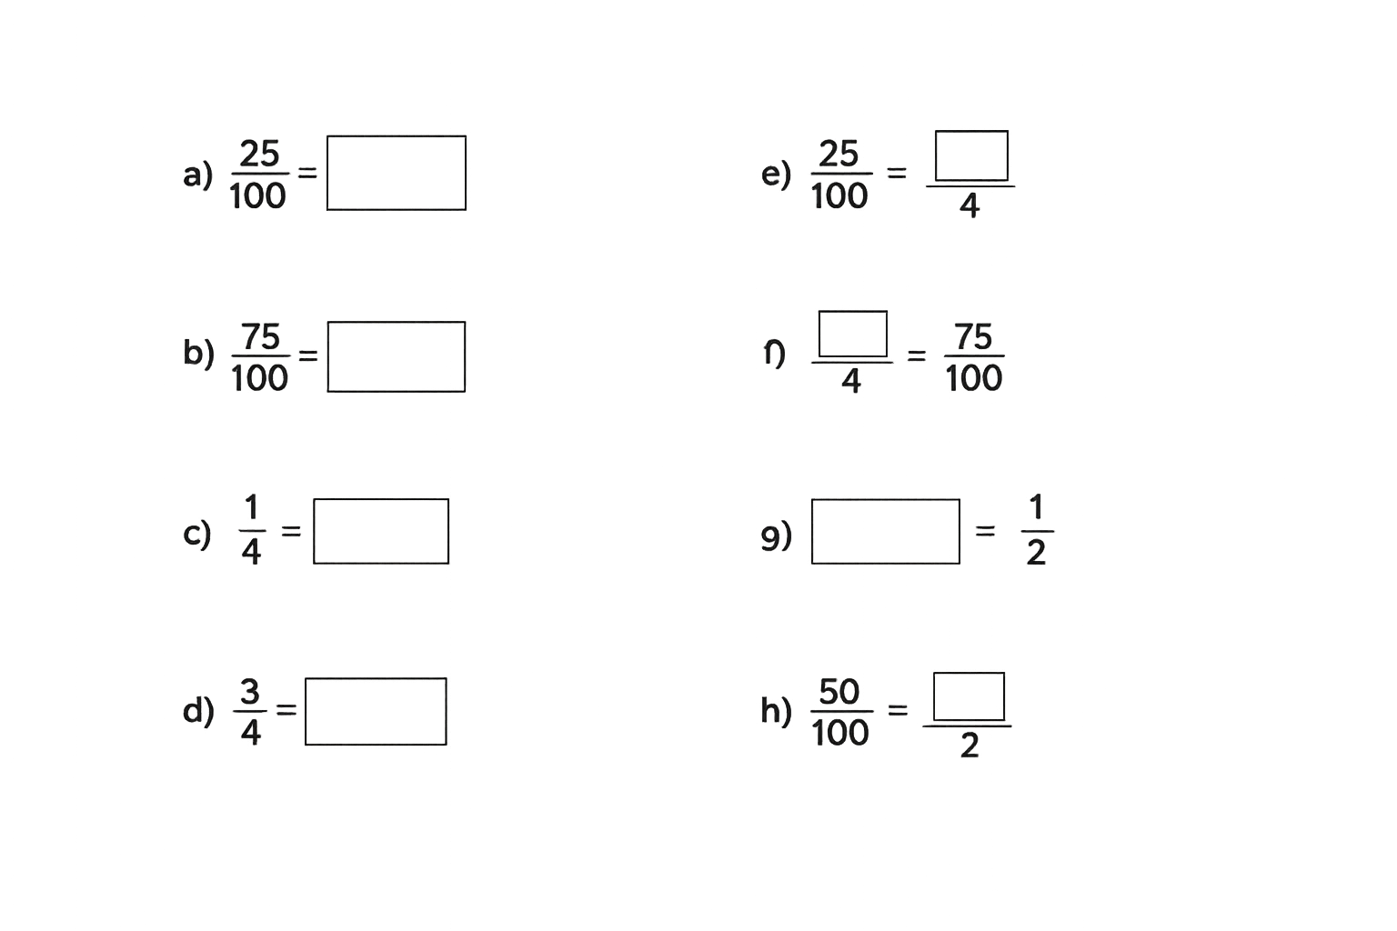
Your Turn
Complete the equivalent fractions and decimals.
1
0.25
3
0.75
f)
0.25
0.5
0.75
1

