Slide 1
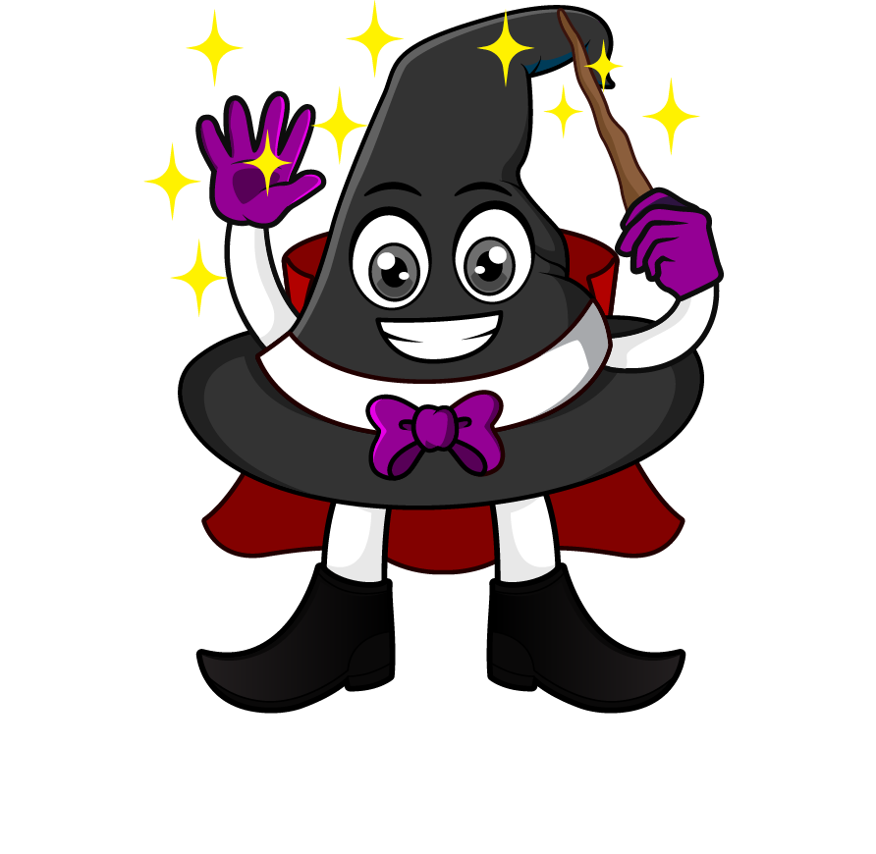

Lesson 5:
Assess and Review
www.arithmagicians.com

Slide 2

Recap:
1.5 cm = ? mm
15 mm
10 m = ? cm
1000 cm
2.3 kg = ? g
2300 g
4.2 L = ? ml
4200 ml
0.5 km = ? m
500 m

Slide 3
A race is 3 km long. Sam has already run 1,450 m. How much further does he need to run in m?
3000 m
1450m
?
?
1550m
3000 – 1450 =

Slide 4
A recipe needs 2 litre of milk. Amy has 3 bottles of 500 ml each. How much more milk does she need?
2000 ml
500ml
500ml
500ml
?
?
500ml
2000 – 1500 =

Slide 5

A jug contains 1.5 litres of juice. 450 ml is poured into cups. How much juice is left in ml?
1500 ml
?
450ml
?
1050 ml
1500 - 450 =

Slide 6
A bag of flour weighs 1.5 kg. A bag of sugar weighs 750 g. What is the total mass in grams?
?
1500g
750g
?
2250g
1500 + 750 =

