Slide 1


Lesson 5:
Assess and Review
www.arithmagicians.com

Slide 2

Recap:
How many seconds in one minute?
How many minutes in one hour?
60 seconds
60 minutes

Slide 3
Recap:
24
There are _______ hours in one day.
7
There are _______ days in one week.
365
There are _______ days in a year.
366
There are _______ days in a leap year.

Slide 4
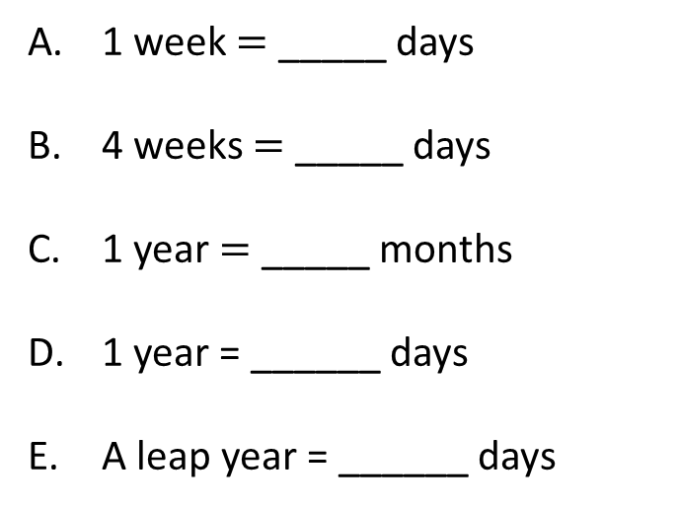
Recap:
Days, Weeks, Months
7
1 week $=$ _____ days
4 weeks $=$ _____ days
1 year $=$ _____ months
1 year = ______ days
A leap year = ______ days
28
12
365
366

Slide 5


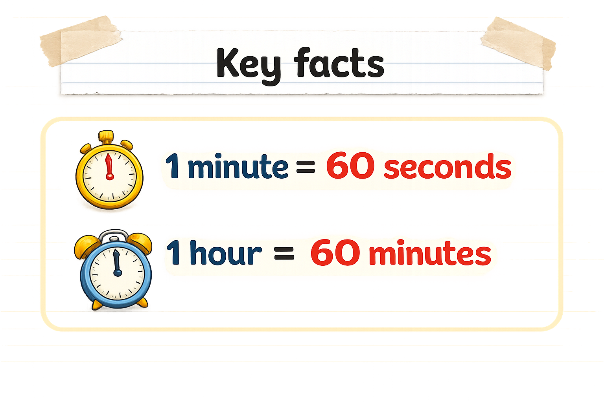
Your Turn
3 minutes = ___ seconds
120 seconds = ___ minutes
2 hours = ___ minutes
180
2
120
Tip: Use bar models to help you.

Slide 6
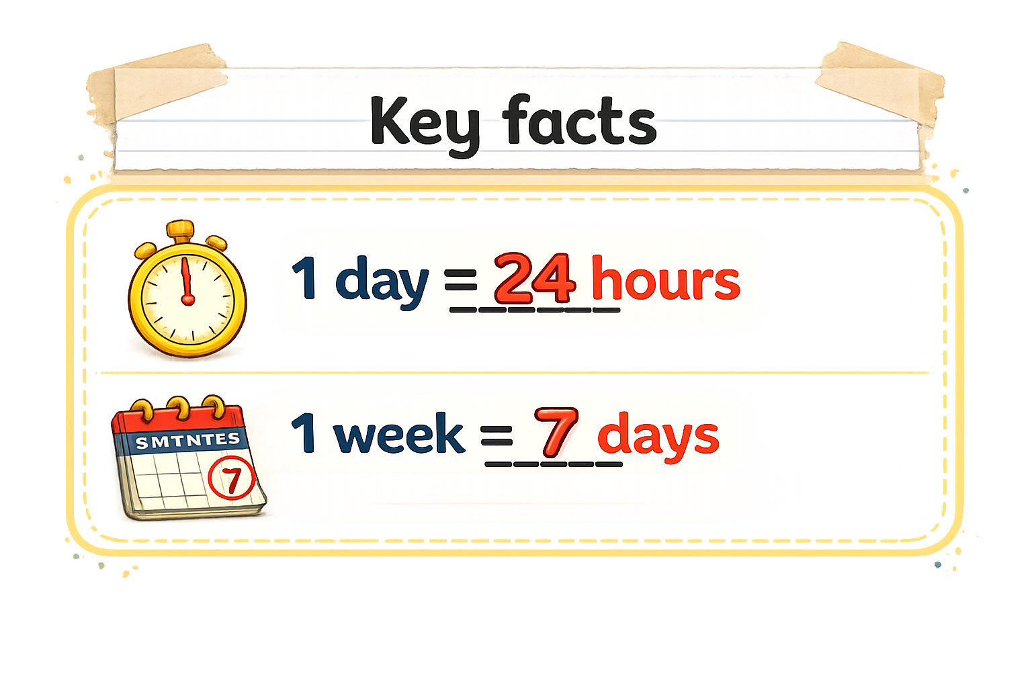
Your Turn
72 hours = ___ days
28 days = ___ weeks
4 days = ___ hours
3
4
96
Tip: Use bar models to help you.

