Slide 1

Lesson 2:
Recap - Add 2 to any number
www.arithmagicians.com

Slide 2

+1
+1
+1
+1
+1
+1
+1
+1
+1
+1
60
61
62
63
64
65
66
67
68
69
70
Get ready to count up in 1s

Slide 3

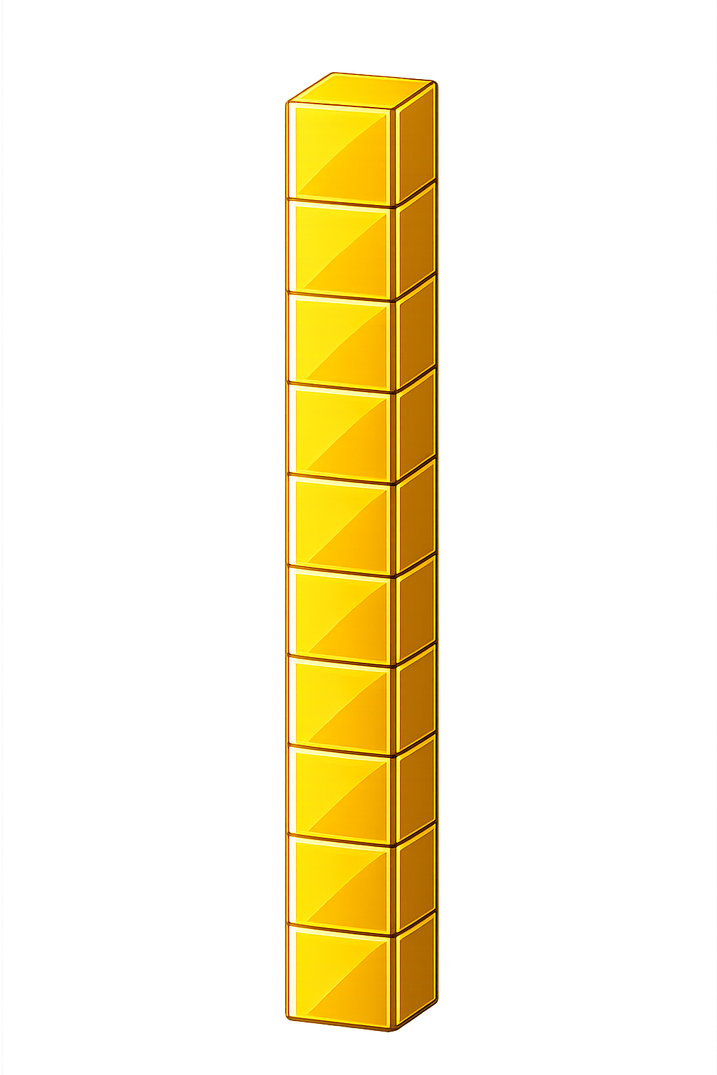

What number is shown below?
26
28
+ 2 = ?

Slide 4
What number is shown below?
We exchange 10 ones
for 1 ten
What happens if the number has 8 ones and we add 2 more??
28
30
+ 2 = ?

Slide 5
What number is shown below?
Remember: exchange 10 ones
for 1 ten
29
31
+ 2 = ?

Slide 6

55
56
57
58
59
60
61
?
?
62
63
64
65
+
=
59
2
61

Slide 7


Your Turn
80
78 + 2 = ?
81
2) 79 + 2 = ?
40
3) 38 + 2 = ?
4) ? + 2 = 50
48
5) ? + 2 = 61
59

