Slide 1

Lesson 3:
Recap: Subtract 1 from
any number
www.arithmagicians.com

Slide 2


-1
-1
-1
-1
-1
-1
-1
-1
-1
-1
30
31
32
33
34
35
36
37
38
39
40
Get ready to count back in 1s

Slide 3

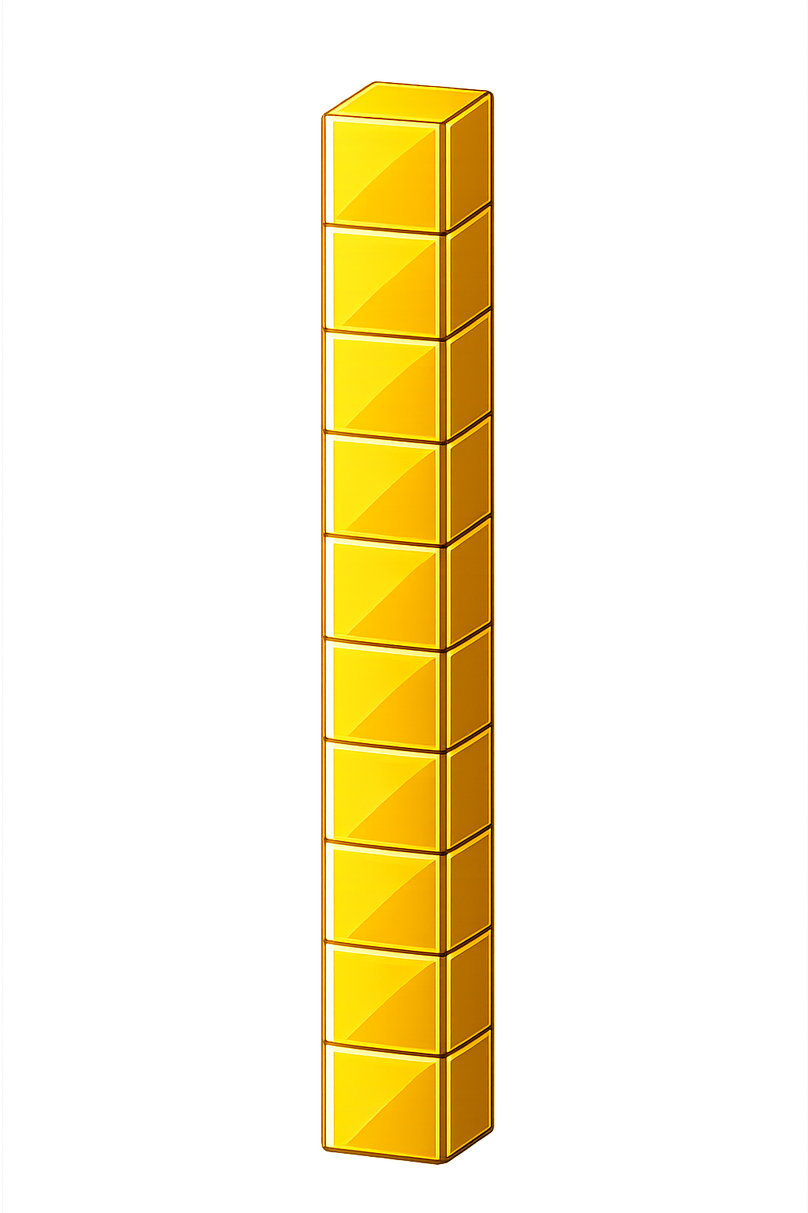

What number is shown below?
29
28
- 1 = ?

Slide 4
What number is shown below?
We exchange one ten for ten ones.
What happens if we have no ones to remove?
40
39
- 1 = ?

Slide 5

74
75
76
77
78
?
80
81
82
83
84
79
80
-
1
=
79

Slide 6


Your Turn
20 - 1 = ?
19
49
2) 50 - 1 = ?
69
3) 70 - 1 = ?
4) ? - 1 = 39
40
30
5) ? - 1 = 29

