Slide 1

Lesson 1:
Subitise to 20
www.arithmagicians.com

Slide 2

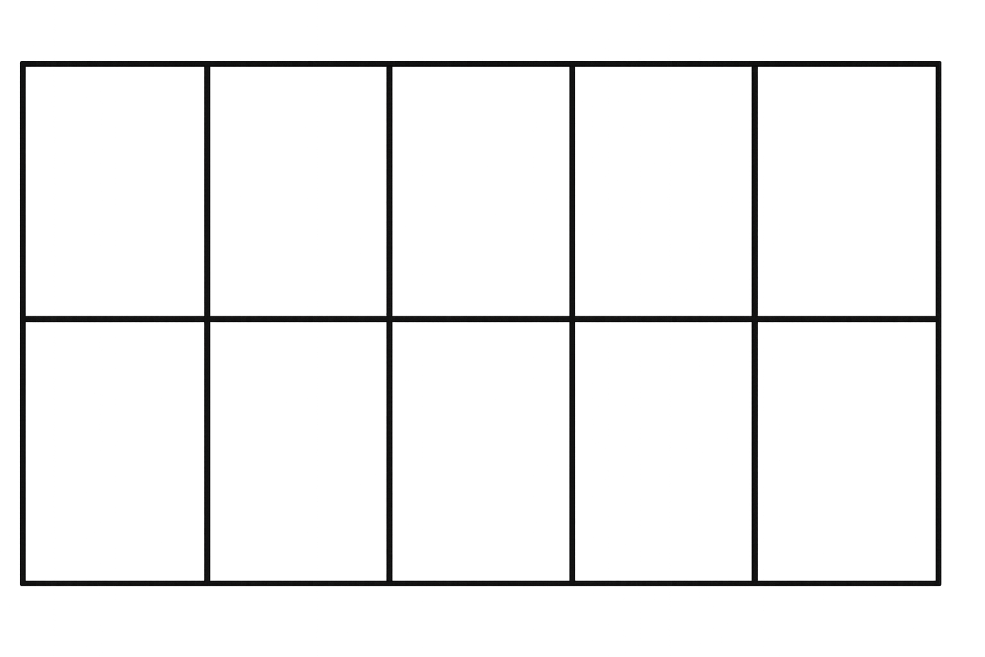
What do you see?
How do you see it?
10
6
I see ___ and ___
16
There are ___ altogether.

Slide 3
What do you see?
How do you see it?
10
3
I see ___ and ___
13
There are ___ altogether.

Slide 4
What do you see?
How do you see it?
10
9
I see ___ and ___
19
There are ___ altogether.

Slide 5

Work in pairs.
Take up to 20 counters.
Make two groups and arrange
them like the examples we did.
Show your partner - how many altogether?
I can see __ and __ .
There are __ altogether.

Slide 6

True or False
If you see 18 dots,
you must always count from 1.
False

