Slide 1

Lesson 2:
Add 10 to a single
digit number
www.arithmagicians.com

Slide 2

What is a single digit number?
A single digit number is a number that has only one digit.
Examples: 0, 1, 2, 3, 4, 5, 6, 7, 8, 9

Slide 3

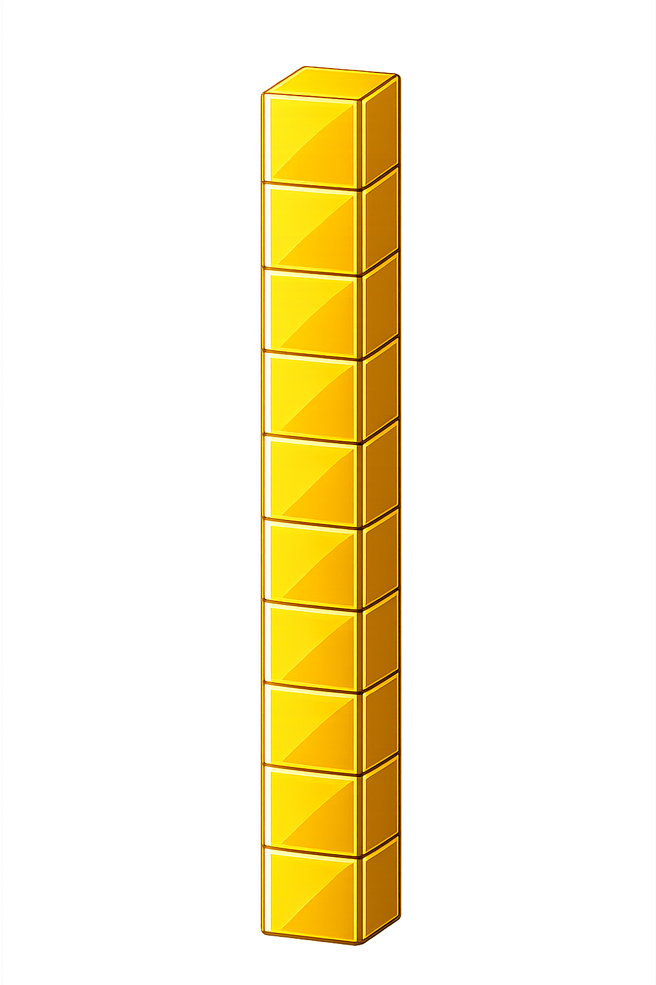

What do you see?
10
8
I see ___ and ___
18
10 + 8 = ___

Slide 4


+
10
+
3
=
13

Slide 5
16
?
6
10

Slide 6
What do you notice?
10
+
8
=
18
10
+
3
=
13
When I add ____ to a single digit number,
I simply add _____ ten and keep the ones the _____.
10
one
same

Slide 7


Your Turn
+
= ?
10
17
A)
7
9
19
+
= ?
10
B)
= ?
+
14
4
C)
10
+
= 15
10
?
D)
5

Slide 8
True or False
When I add 10 to a single digit number, only the tens change.
True

