Slide 1

Lesson 3:
Find Number Bonds To 20
www.arithmagicians.com

Slide 2

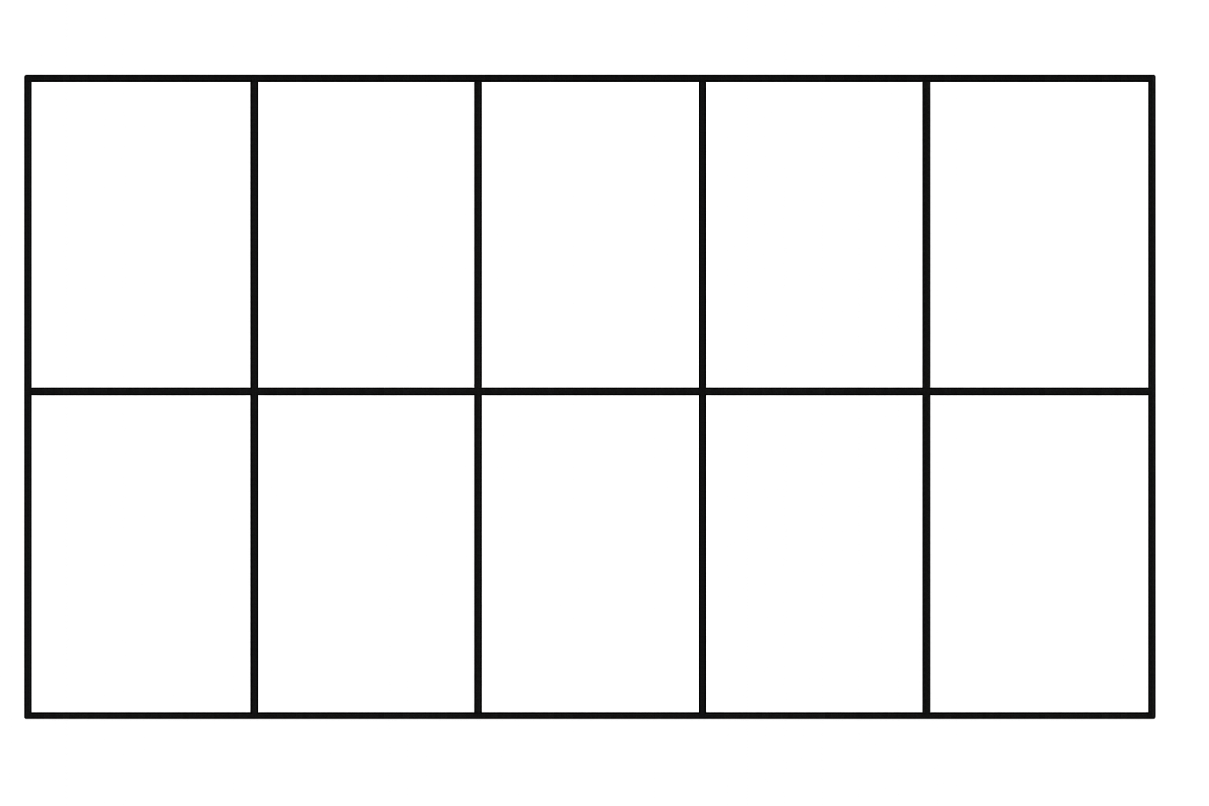

Complete the sentences to match the ten frame.
There are ___ red counters.
There are ___ yellow counters.
Altogether there are ___ counters.
6
4
10
6 $+$ 4 $=$ __
10

Slide 3

Complete the sentences to match the ten frame.
There are ___ red counters.
There are ___ yellow counters.
Altogether there are ___ counters.
16
4
20
20
16 $+$ 4 $=$ __

Slide 4


What do you notice?
6 $+$ 4 $=$ __
10
16 $+$ 4 $=$ __
20

Slide 5


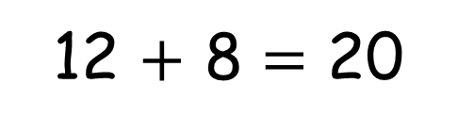
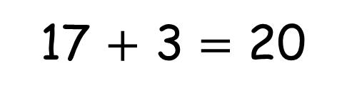
Your Turn
17 $+$ 3 $=$ 20
12 $+$ 8 $=$ 20
What other bonds to 20 can you find?
Can you find 11 different number bonds to 20?

Slide 6
Your Turn
0 + 20
1 + 19
2 + 18
3 + 17
4 + 16
5 + 15
6 + 14
7 + 13
8 + 12
9 + 11
10 + 10

Slide 7

True or False
16 + 4 = 4 + 16
True

