Slide 1

Week 2:
Assess & Review
www.arithmagicians.com

Slide 2

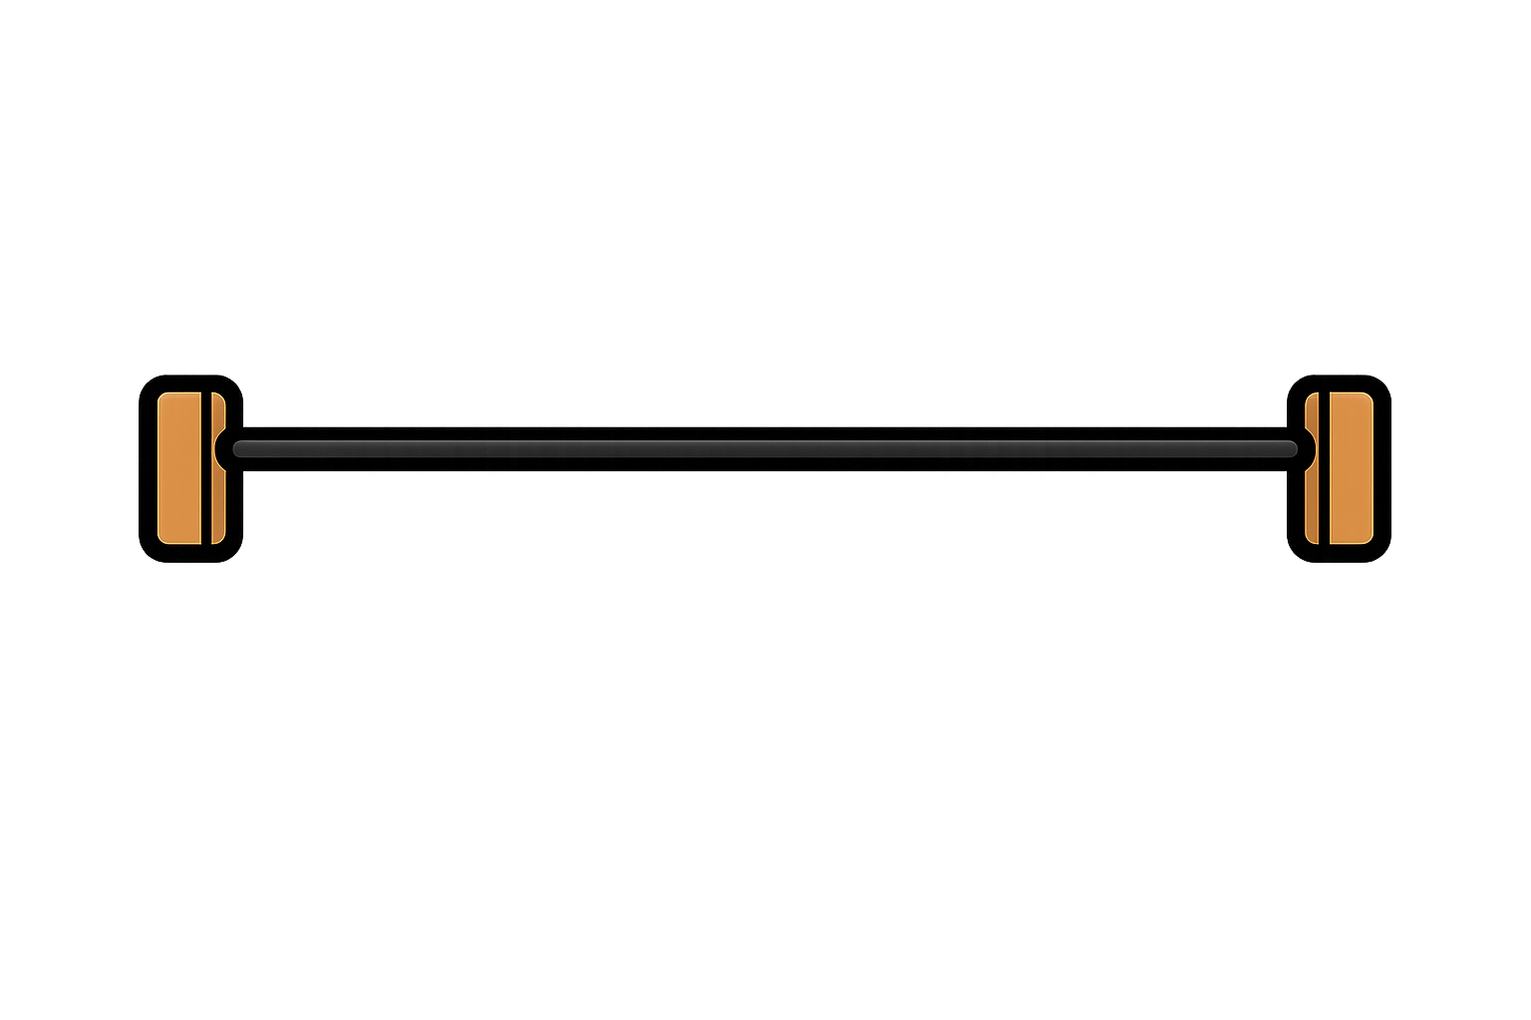
How many beads can you see?
20
I can see ___

Slide 3



There are 20 beads.
How many are missing?
20
15
5

Slide 4
There are 20 beads.
How many are missing?
20
17
3

Slide 5
There are 20 beads.
How many are missing?
20
16
4

Slide 6
There are 20 beads.
How many are missing?
20
18
2

Slide 7

