Slide 1

Lesson 2:
Part whole models
www.arithmagicians.com

Slide 2



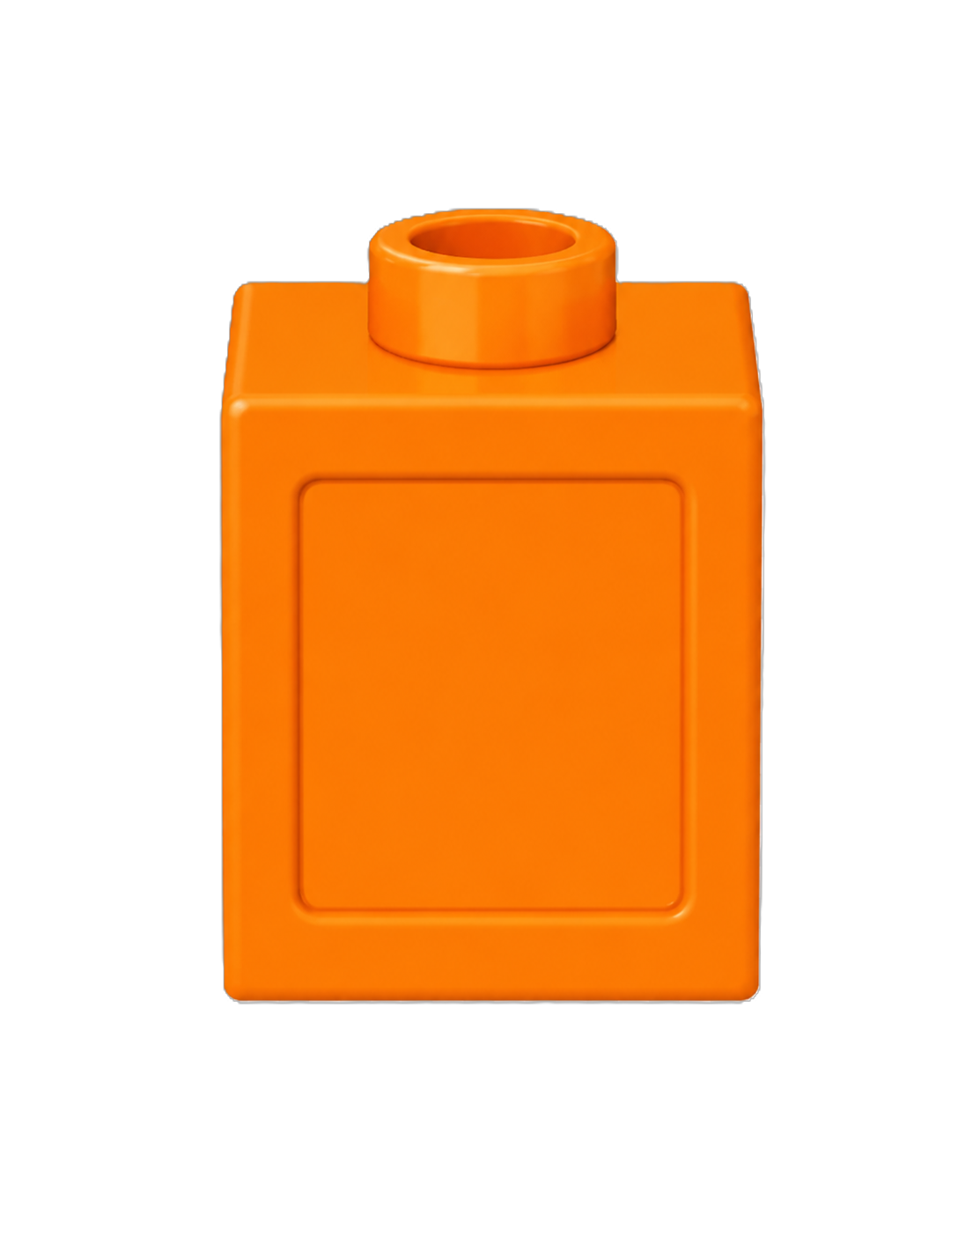
There are ___ red cubes.
There are ___ blue cubes.
There are ___ cubes altogether.
16
There are 20 orange cubes.
4
20

Slide 3
16 + 4 = 20
16
is a part.
?
20
is a part.
?
4
16
4
20
is the whole.
?

Slide 4


Your Turn
The whole is 20
Complete the part-whole models in different ways.
How many different ways can you make the whole?
5
20
20
20
18
2
19
1
15

Slide 5
True or False
The part-whole model is correct.
False
17
20
3

