Slide 1

Lesson 3:
Write number sentences
www.arithmagicians.com

Slide 2

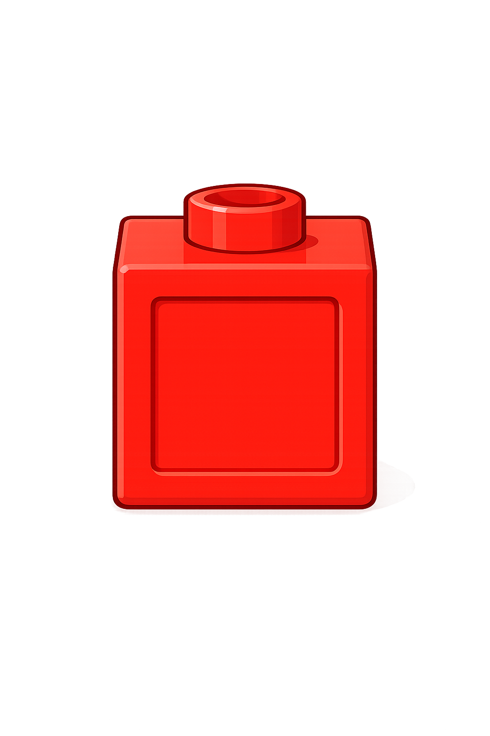

Whole
Part
Part
+
=
16
4
20
16
+
=
4
20

Slide 3

Whole
Part
Part
+
=
14
6
20
+
=
6
14
20

Slide 4


Your Turn
Whole
Part
Part
+
=
1
19
20
+
=
19
1
20

Slide 5
Your Turn
Whole
Part
Part
+
=
17
3
20
17
+
=
3
20

Slide 6
True or False
Whole
Part
Part
The part-whole model is correct.
15
+
=
False
5
20

