Slide 1

Week 3:
Assess & Review
www.arithmagicians.com

Slide 2



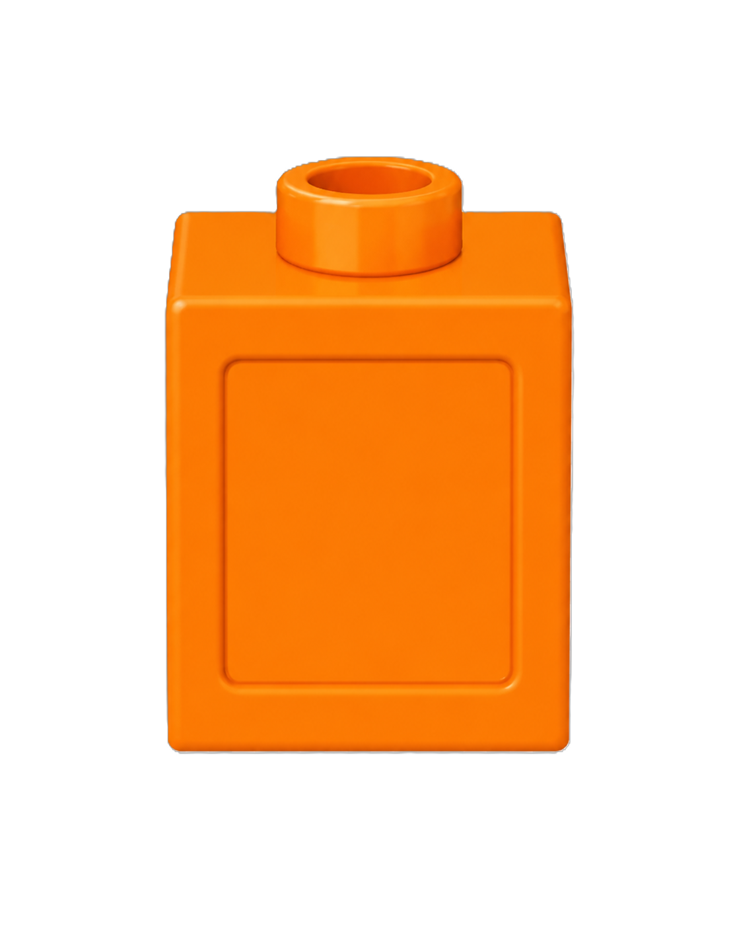
There are ___ red cubes.
There are ___ blue cubes.
There are ___ cubes altogether.
16
There are 20 orange cubes.
4
20

Slide 3
16 + 4 = 20
16
is a part.
?
20
is a part.
?
4
16
4
20
is the whole.
?

Slide 4


Your Turn
The whole is 20
Complete the part-whole models in different ways. How many different ways can you find?
20
20
20
1
19
2
18
10
10
20
20
20
3
17
5
15
7
13

Slide 5
True or False
The part-whole model is correct.
False
19
1
20

