Slide 1

Lesson 2:
Find the missing part.
www.arithmagicians.com

Slide 2

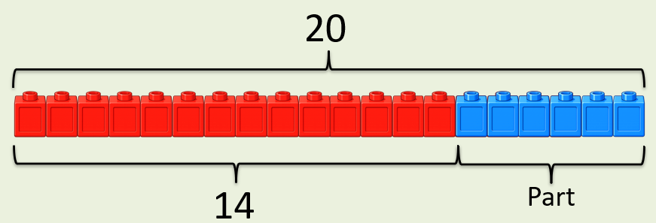
+
6
?
14
= 20
If the whole is ____ and ___ is a part, then the other part is
20
14
6
20
14
?

Slide 3
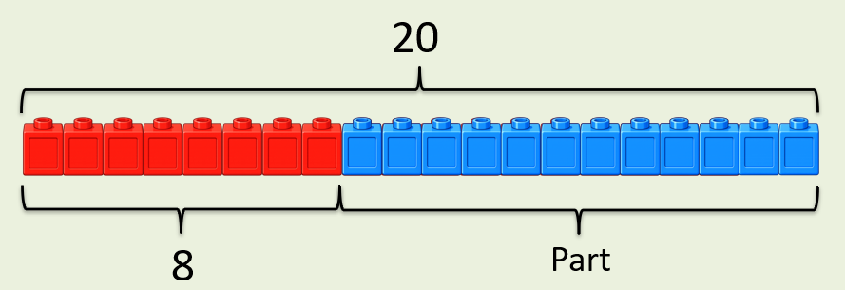
+
12
?
8
= 20
If the whole is ____ and ___ is a part, then the other part is
20
8
12
20
8
?

Slide 4


Your Turn
What is the missing part?
+
17
?
A)
3
= 20
+
13
?
B)
7
= 20
+
9
?
C)
11
= 20
18
+
= 20
?
D)
2

Slide 5
True or False
The missing part can be 3.
+
= 20
18
?
False: Can you explain why?

