Slide 1
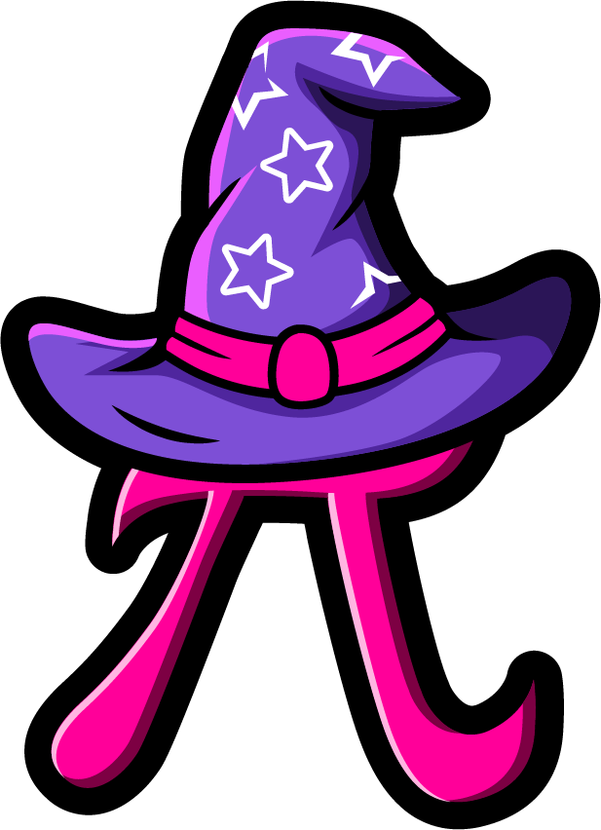
Lesson 3:
Find the missing part.
www.arithmagicians.com

Slide 2

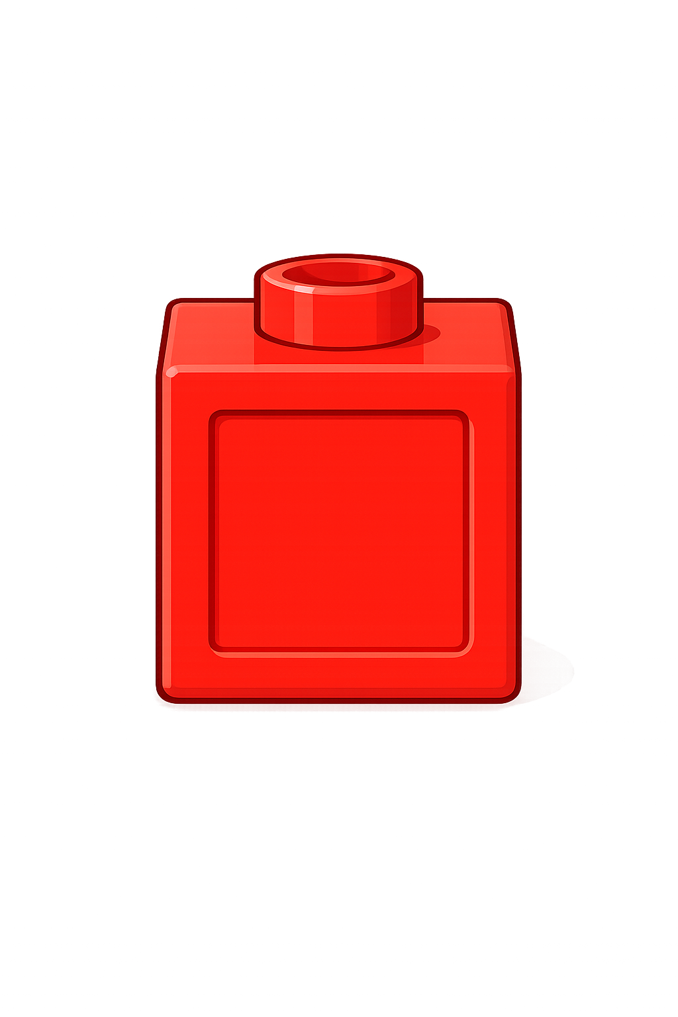



So,
? = 19
The whole is 20
1 is a part
The other part is 19
+
19
1
?
= 20
20
Part
Part

Slide 3


So,
? = 3
The whole is 20
The other part is 3
17 is a part
+
3
17
?
= 20
20
Part
Part

Slide 4


Your Turn
+
6
= 20
14
A)
?
8
?
+
= 20
12
B)
+
= 20
?
4
C)
16
+
= 20
?
13
D)
7

Slide 5

True or False
There are two missing parts.
One part could be 9.
20
?
?
True

