Slide 1
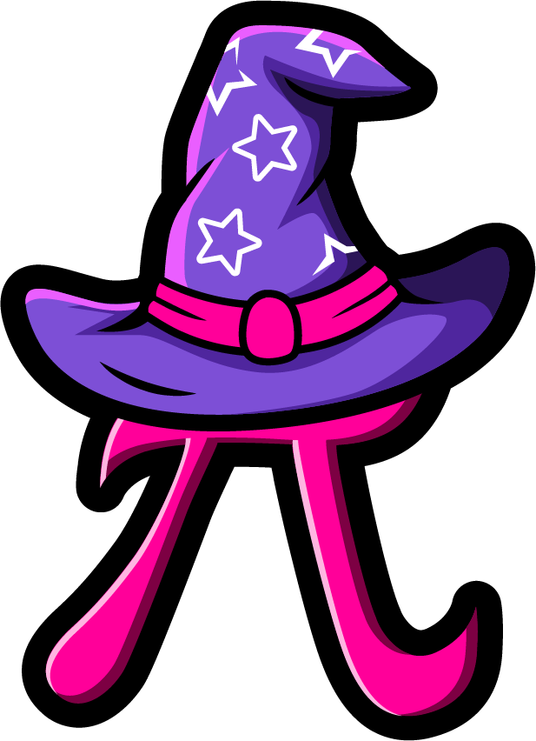
Lesson 4:
Find the missing part.
www.arithmagicians.com

Slide 2

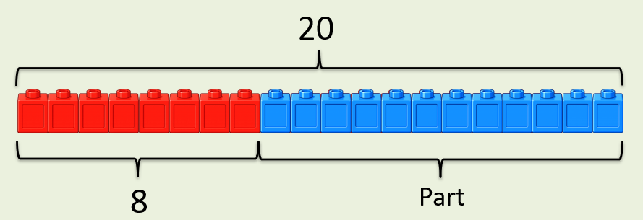
+
12
?
8
= 20
If the whole is ____ and ___ is a part, then the other part is
20
8
12
20
8
?

Slide 3
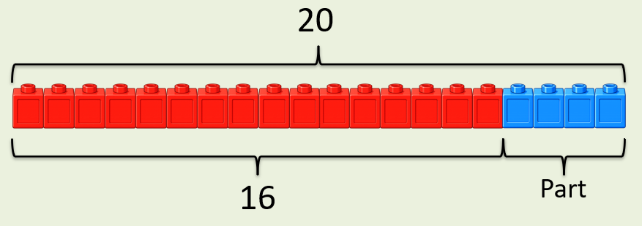
+
4
?
16
= 20
If the whole is ____ and ___ is a part, then the other part is
20
16
4
20
16
?

Slide 4


Your Turn
What is the missing part?
+
13
?
A)
7
= 20
+
11
?
B)
9
= 20
14
+
?
6
C)
= 20
18
+
= 20
?
D)
2

Slide 5
True or False
The missing part is 0.
+
20
?
= 20
True

