Slide 1

Week 4:
Assess & Review
www.arithmagicians.com

Slide 2





So,
? = 3
The whole is 20
The other part is 3
17 is a part
+
3
17
?
= 20
20
Part
Part

Slide 3

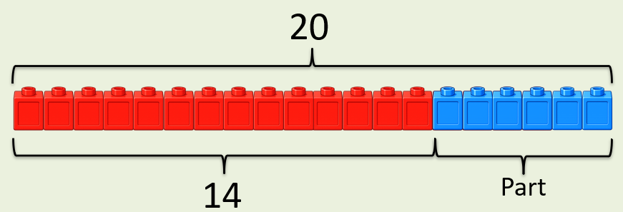
+
6
?
14
= 20
If the whole is ____ and ___ is a part, then the other part is
20
14
6
20
14
?

Slide 4


Your Turn
What is the missing part?
+
12
?
A)
8
= 20
+
13
?
B)
7
= 20
19
+
?
1
C)
= 20
16
+
= 20
?
D)
4

