Slide 1

Lesson 3:
Subtract from 20
www.arithmagicians.com

Slide 2

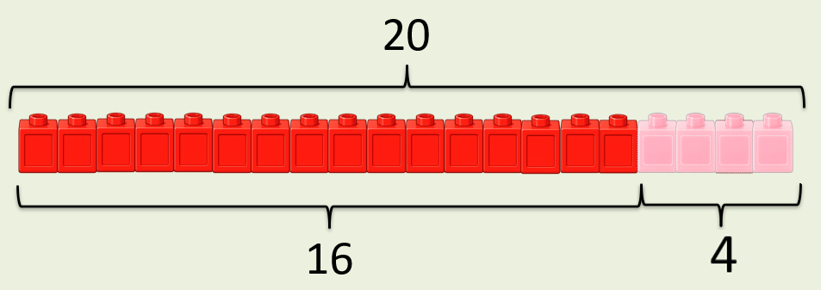
20
-
?
=
16
4
?
20
16
?

Slide 3
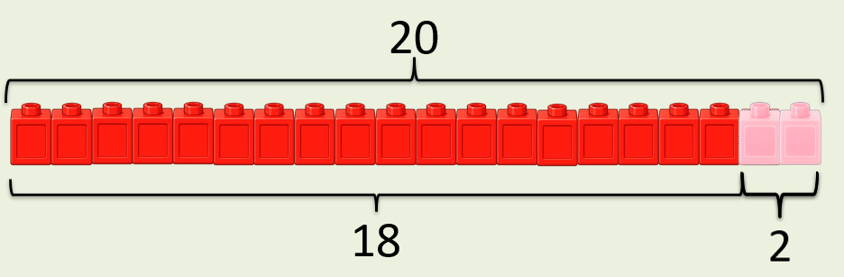
20
-
?
=
18
2
?
20
18
?

Slide 4


Your Turn
-
6
= 14
20
A)
?
-
7
= 13
20
B)
?
-
10
= 10
20
C)
?
-
8
= 12
20
D)
?

Slide 5
True or False
If
20
-
?
=
3
?
Then
3
+
?
=
?
20
True

