Slide 1

Lesson 2:
Recap: Part whole models
www.arithmagicians.com

Slide 2



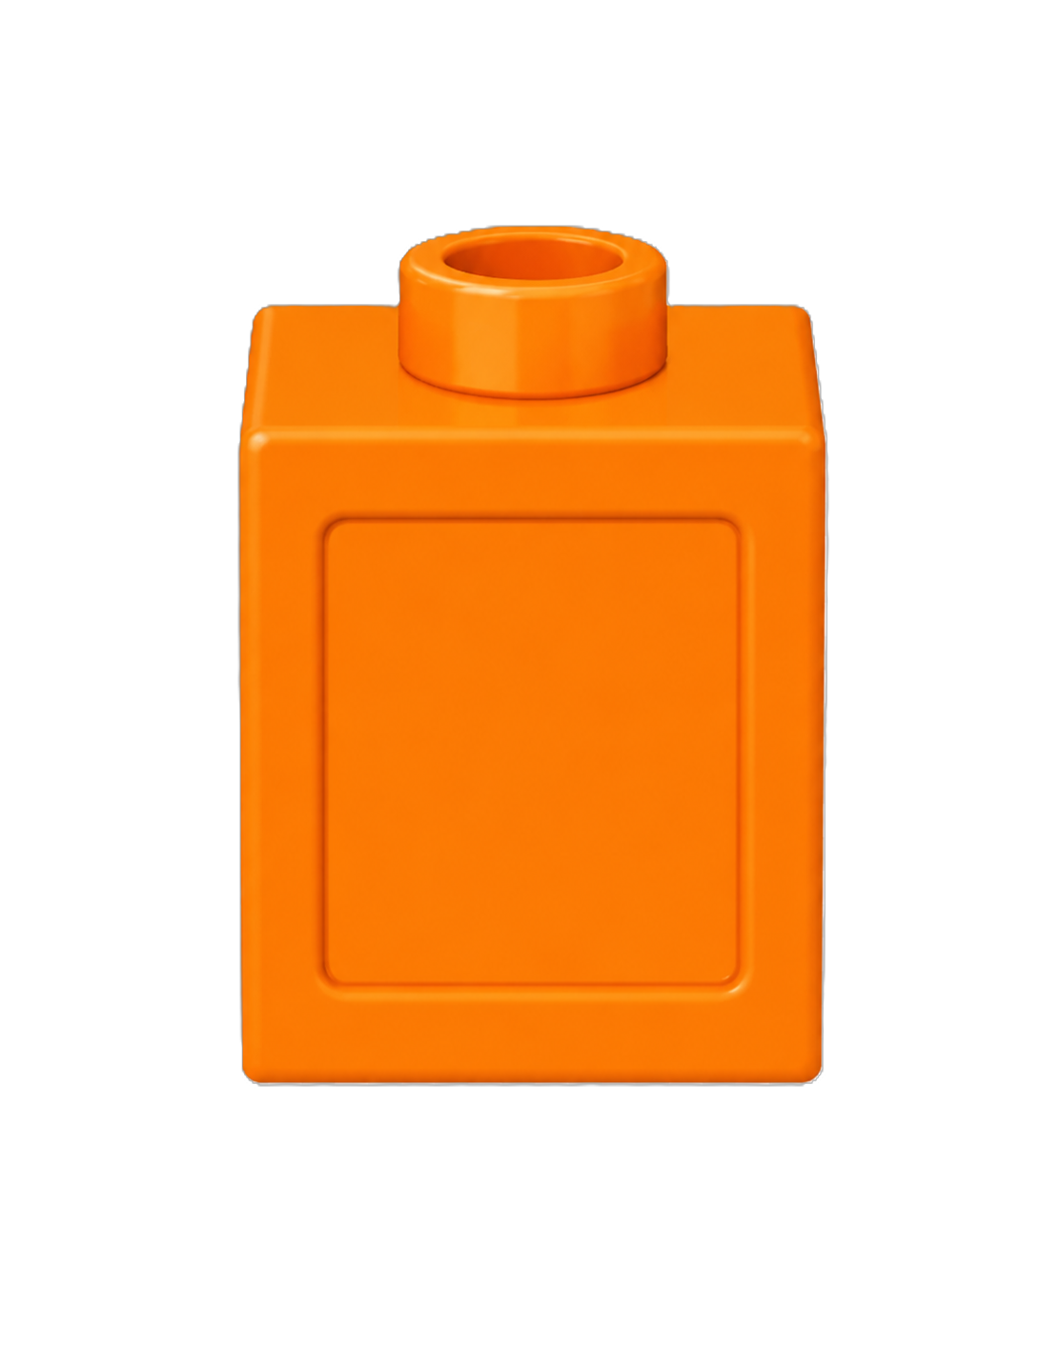
There are ___ red cubes.
There are ___ blue cubes.
There are ___ cubes altogether.
18
There are 20 orange cubes.
2
20

Slide 3
18 + 2 = 20
18
is a part.
?
20
is a part.
?
2
18
2
20
is the whole.
?

Slide 4


Complete the part-whole model
Whole
Part
Part
20
16
4

Slide 5
Complete the part-whole model
Whole
Part
Part
20
1
19

Slide 6
Your Turn
The whole is 20
Complete the part-whole models in different ways.
How many different ways can you make the whole?
5
20
20
20
18
2
19
1
15

Slide 7
True or False
The part-whole model is correct.
False
15
20
5

