Slide 1

Lesson 2:
Recap: Part-whole
models to 10
www.arithmagicians.com

Slide 2

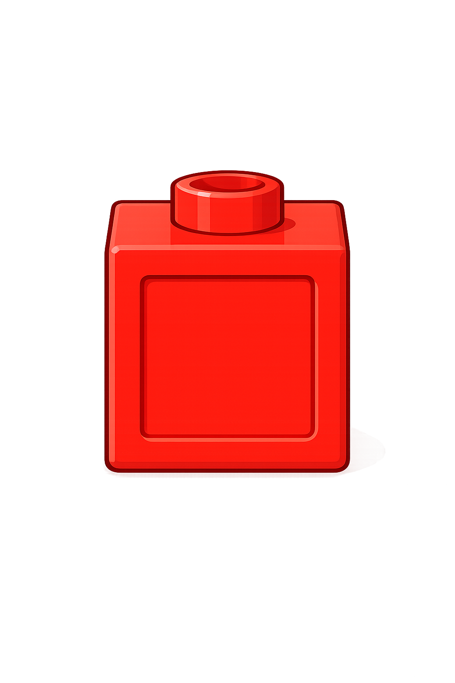
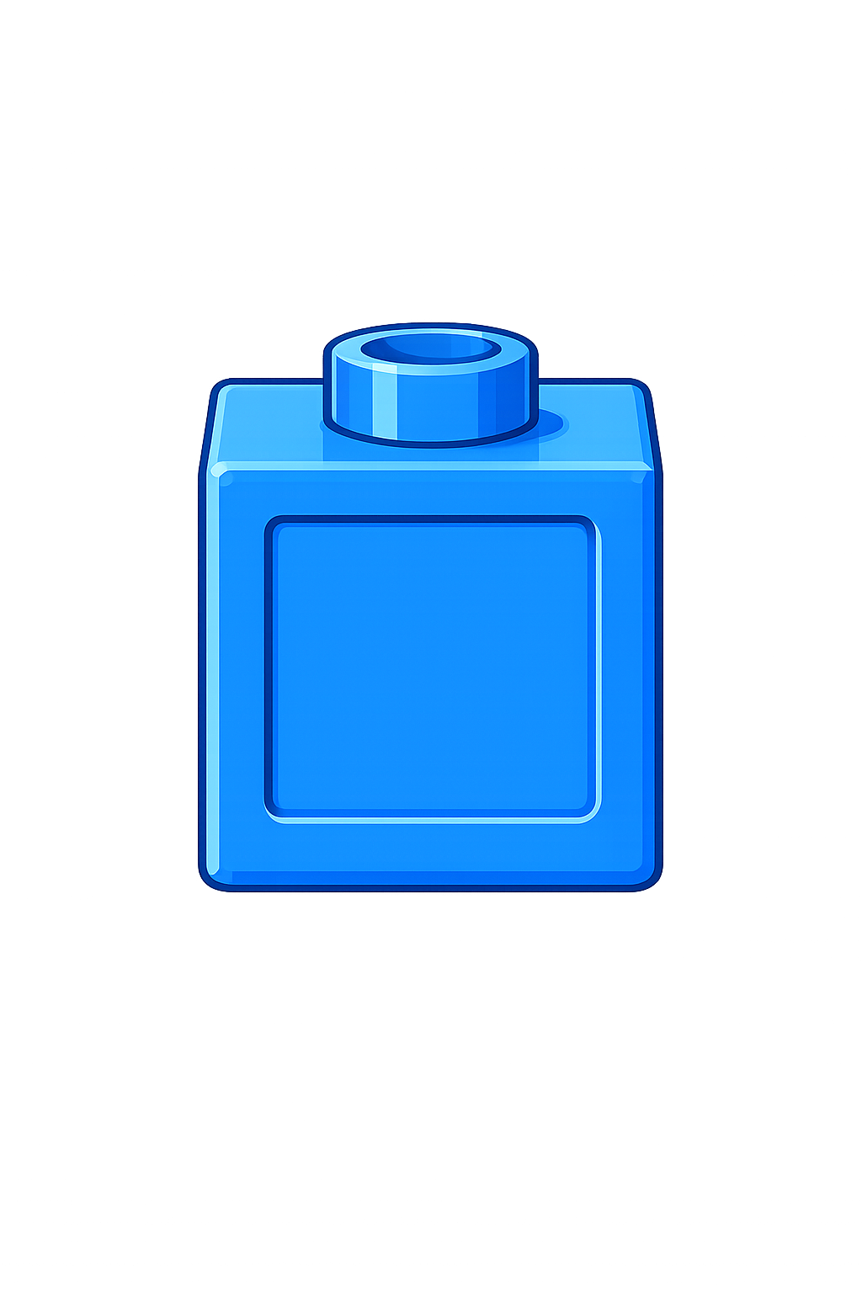
Whole
Part
Part
+
=
6
4
10
+
=
4
6
10

Slide 3

Whole
Part
Part
+
=
8
2
10
+
=
2
8
10

Slide 4


Your Turn
Find different ways of making 10
+
=
+
=
1
9
10
4
6
10
10
+
=
+
=
2
8
10
5
5
+
=
+
=
3
7
10
10
0
10

Slide 5
True or False
The part-whole model is correct.
+
=
False
3
10
7

