Slide 1

Lesson 3:
Recap: Find the missing part
www.arithmagicians.com

Slide 2

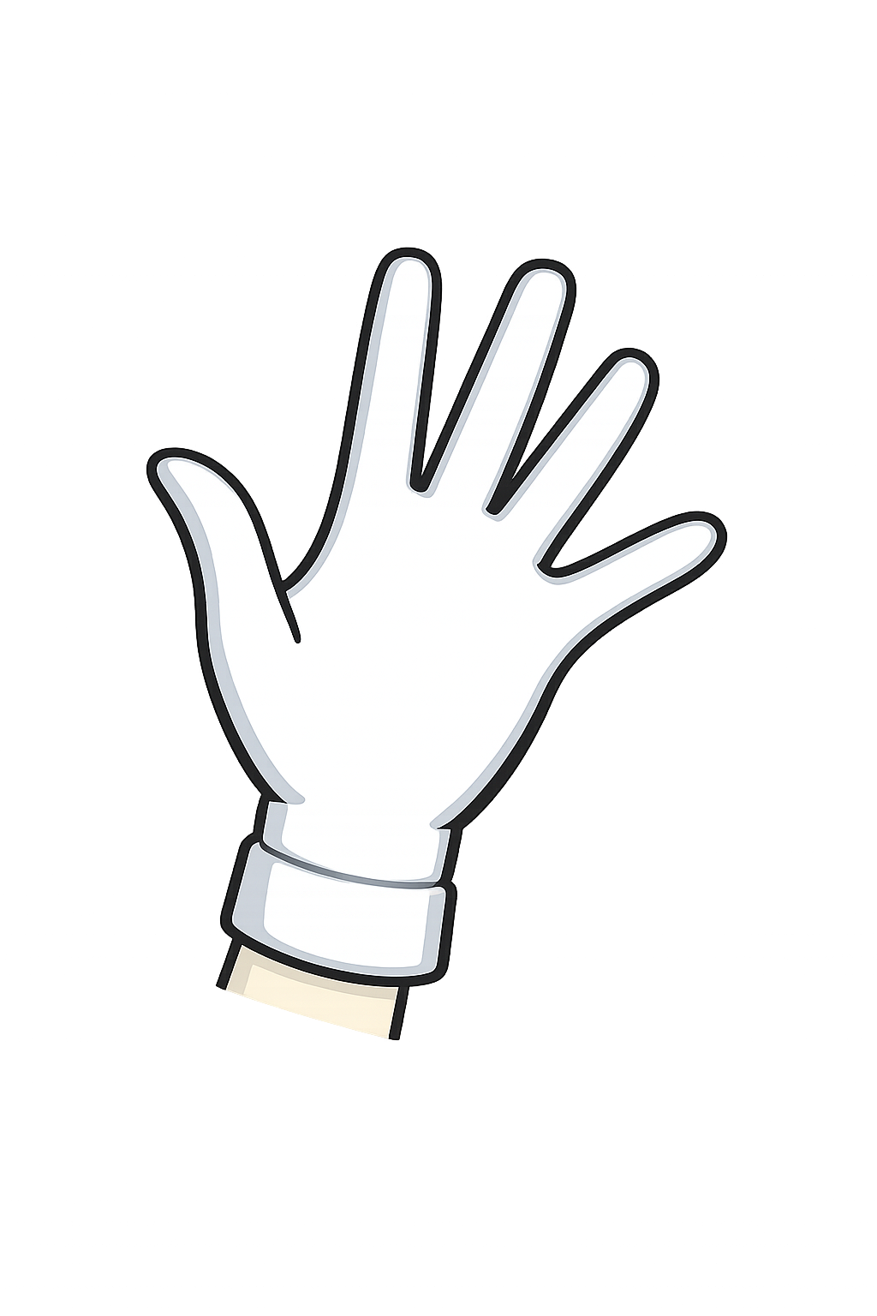

How many counters
are in my closed hand?
I have 10 counters

Slide 3
How many counters
are in my closed hand?
I have 10 counters

Slide 4
How many counters
are in my closed hand?
I have 10 counters

Slide 5


Your Turn
Work in pairs.
Take 10 counters.
Hide some in each hand.
Show one hand.
Your partner says how many are in the other hand.

Slide 6

True or False
If I start with 10 counters
and have 3 in one hand,
there must be 5 in the other hand.
False: Can you explain why?

