Slide 1

Lesson 4:
Recap: Subtract from 20
www.arithmagicians.com

Slide 2

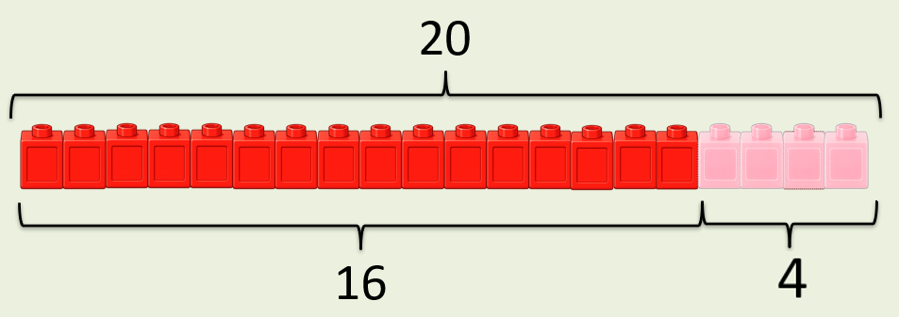
20
-
?
=
16
4
?
20
16
?

Slide 3
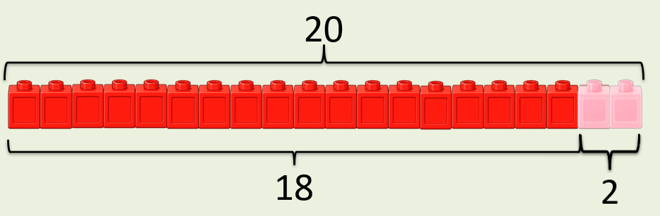
20
-
?
=
18
2
?
20
18
?

Slide 4


Your Turn
-
2
?
-
15
20
= 18
?
20
= 5
D)
A)
-
?
-
20
= 4
11
16
?
20
= 9
E)
B)
-
8
= 12
-
?
0
20
?
20
= 20
F)
C)

