Slide 1

Lesson 4:
Recap: Subtract from 10
www.arithmagicians.com

Slide 2




10
-
?
=
8
2
Whole
8
?
8
+
2
=
10
?

Slide 3

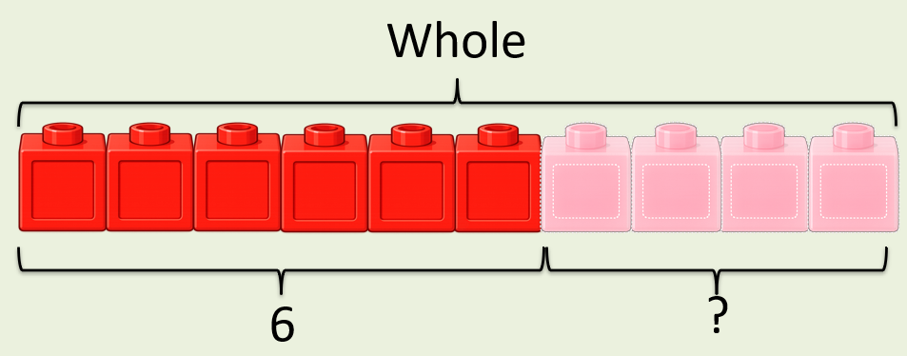
10
-
4
?
=
6
10
6
?

Slide 4
10
-
?
=
7
3
10
10
7
3
7
?

Slide 5


Your Turn
-
6
10
= 4
A)
?
-
7
= 3
10
B)
?
-
10
= 0
10
C)
?
-
8
= 2
10
D)
?

Slide 6
True or False
If
10
-
?
=
3
?
Then
3
+
?
=
?
10
True

