Slide 1


Lesson 2:
Double numbers to 100 using different strategies.
www.arithmagicians.com

Slide 2




What is the bridging strategy?
Let us do an example together.
A friendly number is any number
that end in zero.
The bridging strategy is when you
bridge to a ‘friendly’ number.
= Ends in zero

Slide 3
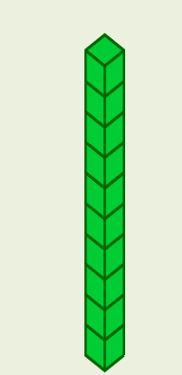

+
29
29
= 58
+
28
30 = 58
First, I bridge to 30 by taking 1 from one 29 and adding it to the other 29.
Next, I solve 28 + 30 in my head.

Slide 4
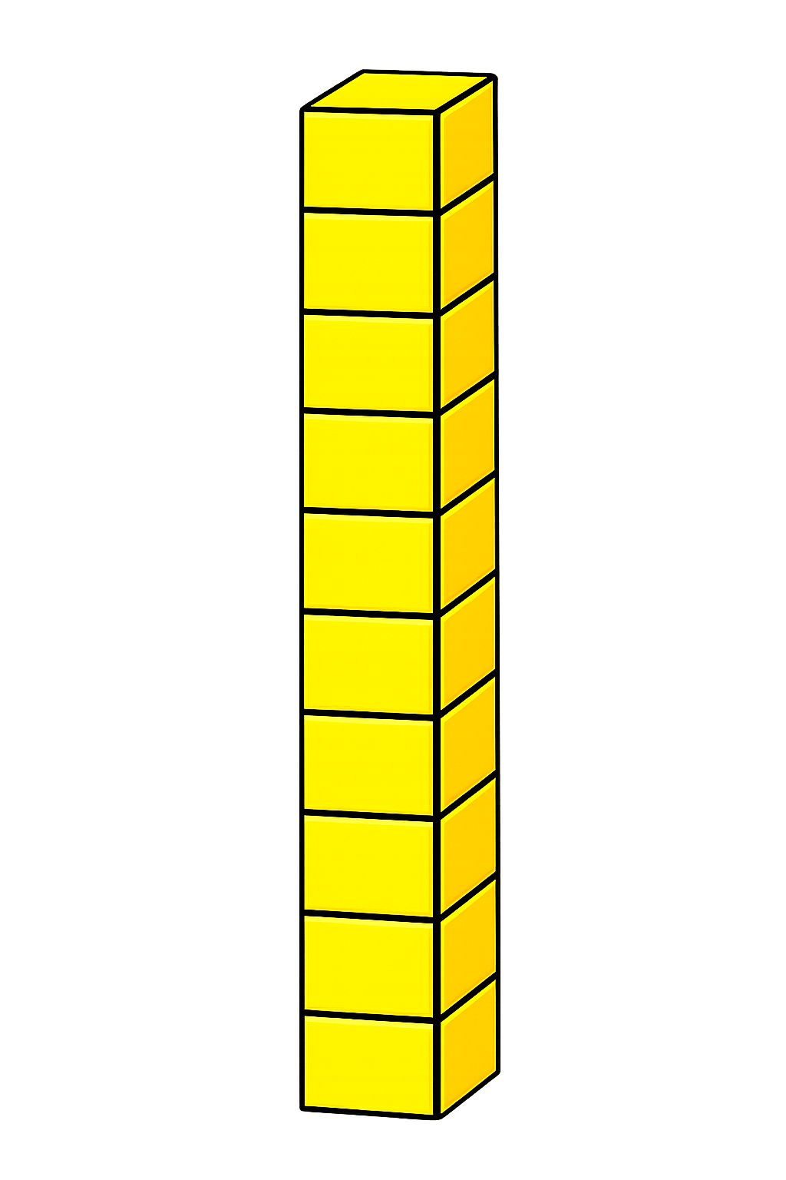

+
56
56
+
+
100
+
12
112

Slide 5

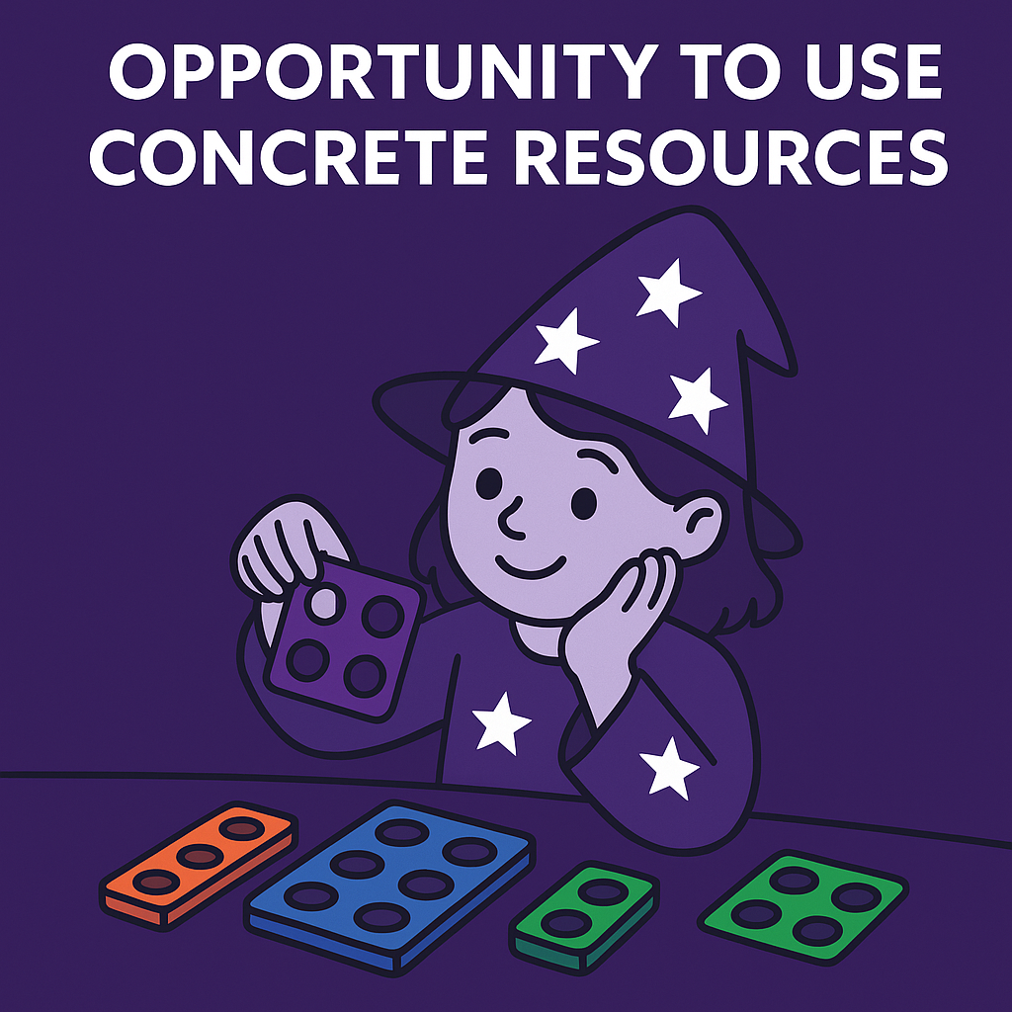
Your Turn
86
43 + 43 = ?
64
2) Double 32 = ?
3) 86 x 2 = ?
172
142
4) Double 71 = ?
190
5) 95 + 95 = ?

Slide 6


Partitioning:
30 + 30 + 8 + 8
60 + 16
76
Compensating:
38 + 40 – 2
78 – 2
76
How many different
ways can you solve:
38 + 38
Bridging:
38 + 38 = 40 + 36
= 76
Which strategy do you prefer? Explain why.

