Slide 1


Lesson 4:
Doubles
www.arithmagicians.com

Slide 2



Double 1
2

Slide 3
Double 2
4

Slide 4
Double 3
6

Slide 5
Double 4
8

Slide 6
Double 5
10

Slide 7

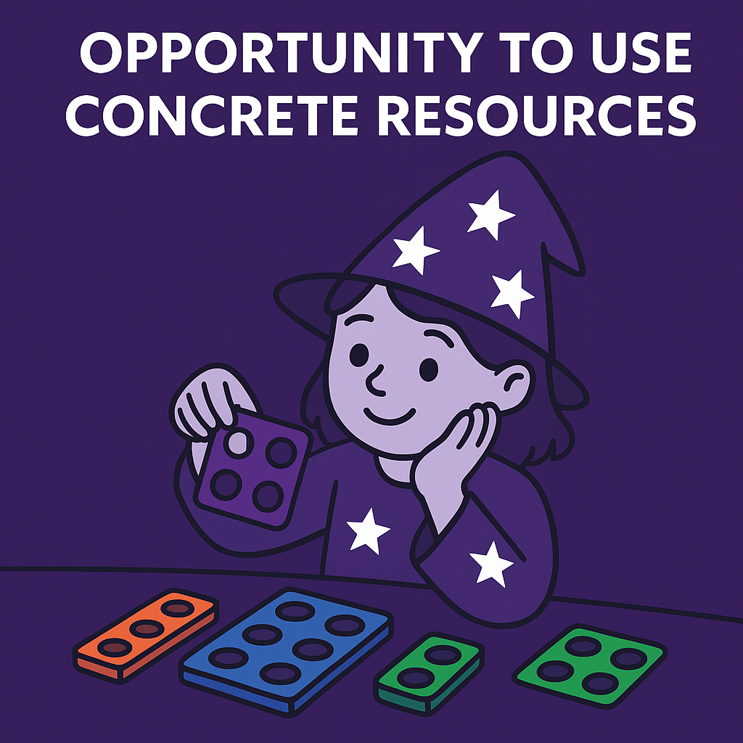
Your Turn
1 + 1 = ?
2
6
2) 3 + 3 = ?
10
3) 5 + 5 = ?
4
4) 2 + 2 = ?
8
5) 4 + 4 = ?

Slide 8

True or False
When you double zero the number gets bigger
False

